Slide 1
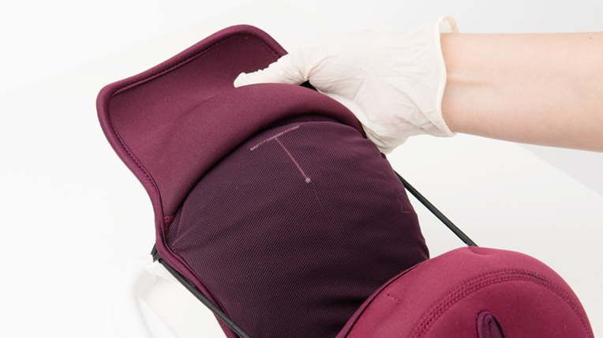
Copper-Bearing IUDs
Session V
PPIUD Insertion technique

Slide 2
Session Objectives
By the end of the session participants will:
Review the clinical skills checklist and view the video on the immediate PPIUD insertion technique.
Describe infection prevention requirements for the insertion of PPIUD
Describe and demonstrate the steps for PPIUD insertion.
List post-insertion tasks.
Describe best practices to minimize possible complications.
Practice the procedure on anatomical models in an equipped station and using the clinical skill checklists
Notes:
This session describes the steps for inserting the IUD in the immediate postpartum period. It also describes practices to prevent infection during insertion..
Complications such as perforation of the uterus or expulsion are associated mainly with provider skill.
Extensive practice on models, observations of master clinicians and supervised practice are necessary for the provider to be skillful in the PPIUD insertion procedure.
During this session, we will first view a video and review the steps of PPIUD insertion, using the slides. This will be followed by a demonstration, return demonstration and practice by participants on anatomical models, using competency-based checklists to monitor progress.

Slide 3
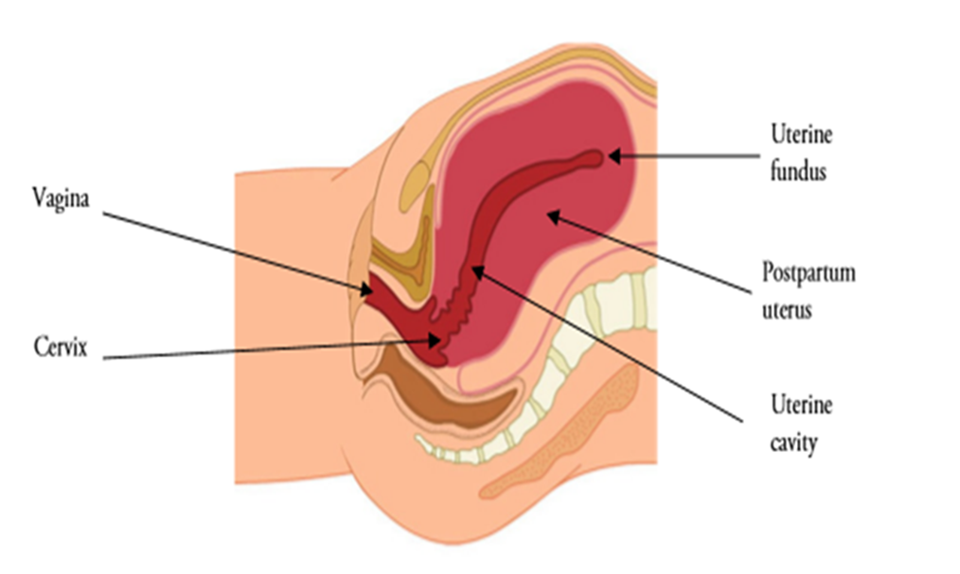
Anatomy of a Postpartum uterus
Immediately after the expulsion of the placenta, the fundus is just below the umbilicus. It can easily be palpated through the abdominal wall. After delivery and AMTSL, the uterus is slightly tilted forward in the lower abdominal cavity.
As you can see in the diagram, the axis of the uterine cavity is almost at right angles to the vaginal cervical axis. During insertion, this angle has to be negotiated carefully to reach the fundus. Many may believe that they have reached the fundus.
Notes:
Tell participants that it is important to understand the anatomy of the postpartum uterus. This will enable them to insert the PPIUD correctly and safely.

Slide 4
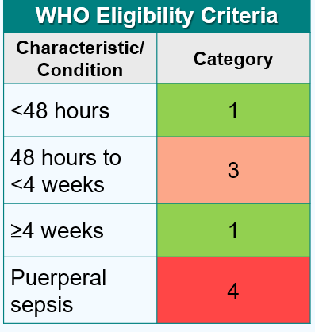

Providing PPIUD services
Clinical assessment - Pre-Insertion screening
  Immediately before insertion assess the woman for the following conditions. If any one of these exist, she is not eligible for IUD now:
  Chorioamnionitis ( category 3)
  Postpartum endometritis/metritis (Category 4)
  Puerperal sepsis (Category 4)
  More than 18 hours from rupture of membranes to delivery of the baby(Category 3)
  Unresolved postpartum hemorrhage( Category 4)
  Extensive genital trauma, the repair of which would be disrupted by the postpartum placement of the IUD ( Category 3)
Notes:
If the woman has any of these conditions counsel for an alternate method. If a woman insists on IUD, she can have it after 4 weeks. Refresh the MEC criteria for PPIUD. Distribute the Handout # 8, Pre Screening Checklist for PPIUD and review with participants.

Slide 5
Pre insertion counseling
If the woman has cleared the screening-
Confirm with her if she still wants the IUD and take consent
Briefly explain to her what you will be doing and what she should expect
Tell her that the procedure is quick but she may experience some pain
The woman should tell the provider if she feels something alarming
Proceed with the procedure
Important:
While working with models and clients, it is strongly recommended that the trainers and participants practice and promote autonomy, dignity, comfort, respect, and privacy.
Ensure audio visual privacy during procedures.
Always ensure that the model is draped when not in use.
When demonstrating with models, talk with the ‘model’ about what is being done as you would to a real client.
Be sure to ask the clients for their consent, invite them to ask questions before starting, and remind the client that they can request the procedure be paused or discontinued at any time. Consent is an ongoing process
Role modeling by the trainers will encourage participants to practice respectful behavior on models and real clients at their workplaces.

Slide 6
Postpartum IUD insertion technique
Distribute the skills checklist Evaluation Tool # 4 for immediate PPIUD insertion and review with participants, going through every step carefully. Pause for any questions or clarifications. Review Evaluation tool# 5 for Intracesearean insertion based on the cadre of the audience.
Distribute Handout # 18 showing the illustrations and steps for PPIUD insertion.
Notes:
Introduce the session. Tell participants that they will now learn the insertion technique for Immediate PPIUD .
Distribute the skills checklist Evaluation Tool # 4 for immediate PPIUD insertion and review with participants, going through every step carefully. Pause for any questions or clarifications. Review Evaluation tool # 5 for Intracesaarean insertion based on the cadre of the audience.

Slide 7
Show the video on the immediate PPIUD insertion technique
https://globalhealthmedia.org/videos/inserting-an-id-postpartum-teaching-short/
Notes:
Show the video for Immediate PPIUD insertion.
Clarify with participants that inserting the PPIUD manually is not recommended though the video mentions this. Use of a long placental forceps/Kelly placental forceps is most recommended.
Pause for any questions or clarifications

Slide 8
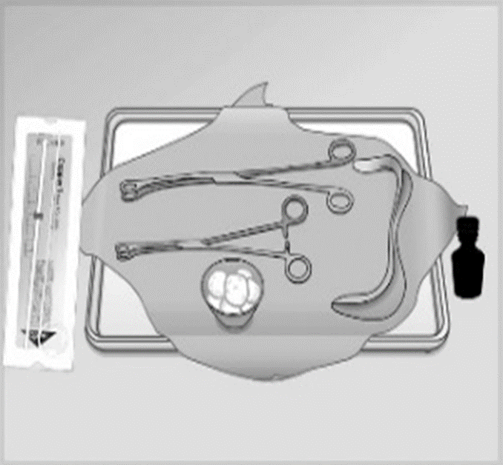
Instruments and Supplies
IUD in an unopened, undamaged, sterile package that is not beyond its expiration date.
Sim's speculum
Ring forceps
Kelly or Long Placental forceps
Cotton swabs
Antiseptic-Betadine
Notes:
Note to Facilitator: review the list of recommended supplies and equipment for PPIUD insertion procedures.
The recommended supplies and equipment include:
IUD in an unopened, undamaged, sterile package that is not beyond its expiration date.
Sims speculum
Ring forceps
Kelly or Long Placental forceps
Cotton swabs
Antiseptic-Betadine

Slide 9
Instruments and Supplies, cont.
Gloves (single-use disposable, HDL, or sterile)
Bowl for antiseptic solution
Drape/cloth to cover woman’s abdomen
Light source to visualize the cervix

Slide 10
Infection Prevention Practices
Wash hands thoroughly with soap and water before and after the procedure.
Use clean, HLD, or sterilized instruments and clean/sterile gloves
Thoroughly prep the cervix with antiseptic at least twice before beginning the procedure.
Arrange the items in the tray.
Open the IUD package correctly (at the appropriate time), holding the package from the bottom so that the IUD does not fall out.
Use a “no-touch” insertion technique to reduce contamination of the uterine cavity.
Properly dispose of waste material according to guidelines (gauze, cotton, and disposable gloves) after completion of the procedure.
Notes:
Distribute Handout #14 for infection prevention practices and new guidance on point of use cleaning before processing instruments

Slide 11
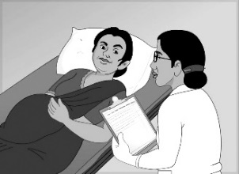
Step 1
Ensure that the woman has been counselled and wants the IUD after delivery. Ask her if she has any questions.
Notes:
Refer to Handout# 18 for steps for PPIUD insertion

Slide 12
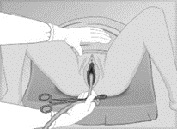
Step 2
Manage labor and delivery, including active management of the third stage of labor (AMTSL).

Slide 13
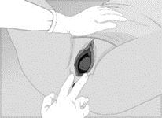
Step 3
Do a second screening, including an inspection of the vagina and perineum for lacerations

Slide 14
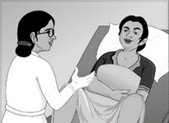
Step 4
If no problems, ask the woman if she is ready for the IUD insertion.

Slide 15

Step 5
Arrange supplies and equipment, with IUD kept to the side.

Slide 16
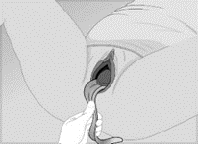
Step 6
Visualize the cervix by pressing the posterior vaginal wall with a speculum.

Slide 17
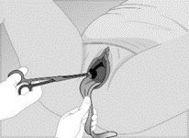
Step 7
Clean the cervix and vagina at least TWICE with two separate gauze pieces.

Slide 18
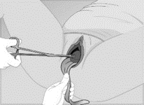
Step 8
Grasp the anterior lip of the cervix with ring forceps.

Slide 19
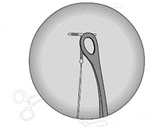
Step 9
Open the IUD package. Remove the inserter, plunger and card and grasp the IUD at the angle of the vertical and horizontal limb with the long Kelly placental forceps

Slide 20
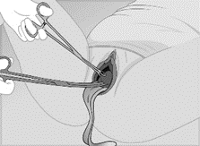
Step 10
Insert forceps with IUD through the cervix to the lower uterine cavity; avoid touching the vagina and keep forceps closed.

Slide 21
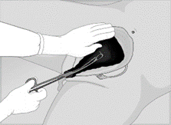
Step 11
Let go of ring forceps and place a hand on the abdomen

Slide 22
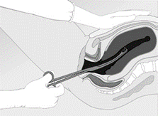
Step 12
“Elevate” the uterus by pushing it upward toward the woman’s head. This helps to straighten the uterine cavity and ensures fundal placement.

Slide 23
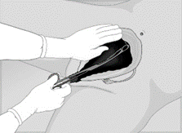
Step 13
Move the IUD and forceps upward—toward the umbilicus—until the fundus is felt; follow the contour of the uterine cavity.

Slide 24
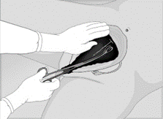
Step 14
Open forceps and release IUD at the fundus.

Slide 25
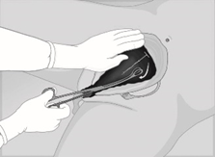
Step 15
Sweep forceps to the side wall of the uterus.

Slide 26
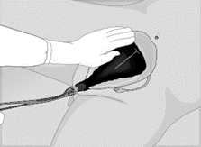
Step 16
Slowly remove forceps—keeping them slightly open.

Slide 27
Step 17
Before removing gloves:
Wipe used instruments with a wet cloth or soak them in a bucket of tap water for point-of-use cleaning and further processing
Segregate and dispose of waste materials in appropriate leak-proof containers with lids
Wipe surfaces that may have been contaminated with blood/discharge with 0.5% chlorine solution.
Take gloves off, wash hands thoroughly with soap and water, and dry them.

Slide 28
Step 18
Allow the woman to rest.
Provide post Insertion instructions when she is comfortable.
Be sure she receives complete postpartum care.
Help her initiate breast feeding

Slide 29
Post insertion instructions
Review side effects and normal postpartum symptoms;
Tell the woman when to return for PPIUD/postnatal and newborn checkup(s);
Emphasize that she should return any time she has a concern or experiences warning signs;
Review the warning signs (PAINS)
Tell her what to do if she sees that the IUD has fallen out( expelled).
Ensure that the woman understands post-insertion instructions;
Give written post-insertion instructions, if possible;
Complete the reminder client card and give it to the client. Explain that the card shows the type of IUD, the date of insertion, the clinic name, and the intended date of removal/replacement.

Slide 30
Post insertion instructions…
Remind client:
No protection against STIs; need to use condoms if at risk.
Possible side effects, especially bleeding changes expected.
When to return to the clinic
Complete the client record

Slide 31
What are the problems that a provider can encounter at the time of insertion
IUD seen in vagina or cervix after placement or length of the string is not consistent with fundal position:
  Remove the IUD with HLD forceps and reinsert the same IUD if not contaminated. If contaminated, use a new IUD
Uterine perforation (very rare): Loss of resistance and sudden pain
  Stop the procedure and remove the instruments
  Observe vitals, rigidity, and bleeding. Start IV fluids and IV Antibiotics
  If vitals low-Refer
Notes:
Discuss the problems that a provider may encounter during inserting a PPIUD and how to correct these.

Slide 32
Best practices to minimize the risk of complications
Careful screening of clients
Screen the client for high risk of STIs)
Screen the client to be certain there is no increased risk of infection due to rupture of membranes longer than 18 hrs, Chorioamnionitis
Use of Correct instruments
Correct insertion technique
Strict adherence to infection prevention practices during delivery and insertion.
Slow and gentle movements during insertion to assure technical accuracy, client comfort, and safety.
Provider competence and confidence

Slide 33
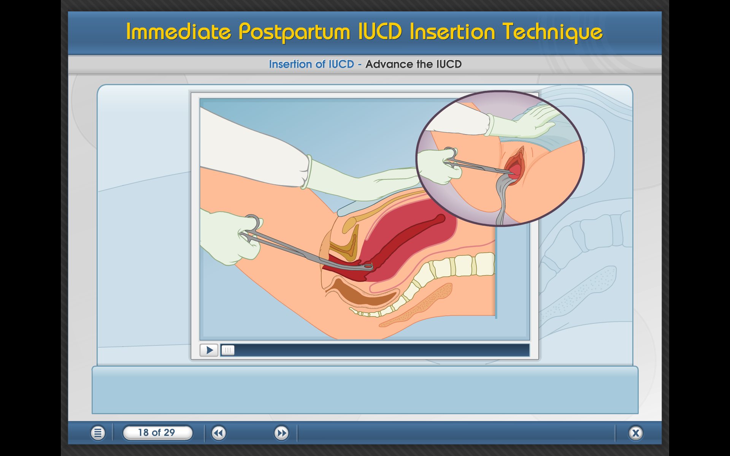
Key message for providers!
Understanding what is happening in the woman’s body is critical to proper PPIUD insertion
Correct technique and use of correct instruments help ensure:
  Placement of IUD at the fundus that is critical to the retention of the IUD.
  Be gentle and patient: Remember, she has just delivered a baby.
  Follow all infection prevention practices.
  Remember to counsel the woman for removal if and when she desires it.
Notes:
Importance of proper technique in PPIUD Insertion
An understanding of what is happening in the woman’s body during the postpartum period is critical to mastering the proper insertion technique for the PPIUD.

Slide 34
PPIUD: Summary
The postpartum period is a powerful opportunity to support reproductive autonomy and contraceptive choices. PPFP benefits the health benefits of mothers, children, and families.
Cost-effective and convenient way to provide a safe, highly effective, and reversible long-acting method.
The antenatal through postpartum period are opportunities to provide FP/RH counseling, method choice information, and comprehensive FP/RH services, including the provision of PPFP which ensures that a woman can choose the right method for her reproductive intentions. The IUD is one of the many option that can support women in their reproductive needs
One limitation of PPIUD versus interval IUD is the higher expulsion rates. This is related to provider skills… and this is why we are here.
We must work together to correct myths and misinformation about the IUD/PPIUD!
Notes:
PPIUDs: Summary
• Cost-effective and convenient way to provide a safe, highly effective and reversible long-acting method—BEFORE WOMAN LEAVES FACILITY AFTER CHILDBIRTH.
• Powerful tool in the global refocusing on health benefits of FP/PPFP to mothers, children, families
• Exclusions/precautions of the method are few, especially those specifically relevant to the postpartum woman

Slide 35
Demonstration and practice session
Demonstrate the PPIUD insertion procedure using the clinical skills checklists and allow participants to practice on models.
Notes:
See Session Plan for details

Slide 36
Questions?

