Slide 1
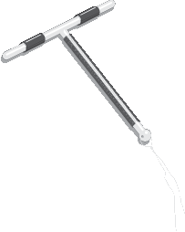
Copper-Bearing Intrauterine Devices (IUDs)
Session IV: Interval IUD Insertion and Removal
TCu 380A
Notes:
Reference:
Unless otherwise stated, information and illustrations in this presentation are adapted from:
Bluestone J, Chase R and Lu ER. IUD guidelines for family planning service programs: A problem-solving reference manual. Baltimore, MD: Jhpiego, 2006.
Illustration credit: Salim Khalaf/FHI

Slide 2
Session Overview
This session describes the steps for inserting and removing a copper-bearing IUD and for preventing infection during insertion and removal.
Complications such as perforation of the uterus or expulsion are associated mainly with provider skill.
Extensive practice on models, observations of master clinicians and supervised practice are essential for the provider to be skillful in the IUD insertion and removal procedures.

Slide 3
Providing Interval IUD services
Clinical assessment - Pre-Insertion screening
  Once the woman has confirmed her choice for an IUD:
  Check that the screening has been completed and the IUD is a safe option for her.
If the woman has cleared the screening-
Briefly explain to her what you will be doing and what she should expect
Tell her that she will experience some discomfort or cramping during the procedure.
Ask her to tell you anytime she feels the pain.
Tab Ibuprofen 200-400 mg, paracetamol, 325-1,000 mg may be given 30 mins before the procedure to help reduce the pain.
Important:
While working with models and clients, it is strongly recommended that the trainers and participants practice and promote autonomy, dignity, comfort, respect, and privacy.
Ensure audio visual privacy during procedures.
Always ensure that the model is draped when not in use.
When demonstrating with models, talk with the ‘model’ about what is being done as you would to a real client.
Be sure to ask the clients for their consent, invite them to ask questions before starting, and remind the client that they can request the procedure be paused or discontinued at any time. Consent is an ongoing process
Role modeling by the trainers will encourage participants to practice respectful behavior on models and real clients at their workplaces.
Notes:
If the woman has any of these conditions counsel for an alternate method. If a woman insists on IUD, she can have it after 4 weeks
Distribute the handout # 7-Screening CL for Interval IUDs and review it with participants.
.

Slide 4
Interval IUD insertion technique
Reviewing the Clinical skill checklist
Review the clinical skill competency checklists with the participants.
Distribute Handouts #15 and 16 showing the illustrations for loading and inserting the loaded IUD
Notes:
Introduce the session. Tell participants that they will now learn the insertion and removal of Interval IUDs..
Distribute the clinical skills checklist Evaluation Tool # 4 , checklist for insertion and removal of IUDs in the interval timing, and review with participants, going through every step carefully. Pause for any questions or clarifications.

Slide 5
Show the video on the IUD in the interval timing
https://globalhealthmedia.org/videos/inserting-an-iud-teaching-short/
Notes:
Show the video for Interval IUD insertion.
Pause for any questions or clarifications

Slide 6
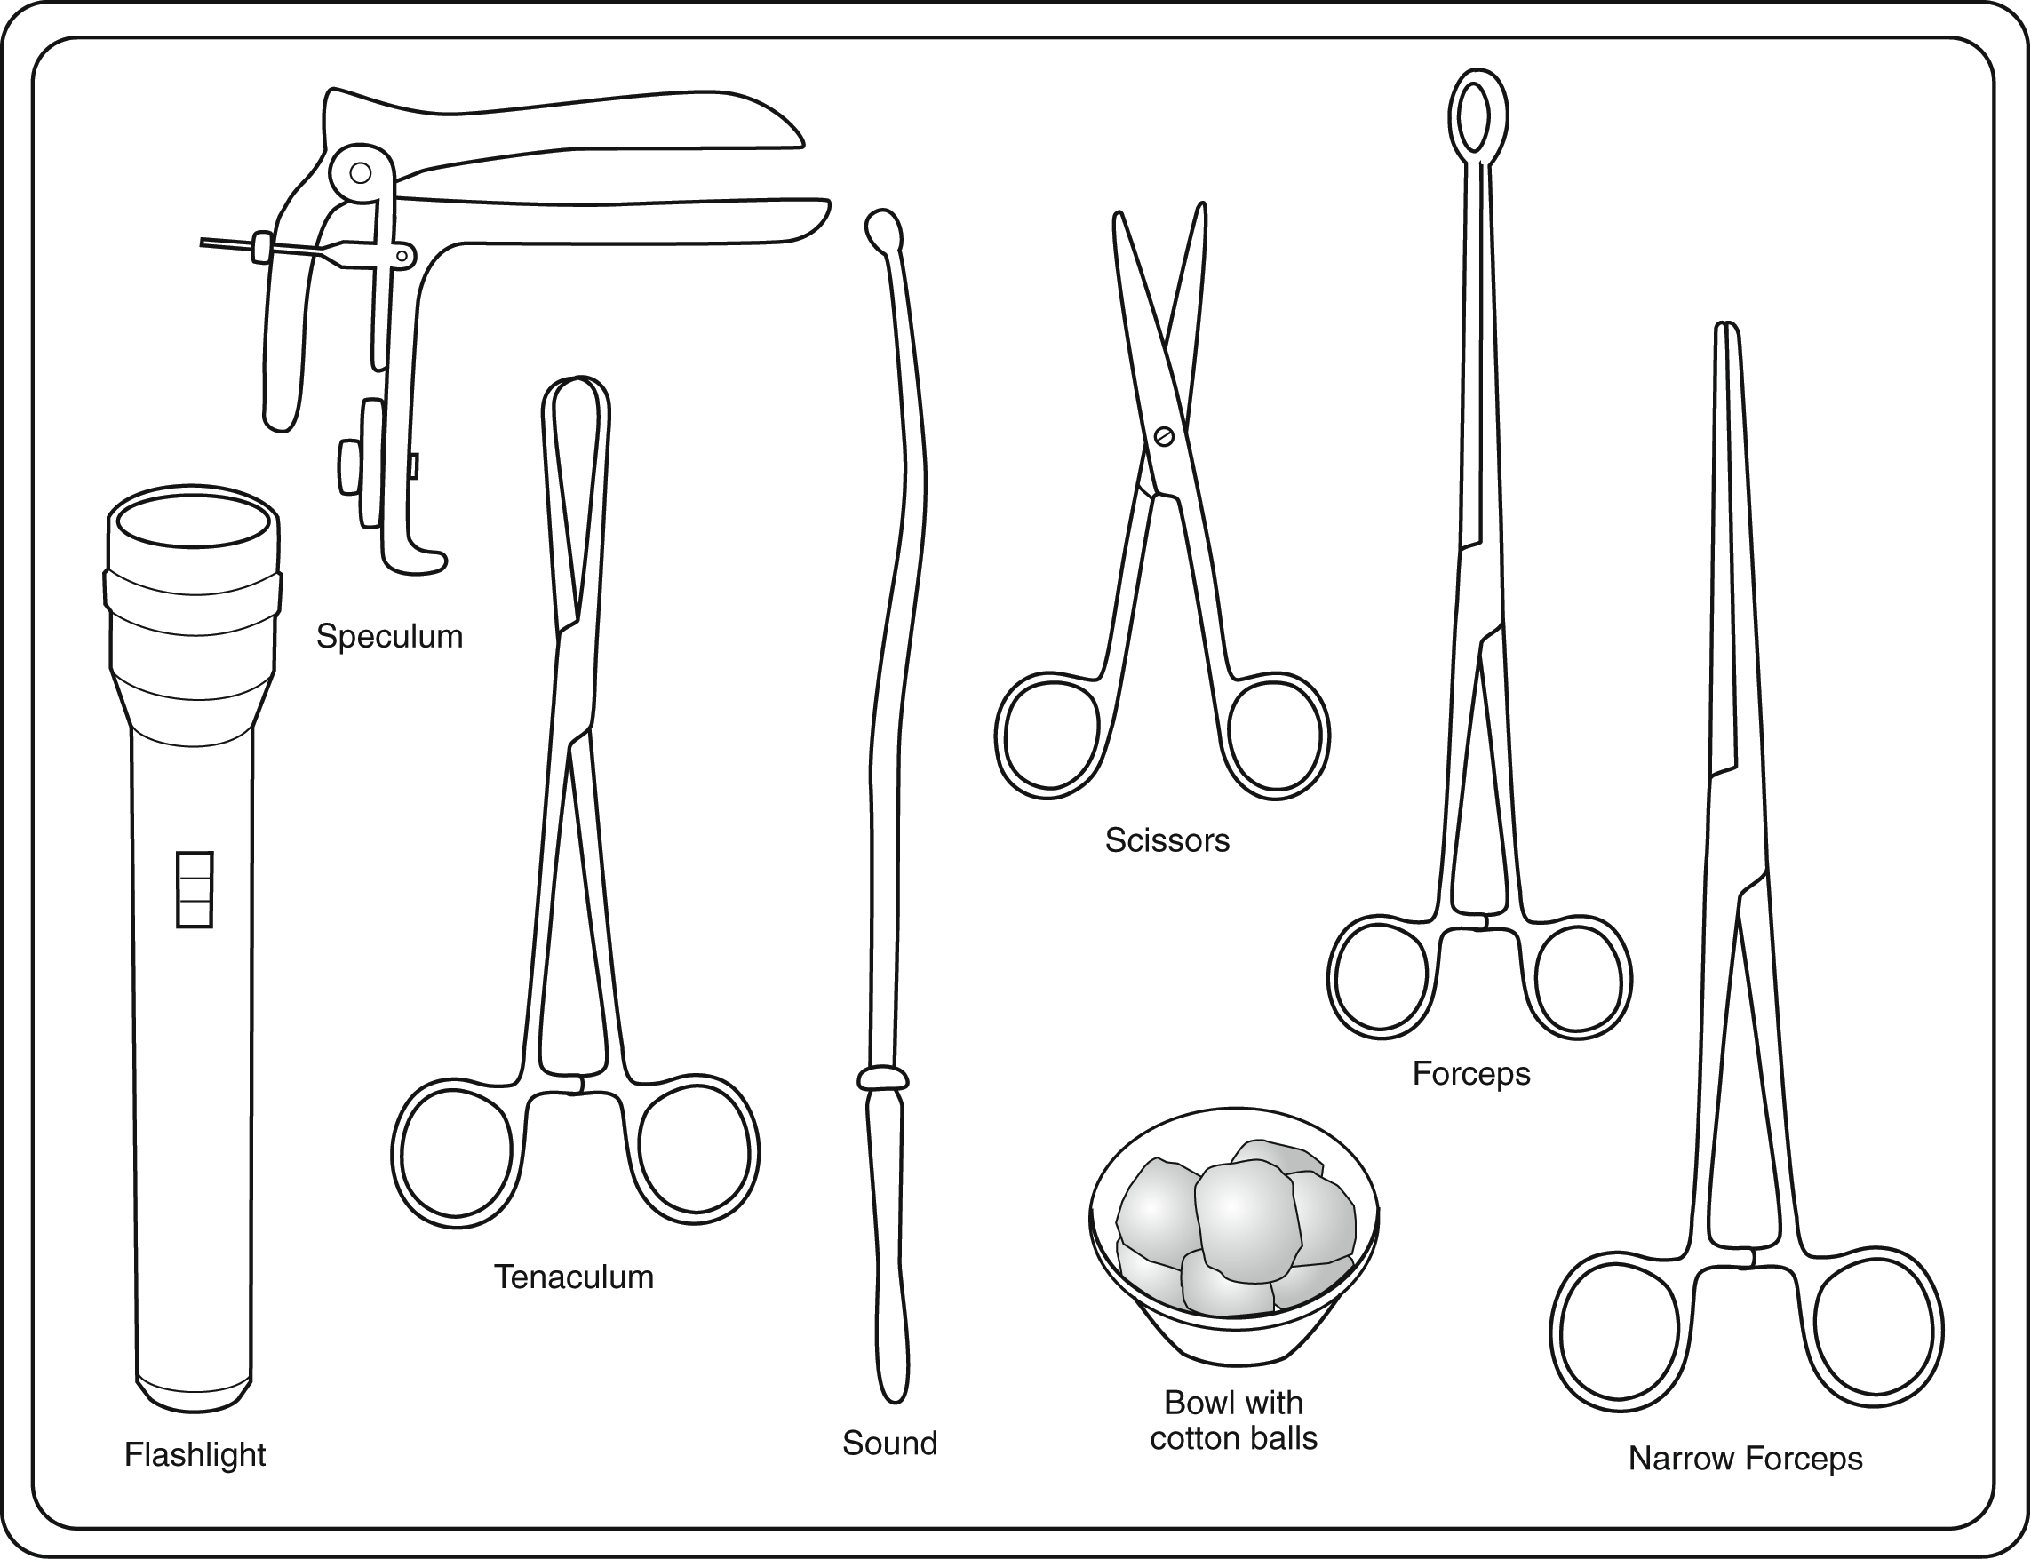
IUD Insertion Procedure:
Instruments and Supplies
IUD in unopened, undamaged, sterile package
Bivalve speculum
Tenaculum
Uterine sound
Ring forceps
Sharp scissors
Narrow forceps (uterine dressing or sponge)

Slide 7
IUD Insertion Procedure:
Instruments and Supplies (2)
(continued)
Light source to visualize cervix
Gloves (single use disposable, HDL, or sterile)
Bowl with antiseptic solution
Chlorine solution, 0.5% to decontaminate surfaces after procedure
Sterile gauze/cotton balls
Drape/cloth to cover table and woman’s pelvic area

Slide 8
IUD Insertion Procedure:
Preventing Infection during IUD Insertion
Wash hands before and after procedure, and wear examination gloves.
Use high-level disinfected (or sterile) instruments.
Load the IUD within the sterile package without touching the IUD.
Clean the cervix thoroughly with antiseptic.
Notes:
Please read session plan for detailed guidance. Refer to Handout# 14 for guidance on infection prevention practices

Slide 9
IUD Insertion Procedure:
Preventing Infection During IUD Insertion (2)
(continued)
Insert the IUD without touching the speculum blades or vaginal wall, using the 'no touch ' technique.
Pass sound and loaded IUD only once through cervical canal.
Clean and process instruments after the procedure.
Dispose of contaminated waste properly.
Giving antibiotics routinely is not recommended
Notes:
Decontamination of used instruments is no longer recommended. Follow country guidelines https://apps.who.int/iris/bitstream/handle/10665/250232/9789241549851eng.pdf;jsessionid=D1491511C20FB36BA52BC71DD829B26E?sequence=1
http://resources.jhpiego.org/system/files/resources/IPC_M6_Instruments.pdf

Slide 10
IUD Insertion Procedure:
Procedure Overview
Conduct bimanual and speculum pelvic examination to:
    Screen for eligibility
    Determine the size and position of the uterus
Sound the uterus to determine its depth
Load the IUD into the inserter without taking it out of the sterile package
Set the depth gauge to the sounded depth
Place the IUD into the uterus
Allow the woman to rest
Notes:
Distribute Handout# 12 for checklist on Pelvic Bimanual and per Speculum Examination

Slide 11
IUD Insertion Procedure:
Step 1: Perform Pelvic Exam
Conduct pelvic exam (bimanual exam, then speculum exam)
Screen for medical eligibility:
  If no signs and symptoms of infection—proceed with the insertion
  If suspicious of infection—do not insert IUD— diagnose/treat as appropriate, then reassess for insertion
Assess the position of the uterus (tilted up or down) to determine the appropriate orientation of inserting the sound
Notes:
Distribute Handout # 12 for guidance on pelvic and per speculum examination.

Slide 12
IUD Insertion Procedure:
Step 2: Sound the Uterus
Clean the cervix with an antiseptic solution.
Apply a tenaculum to the cervix.
Gently pull the tenaculum to align the uterus, cervical opening, and vaginal canal.
Insert the uterine sound into the vagina and through the cervical opening.
Advance the sound into the uterine cavity until a slight resistance is felt.
Slowly withdraw the sound and assess the level of mucus/blood to determine the depth of the uterus (average depth is 6 to 8 cm).
Notes:
Distribute Handout # 13 for guidance on sounding the uterus.

Slide 13
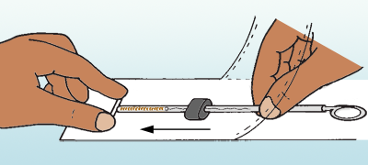
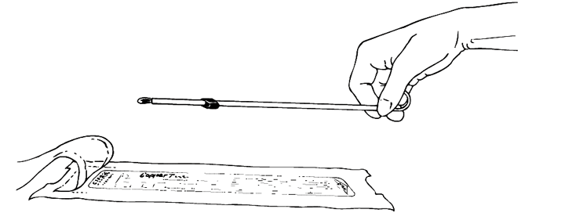
IUD Insertion Procedure:
Step 3: Load the Copper IUD (Copper T 380A)
Load the IUD by folding its arms and placing them inside the insertion tube.
Do not load more than five minutes before inserting the IUD into the uterus.
  If IUD arms remain folded for more than five minutes, they may not return to their original shape when released.
Notes:
Distribute Handout # 15 for instructions on loading the Copper IUD

Slide 14
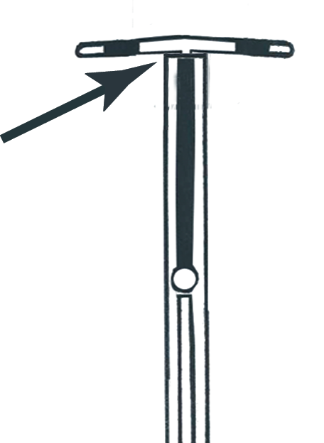
Loading the Copper T IUD:
Step 3.1: Load the Copper T
Adjust the contents of the package through the clear plastic cover
Ensure that the vertical stem of the T is fully inside the insertion tube
Ensure that the other end of insertion tube is close to sealed end of package

Slide 15
Loading the Copper T IUD:
Step 3.2: Load the Copper T
Partially open the package:
Place the package on a clean, hard flat surface with the clear plastic side up.
Pull up on the clear plastic cover from the end farthest from the IUD.
Keep pulling the plastic cover until package is open half way to the blue depth-gauge.

Slide 16
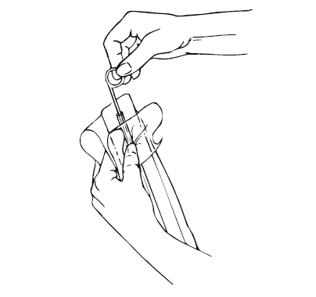
Loading the Copper T IUD
Step 3.3: Load the Copper T
Place the white plunger rod in the clear insertion tube:
Pick up the package and hold open end up toward ceiling.
Fold the clear plastic cover and white backing flaps away from each other.
Grasp the white plunger rod by circular thumb grip and place it inside the insertion tube. Gently push until tip of rod almost touches bottom of T.

Slide 17
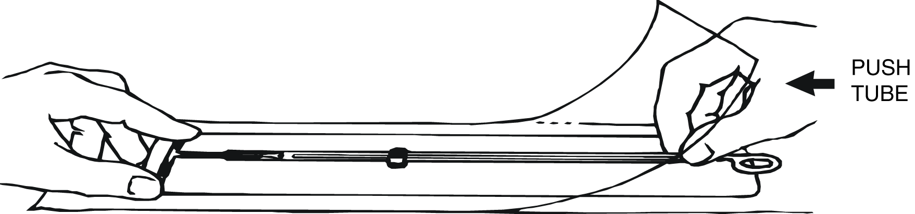
Loading the Copper T IUD:
Step 3.4: Load the Copper T
Bend the arms of the T downward:
Release the white backing flap, and place package on a clean, hard surface with clear plastic side up
Place your thumb and index finger over the tips of the arms of T
Push the measurement insert so it slides under the IUD
Grasp the insertion tube and push it against the T; the arms will start to bend downward
Bring your thumb and index finger together

Slide 18
Loading the Copper T IUD
Step 3.5: Load the Copper T
Pull the insertion tube away from the folded arms of the T:
When the arms of the T are folded down enough to touch the sides of the insertion tube, pull the insertion tube back, so its opening is positioned right underneath the folded arms.

Slide 19
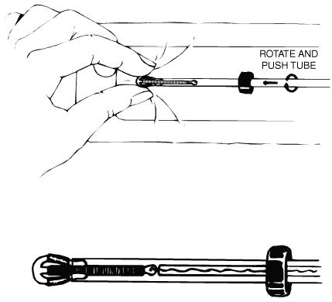
Loading the Copper T IUD
Step 3.6: Load the Copper T
Push the folded arms of the T into the insertion tube:
Gently push and rotate the insertion tube back over the tips of the folded arms of the T, so that both tips are caught inside insertion tube.
Do not try to push the copper bands on the arms into the insertion tube; they will not fit.

Slide 20
Loading the Copper T IUD
Step 3.7: Load the Copper T
Set the blue depth-gauge to reflect the uterine depth as measured by the sound:
Move the depth-gauge so its upper edge is aligned with the appropriate centimeter mark on the measurement insert.
Press down on the depth-gauge while sliding the insertion tube, until the tip of the IUD aligns with the tip in the diagram on the measurement insert.
Ensure that the distance between tip of the IUD and the inside edge of the depth-gauge is equal to the depth of the uterus.

Slide 21
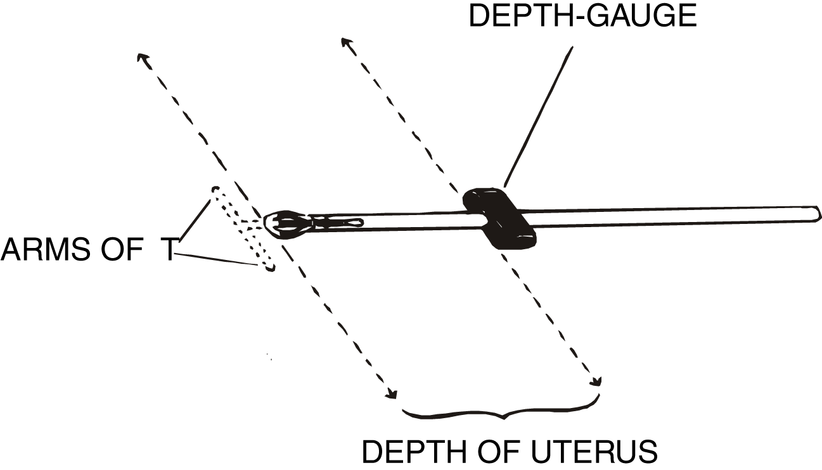
Loading the Copper T IUD
Step 3.8: Load the Copper T
Align the depth-gauge and the folded arms of the T so that they are both in a horizontal position.

Slide 22
Loading the Copper T IUD:
Step 3.9: Load the Copper T
Remove the loaded IUD from the package, keeping it level.
Notes:
Instructions for facilitator:
Note that it is important to keep the loaded IUD level, so that the T and the white plunger rod do not fall out, and not to push the white rod, which would release the T from the insertion tube.

Slide 23
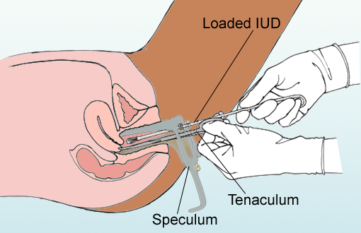
IUD Insertion Procedure:
Step 4: Insert IUD into Vagina
Gently grasp the tenaculum (still in place from sounding the uterus) and apply gentle traction.
Insert the loaded IUD, without touching vaginal walls or speculum blades.
Notes:
Distribute the Handout# 16 for instructions on inserting the loaded IUD

Slide 24
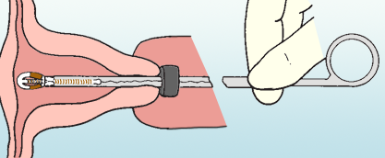
IUD Insertion Procedure:
Step 5: Advance IUD into Uterus
Gently advance the loaded IUD into the uterine cavity.
STOP when the blue depth-gauge comes in contact with the cervix or light resistance is felt.

Slide 25
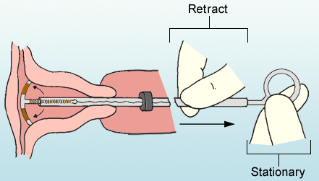
IUD Insertion Procedure:
Step 6: Release Arms of Copper T
Hold the tenaculum and white plunger rod stationary, while partially withdrawing the insertion tube.
This releases the arms of the Copper T.

Slide 26
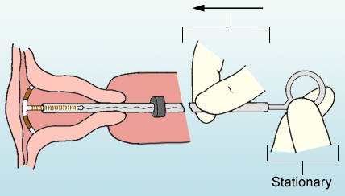
IUD Insertion Procedure:
Step 7: Gently Push Insertion Tube
Gently push the insertion tube until you feel a slight resistance.
This step ensures placement high in the uterus

Slide 27
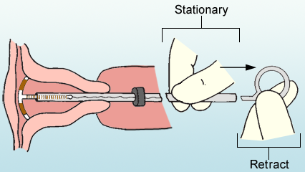
IUD Insertion Procedure
Step 8: Remove Plunger Rod
Remove the white plunger rod, while holding the insertion tube stationary.

Slide 28
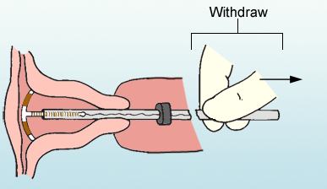
IUD Insertion Procedure
Step 9: Partially Withdraw Inserter
Gently and slowly withdraw the inserter tube from the cervical canal until strings can be seen protruding from the cervical opening.

Slide 29
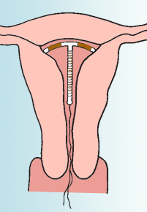
IUD Insertion Procedure
Step 10: Cut IUD Strings
Use sharp Mayo scissors to cut the IUD strings at 3–4 cm from the cervical opening
  If scissors are dull, IUD strings may get caught in blades.
Completely withdraw insertion tube with cut ends of strings inside

Slide 30
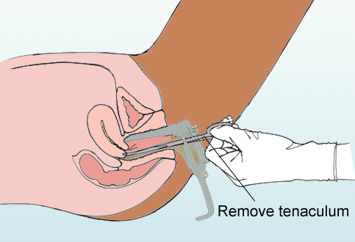
IUD Insertion Procedure
Step 11: Remove Tenaculum
Gently remove the tenaculum
Observe the woman’s cervix for bleeding
If there is bleeding, hold swab to site using clean forceps

Slide 31
IUD Insertion Procedure
Step 12: Remove Speculum, clean and rinse Instruments at point of use.
Gently remove the speculum.
Clean and rinse used instruments with plain water at point of use for further processing either by High-Level Disinfection or sterilization.
Notes:
Note: Soaking of instruments in 0.5% chlorine solution or any other disinfectant before cleaning is not recommended for the following reasons: ( follow country guidelines)
It may damage/corrode the instruments
The disinfectant may be inactivated by blood and body fluids, which could become a source of microbial contamination and formation of biofilm
Transportation of contaminated items soaked in chemical disinfectant to the decontamination area may pose a risk to health-care workers and result in inappropriate handling and accidental damage
May contribute to the development of antimicrobial resistance to disinfectants-WHO 2016
Adapted from Blouse A, Kinzie B, McIntosh N. IUD Guidelines for Family Planning Service Programs: A Problem-Solving Reference Manual, 3rd ed. Baltimore, MD: JHPIEGO, 2006.
https://apps.who.int/iris/bitstream/handle/10665/250232/9789241549851eng.pdf;jsessionid=D1491511C20FB36BA52BC71DD829B26E?sequence=1
http://resources.jhpiego.org/system/files/resources/IPC_M6_Instruments.pdf.

Slide 32

IUD Insertion Procedure
Step 13: Allow Woman to Rest
Allow the woman to rest
Begin post-insertion tasks
Provide post-insertion instructions and other key messages

Slide 33
IUD Removal Procedure
  Follow infection prevention guidelines.
  Counsel client that cramping/bleeding may occur.
  Perform bimanual exam.
  Inserts vaginal speculum and looks at length and position of strings. Apply slow, gentle traction to avoid breaking strings.
  Swab cervix and vagina with antispectic.

Slide 34
IUD Removal Procedure, continued
  Grasp strings with a toothed forceps close to the cervix and pull gently but firmly to remove the IUD.
  Show the removed IUD to the woman.
  Dispose of waste materials according to guidelines.
  Refer difficult removals.
  Insert a new IUD immediately following removal (if desired).

Slide 35
Demonstration and practice session
Demonstrate the following procedures using the checklists and allow participants to practice on models under guidance of the facilitator.
Pelvic examination
Loading the Copper IUD in the sterile package
Insertion of IUD using the "No Touch" technique
Removal Procedure
Notes:
See Session Plan for details.

