Slide 1
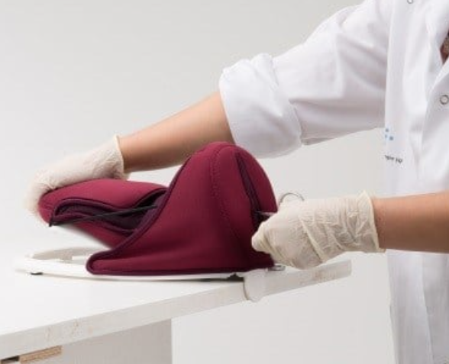
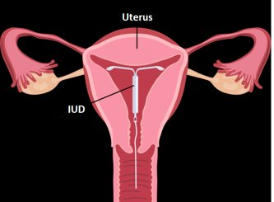
Hormonal IUDs
Session VI
Postpartum Insertion

Slide 2
Session Objectives
By the end of the session participants will:
Understand what is different about the IUD in the postpartum period?
Review the clinical skills checklist on the insertion technique of the H-IUD in the immediate postpartum period.
Describe infection prevention requirements for the insertion of H-IUD in the postpartum(PP) period.
Describe and demonstrate the steps for postpartum H-IUD insertion.
List post-insertion tasks.
Describe best practices to minimize possible complications.
Practice the procedure on anatomical models in an equipped station and using the clinical skill checklists under the guidance of a facilitator.
Notes:
This session describes the steps for inserting the IUD in the immediate postpartum period using the one-handed inserter. The steps for insertion using the two handed inserter, such as the Avibela is similar to the postpartum insertion of copper IUDs.
The session also describes practices to prevent infection during insertion..
Complications such as perforation of the uterus or expulsion are associated mainly with provider skill.
Extensive practice on models, observations of master clinicians and supervised practice are necessary for the provider to be skillful in the PPIUD insertion procedure.
During this session, we will first review the steps of PPIUD insertion, using the slides. This will be followed by a demonstration, return demonstration and practice by participants on anatomical models, using competency-based checklists to monitor progress.

Slide 3
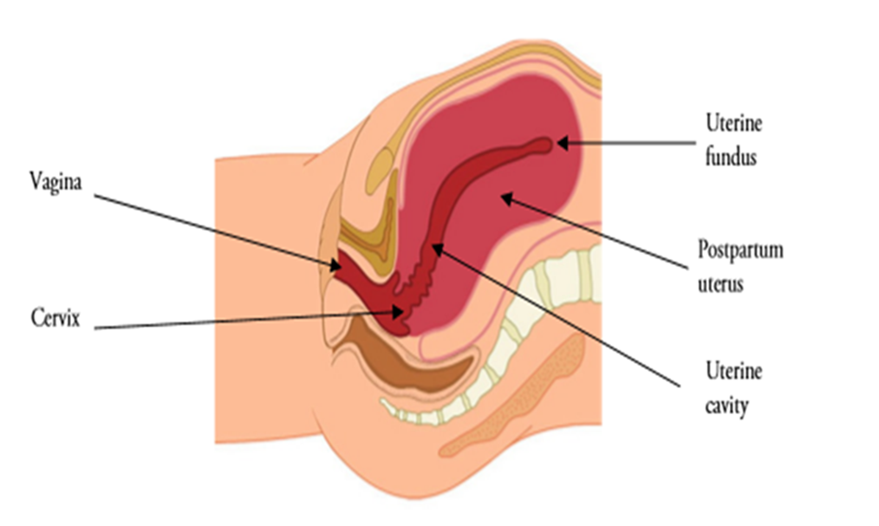
Anatomy of a Postpartum uterus
Immediately after the expulsion of the placenta, the fundus is just below the umbilicus. It can easily be palpated through the abdominal wall. After delivery and Active management of the third stage of labor(AMTSL), the uterus is slightly tilted forward in the lower abdominal cavity.
As you can see in the diagram, the axis of the uterine cavity is almost at right angles to the vaginal cervical axis. During IUD insertion, this angle has to be negotiated carefully to reach the fundus. Many may believe that they have reached the fundus when they feel a resistance at the cervical-uterine angle.
Notes:
Tell participants that it is important to understand the anatomy of the postpartum uterus. This will enable them to insert the PPIUD correctly and safely.

Slide 4
What’s different about postpartum insertion of the IUD?
Timing, place and providers.
Instruments used for PPIUD insertion.
Technique of insertion.
Notes:
Brainstorm: How is postpartum insertion of the IUD different from Interval insertion? Take responses and show the slides

Slide 5
Postpartum and Postabortion timings
Immediate Postpartum insertion is performed before discharge from the health facility after childbirth.
                Post-placental: Within 10 minutes following the delivery of the placenta..
                Intracesarean: Following the removal of the placenta during a cesarean section.
                Pre-discharge: Before discharge from the facility after chilbirth (typically upto 48 hrs after childbirth).
Extended postpartum(Interval): after 4-6 weeks of childbirth upto 1 year or beyond
Post-abortion:
For Medical Abortion: H-IUD can be inserted when it is confirmed that abortion is complete. No back up needed
For Surgical evacuation: Can be inserted immediately after the procedur, if no infection or any other complication. OR within 7 days.
Post second Trimester abortion: Delay insertion until at least 4 weeks post abortion. Provide a backup in the interim.

Slide 6
Place of Postpartum IUD Insertion
Immediate postpartum:
Post Placental: Where does this happen? Who is the provider?
In the labor room and on the labor table using the long Kelly placental forceps.
Maternity health staff are the providers.
Pre-discharge-(before discharge from the health facility:
Where does this happen? Who is the provider?
In the procedure/examination room of the maternity ward using the Kelly forceps or ring forceps( if the uterus is well contracted.
Maternity Health staff is the provider.
Intracesarean: Where does this happen? Who is the provider?
In the operation theatre, inserting the IUD manually or by using a ring forceps, through the uterine incision after removal of the placenta and before closure of the uterine incision. Maternal health clinician/staff is the provider.
Notes:
Ask- “Why is it important to know the place of Insertion?”
Tell them that it is critical to have the essential instruments, supplies, trained providers, and commodities at the place of insertion. Example-The immediate and early postpartum insertion occurs in the labor and maternity wards. The Intracesarean occurs in the operation theatre. So critical that commodities, kits and trained providers be available to provide the services at the place where they happen.

Slide 7
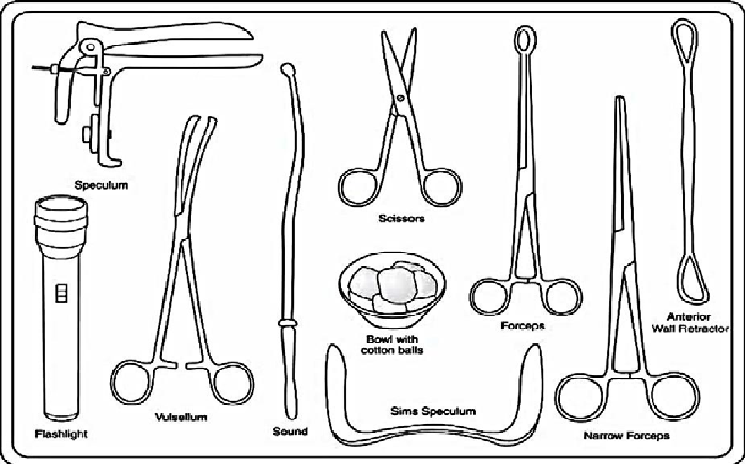
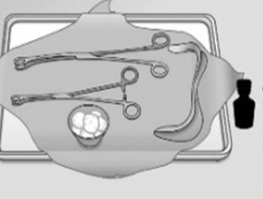
Interval and postpartum IUD kit
Notes:
Conduct Activity #3:The purpose of this activity is to:
•Identify differences between the equipment and supplies needed for PPIUD insertion and those needed for interval insertion.
•Consider differences in the characteristics of clients who come for PPIUD procedures compared with those who come for interval procedures.
See session plan for details of the activity and Activity #1 in the handout tab of this module.
Materials needed: Instruments tray for PPIUD Insertion, Instruments tray for Interval IUD Insertion.

Slide 8
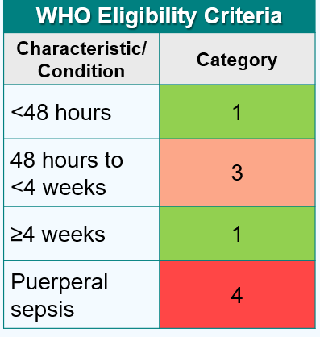

Providing PPIUD services
Clinical assessment - Pre-Insertion screening
  Immediately before insertion assess the woman for the following conditions. If any one of these exist, she is not eligible for the IUD now and should be offered other postpartum contraceptive methods. Call the woman at 4-6 weeks for re-evaluation for the IUD:
  Chorioamnionitis ( Category 3)
  Postpartum endometritis/metritis (Category 4)
  Puerperal sepsis (Category 4)
  More than 18 hours from rupture of membranes to delivery of the baby(Category 3)
  Unresolved postpartum hemorrhage( Category 4)
  Extensive genital trauma, the repair of which would be disrupted by the postpartum placement of the IUD ( Category 3)
Notes:
If the woman has any of the above conditions counsel her for other FP methods. If she insists on the IUD, she can have it after 4 weeks. Refresh the MEC criteria and Pre Screening Checklist for PPIUD with participants.

Slide 9
Pre insertion counseling
If the woman has cleared the screening-
Confirm with her if she still wants the H-IUD and take consent for the same.
Briefly explain to her what you will be doing and what she should expect.
Tell her that the procedure is quick but mildly painful ( Postpartum insertions are less painful than interval, as the cervical os is open at this time).
The woman should tell the provider if she feels something alarming.
Proceed with the procedure.
Important:
While working with models and clients, it is strongly recommended that the trainers and participants practice and promote autonomy, dignity, comfort, respect, and privacy.
Ensure audio visual privacy during procedures.
Always ensure that the model is draped when not in use.
When demonstrating with models, talk with the ‘model’ about what is being done as you would to a real client.
Be sure to ask the clients for their consent, invite them to ask questions before starting, and remind the client that they can request the procedure be paused or discontinued at any time. Consent is an ongoing process
Role modeling by the trainers will encourage participants to practice respectful behavior on models and real clients at their workplaces.

Slide 10
Postpartum IUD insertion technique
Distribute the skills checklist Evaluation Tool # 6 for immediate PPIUD insertion and review with participants, going through every step carefully.
Pause for any questions or clarifications.
Review Evaluation tool# 7 for Intracesarean insertion based on the cadre of the audience.
Notes:
Introduce the session. Tell participants that they will now learn the insertion technique for Immediate PPIUD .
Distribute the skills checklist Evaluation Tool # 6 for immediate PPIUD insertion and review with participants, going through every step carefully. Pause for any questions or clarifications. Review Evaluation tool # 7 for Intracesaarean insertion based on the cadre of the audience.

Slide 11
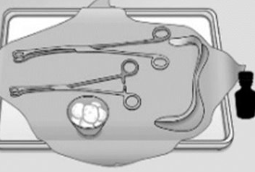


Instruments and Supplies
H-IUD in an unopened, undamaged package that is not beyond its expiration date.
Sim's speculum
Ring forceps
Kelly or Long Placental forceps
Cotton swabs
Antiseptic-Betadine
Notes:
Note to Facilitator: review the list of recommended supplies and equipment for PPIUD insertion procedures.
The recommended supplies and equipment include:
IUD in an unopened, undamaged, sterile package that is not beyond its expiration date.
Sims speculum
Ring forceps
Kelly or Long Placental forceps
Cotton swabs
Antiseptic-Betadine

Slide 12
Instruments and Supplies, cont.
Gloves (single-use disposable, HDL, or sterile)
Bowl for antiseptic solution
Drape/cloth to cover woman’s abdomen
Light source to visualize the cervix

Slide 13
Infection Prevention Practices
Wash hands thoroughly with soap and water before and after the procedure.
Use clean, HLD, or sterilized instruments and clean/sterile gloves
Thoroughly prep the cervix and vagina with antiseptic before beginning the procedure.
Arrange the essential items in the tray.
Open the IUD package correctly and at the appropriate time.
Use a “no-touch” insertion technique to reduce contamination of the uterine cavity.
Properly dispose of waste material according to guidelines (gauze, cotton, and disposable gloves) after completion of the procedure.
Notes:
Distribute Handout #12 for infection prevention practices and new guidance on point of use cleaning before processing instruments

Slide 14
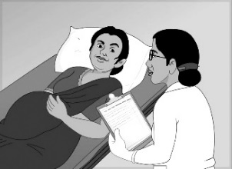
Procedure Overview
Step 1
Confirm that the woman has been counselled and has consented to the H-IUD after delivery.
Ask her if she has any questions.

Slide 15
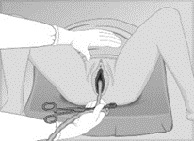
Step 2
Manage labor and delivery, including the active management of the third stage of labor (AMTSL).

Slide 16
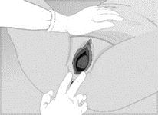
Step 3
Do a second screening, including an inspection of the vagina and perineum for lacerations.
-If there are lacerations that are bleeding heavily, repair them before insertion, if this can be done quickly. Alternatively, place a clamp on the bleeding laceration IF this is not painful for the client.
-If the laceration is not bleeding or bleeding minimally, place a gauze over it, insert the IUD and attend to the laceration after insertion.
Notes:
If the lacerations are small and not bleeding profusely , apply a cotton gauze to cover it and repair after the insertion of the IUD.

Slide 17
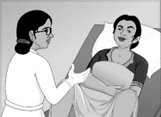
Step 4
If no problems, ask the woman if she is ready for the insertion. Tell the woman what she should expect. She may feel some discomfort or pain. She should alert the provider for any alarming symptom.

Slide 18
Step 5
Arrange supplies and equipment, with the H-IUD kept to the side.( one-hand inserter or two-hand inserter, whichever is available)

Slide 19
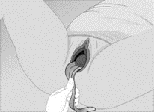
Step 6
Visualize the cervix by gently pressing the posterior vaginal wall with a speculum.

Slide 20
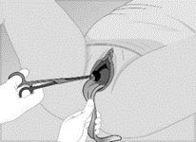
Step 7
Clean the cervix and vagina thoroughly with an antiseptic solution.

Slide 21
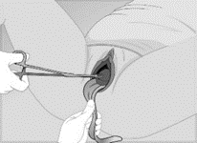
Step 8
Grasp the anterior lip of the cervix with a ring forceps.

Slide 22
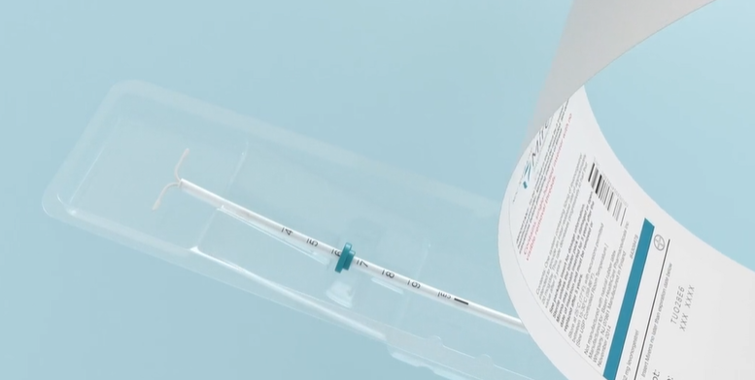
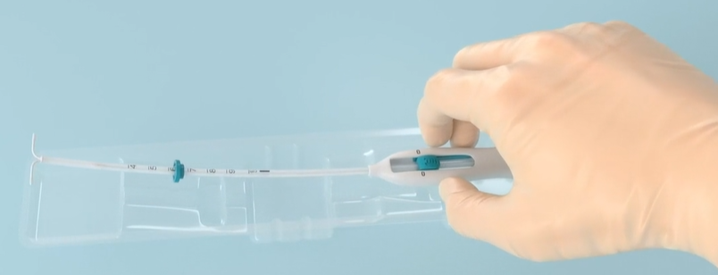
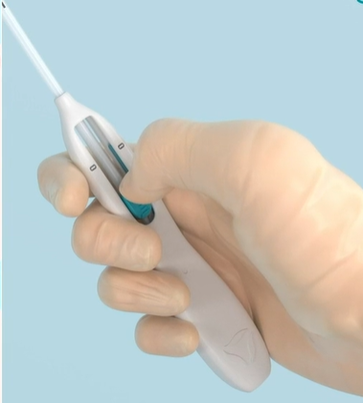
Step 9
Opening the Package-One-handed Inserter
Open the H-IUD package by lifting the plastic cover all the way down.
Lift the handle of the sterile applicator and remove it from the package.
Remember: all contents in the package are sterile.
Hold the slider firmly and release the IUD by moving the slider all the way down.
Use the long placental forceps to gently grasp the IUD by the edge on the very top of the stem above the hormonal reservoir, being careful not to press the reservoir and not to entangle the threads in the forceps.
DO NOT apply pressure on the vertical limb of the H IUD where the hormone containing reservoir is.

Slide 23
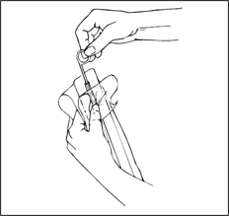
Opening the Package - Two-handed Inserter
Open the IUD package from the bottom by pulling back 1/3rd of the plastic cover. The contents inside the package are sterile.
With a non-dominant hand still holding the package use the dominant hand to remove the plunger, rod, inserter tube, and card from the package.
Use the long placental forceps to gently grasp the H-IUD by the edge on the very top of the stem above the hormonal reservoir, being careful not to press the reservoir and not to entangle the threads in the forceps.
DO NOT apply pressure on the vertical limb of the H IUD where the hormone –containing reservoir is.

Slide 24
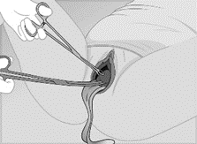
Step 11
Gently lift the anterior lip of the cervix using the ring forceps.
Insert long placental forceps with the H-IUD through the cervix to the lower uterine cavity; avoid touching the vagina and keep forceps closed.

Slide 25
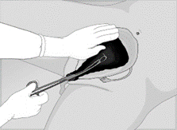
Step 12
Remove the ring forceps that was used to catch the anterior lip of the cervix, and place a hand on the abdomen

Slide 26
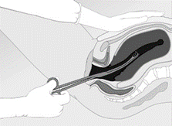
Step 13
“Elevate” the uterus by gently pushing it upward toward the woman’s head. This helps to straighten the vagino-uterine angle and ensures smooth advancement of the forceps holding the IUD to the fundus.

Slide 27
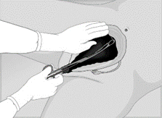
Step 14
Move the IUD and forceps upward toward the umbilicus until the fundus is felt; follow the contour of the uterine cavity.

Slide 28
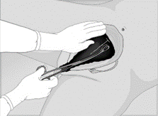
Step 15
Continue to stabilize the uterus, open the forceps by tilting it towards the midline and release IUD at the fundus.

Slide 29
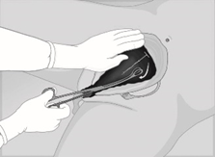
Step 16
Keeping forceps slightly open, sweep forceps to the side wall of the uterus.

Slide 30
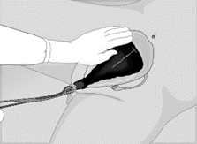
Step 17
Slowly withdraw forceps-keeping them slightly open.

Slide 31
Step 18
Examine cervix to see the threads/strings.
The strings of the H-IUD are long (longer than the Copper IUD) and may be seen protruding from the cervix.
DO NOT pull the threads. If too long, trim to a comfortable length of 3-4 cms outside the cervix. Consider trimming the strings before insertion.
Notes:
As the uterus involutes, the strings may get longer. If the woman sees or feels them hanging out of the vagina, she should see a provider, who may then trim the strings.

Slide 32
Step 19
Before removing gloves:
Wipe used instruments with a wet cloth or soak them in a bucket of tap water for point-of-use cleaning and further processing
Segregate and dispose of waste materials in appropriate leak-proof containers with lids
Wipe surfaces that may have been contaminated with blood/discharge with 0.5% chlorine solution.
Take gloves off, wash hands thoroughly with soap and water, and dry them.

Slide 33
Step 20
Allow the woman to rest.
Provide post Insertion instructions when she is comfortable.
Be sure she receives complete postpartum care.
Help her initiate breast feeding

Slide 34
Post insertion instructions
Review side effects and normal postpartum symptoms.
Tell the woman when to return for PPIUD/postnatal and newborn checkup(s).
Review the warning signs (PAINS)
Emphasize that she should return any time she has a concern or experiences warning signs.
Ask her to look at the pads/cloth for expulsion.
Ask her to return if she sees the strings hanging out of the vagina.
Tell her what to do if she sees that the IUD has fallen out(expelled).
Ensure that the woman understands post-insertion instructions.
Give written post-insertion instructions, if possible;
Complete the reminder client card and give it to the client. Explain that the card shows the type of IUD, the date of insertion, the clinic name, and the duration. Remind client that she can get the IUD removed anytime fr any reason.
Notes:
P: Postpartum symptom related
A: Abdominal cramps
I: Infection signs and symptoms-fever, abnormal vaginal dischsrge
N: Not feeling well, any new symptoms?
S: String related.

Slide 35
Post insertion instructions…
Remind the client:
IUDs including H-IUDs do not protect against STIs; need to use condoms if at risk.
Possible side effects, especially bleeding changes to be expected. If these symptoms are mild and consistent with uterine involution, provide reassurance. Expect lochia but take note of heavy bleeding or clots indicative of postpartum hemorrhage.
When to return to the clinic
Complete the client record
Notes:
See session 3 for details on post procedure instructions

Slide 36
What are the problems that a provider can encounter at the time of insertion
IUD seen in vagina or cervix after placement :
  Remove the IUD with HLD forceps and reinsert the same IUD if not contaminated. If contaminated, use a new IUD.
  The strings of the H IUD are longer than the copper IUD and may be visible at the cervix. Do not pull the strings. Trim them to 3-4 cms outside the cervix.
Uterine perforation (very rare): Loss of resistance and sudden pain
  Stop the procedure and remove the instruments
  Observe vitals, rigidity, and bleeding. Start IV fluids and IV Antibiotics
  If vitals are low and failing- take appropriate steps such as ultrasound and referral to a higher center
Notes:
Discuss the problems that a provider may encounter during inserting of a PPIUD and how to correct these.

Slide 37
Best practices to minimize the risk of complications
Provider competence and confidence
Careful screening of clients before insertion
Screen the client for high risk of STIs
Screen the client to be certain there is no contraindication to the insertion immediate postpartum.
Use correct instrument for insertion to ensure fundal placement
Correct insertion technique
Strict adherence to infection prevention practices during delivery and insertion.
Slow and gentle movements during insertion to assure technical accuracy, client comfort, and safety.

Slide 38
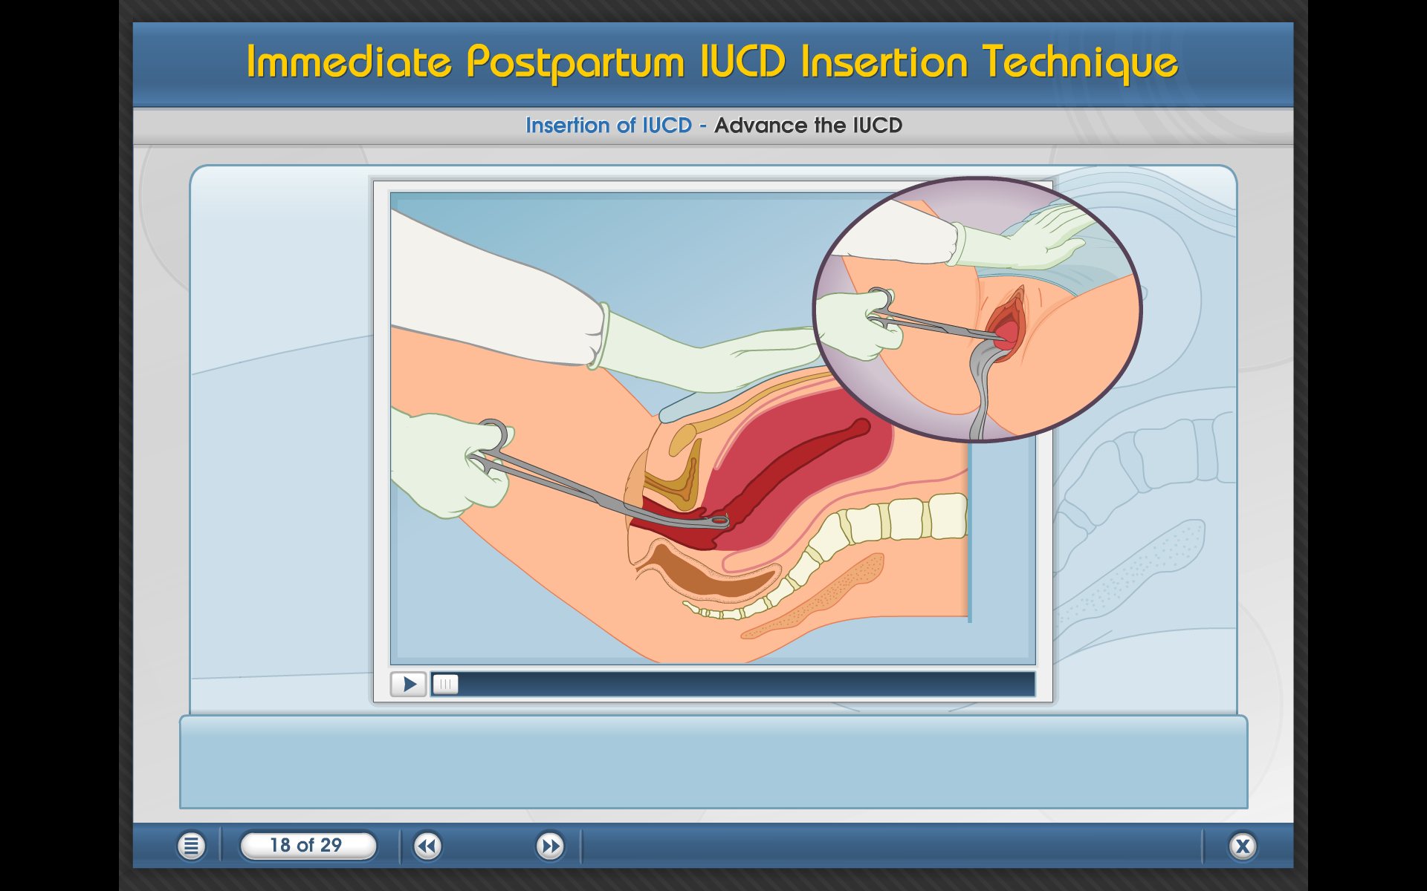
Key message for providers!
Understanding what is happening in the woman’s body is critical to proper PPIUD insertion
Correct technique and use of correct instruments help ensure:
  Placement of IUD at the fundus is critical to the retention of the IUD.
  Be gentle and patient: Remember, she has just delivered a baby.
  Follow all infection prevention practices.
  Remember to counsel the woman for removal if and when she desires it.
Notes:
Importance of proper technique in PPIUD Insertion
An understanding of what is happening in the woman’s body during the postpartum period is critical to mastering the proper insertion technique for the PPIUD.

Slide 39
PPIUD: Summary
The postpartum period is a powerful opportunity to support reproductive autonomy and contraceptive choices. PPFP benefits the health benefits of mothers, children, and families.
Cost-effective and convenient way to provide a safe, highly effective, and reversible long-acting method.
The antenatal through postpartum period are opportunities to provide FP/RH counseling, method choice information, and comprehensive FP/RH services, including the provision of PPFP which ensures that a woman can choose the right method for her reproductive intentions. The IUD is one of the many option that can support women in their reproductive needs
One limitation of PPIUD versus interval IUD is the higher expulsion rates. This is related to provider skills… and this is why we are here.
We must work together to correct myths and misinformation about the IUD/PPIUD!
Notes:
PPIUDs: Summary
• Cost-effective and convenient way to provide a safe, highly effective and reversible long-acting method—BEFORE WOMAN LEAVES FACILITY AFTER CHILDBIRTH.
• Powerful tool in the global refocusing on health benefits of FP/PPFP to mothers, children, families
• Exclusions/precautions of the method are few, especially those specifically relevant to the postpartum woman

Slide 40
Demonstration and practice session
Demonstrate the PPIUD insertion procedure on the anatomical model, using the clinical skills checklists and allow participants to practice under guidance of the facilitator.36
Notes:
See Session Plan for details

Slide 41
Questions?

