Slide 1
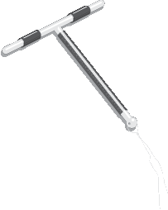
Copper-Bearing IUDs
Interval and Postpartum
Session III: Providing Copper IUDs
Interval and Postpartum
Copper T 380A
Notes:
Illustration credit: Salim Khalaf/FHI

Slide 2
Session Objectives
Describe the timings for initiation of IUDs.
Describe what is different about PPIUD.
Correcting rumors and misinformation about Copper IUDs
Describe in simple language what a client can expect before, during, and after an IUD insertion.
Describe and discuss the management of side effects and potential complications

Slide 3
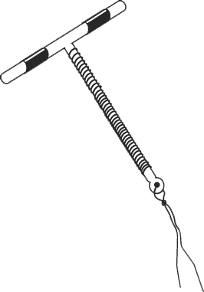
When to start?
Having menstrual cycles
Copper IUD
You can start any day of the menstrual cycle if we can be reasonably sure you aren’t pregnant | If menstrual bleeding started in the last 12 days: Can insert an IUD now. No need for a backup method. If menstrual bleeding started more than 12 days ago: Can insert an IUD now if reasonably sure the woman is not pregnant. There is no need to wait for the next menstrual period or a backup method.

Slide 4
When to start?
Insertion after childbirth (Postpartum)
Copper IUD
Soon after childbirth, (regardless of breastfeeding status) | Within 48 hours after giving birth, including intracesarean - Can insert. Between 48 hours and 4 weeks after birth: delay insertion until 4 weeks or more after childbirth. Offer condoms or another method if she is not fully breastfeeding. 4 weeks after birth: Can insert if reasonably certain she is not pregnant.
Notes:
Adapted from WHO
Note: Although the expulsion rate for postpartum insertions is higher, postpartum IUD insertion may be advantageous and convenient when compared to the generally low rate of women who return later for IUD insertion.
Clients choosing to have the IUD inserted immediately postpartum should be counseled that the risk of expulsion is greater if the IUD is inserted during this period.
The client should have been counseled during ANC contacts before delivery/during early labor and confirmation sought after delivery.
A specifically trained provider is required for the postpartum insertion

Slide 5
When to start?
Fully or nearly fully breastfeeding
Less than 6 months after giving birth.
More than 6 months after giving birth
Can be inserted anytime from 4 weeks to 6 months after giving birth and menstruation has not returned. No need for a backup method.
If menstrual bleeding has returned, then insert as advised for women having menstrual cycles
If her monthly bleeding has not returned, she can have the IUD inserted any time it is reasonably certain she is not pregnant. No need for a backup method.
If her monthly bleeding has returned, she can have the IUD inserted as advised for women having menstrual cycles (see previous slide).

Slide 6
When to start?
Partially or not breastfeeding
If her monthly bleeding has not returned, insert an IUD if reasonably sure she is not pregnant. No need for a backup method.
If menstrual bleeding has returned, then she can have the IUD inserted as advised for women having menstrual cycles
More than 4 weeks after giving birth

Slide 7

When to start?
After an abortion or miscarriage.
Can be inserted immediately or within 12 days after a first- or second-trimester abortion or miscarriage if no infection is present. No need for a backup method. If more than 12 days after a first or second-trimester abortion or miscarriage and no infection is present, insert an IUD if reasonably sure she is not pregnant. No backup method is needed. IUD insertion after second-trimester abortion or miscarriage requires specific training. If not specifically trained, delay insertion until at least 4 weeks after miscarriage or abortion. If infection, insert after the infection has been treated and cured.
Notes:
Adapted from WHO

Slide 8
When to start?
Switching from another method
Can be inserted immediately, if she has been using the method consistently and correctly or if reasonably certain she is not pregnant. If switching from an Injectable, she can have the IUD inserted when the next injection would have been given. No need for backup method.
Notes:
Adapted from WHO

Slide 9
When to start?
As Emergency Contraception
Within 5 days after unprotected sex.
After taking emergency contraceptive pills (ECPs):
The IUD can be inserted on the same day that she takes the ECPs (progestin-only, combined, or ulipristal acetate ECPs). No need for a backup method.
If she does not have it inserted immediately, but returns for an IUD, she can have it inserted any time if it can be determined that she is not pregnant
Notes:
Adapted from WHO

Slide 10
What’s different about the PPIUD?
Timing and place of insertion
Instruments used for PPIUD insertion
Technique of insertion
Notes:
Brainstorm: How is PPIUD different from Interval IUD? Take responses and show the slides

Slide 11
Timing of Postpartum IUD Insertion
Immediate Postpartum insertion is performed before discharge from the health facility after childbirth.
                Post-placental: Within 10 minutes following the delivery of the placenta..
                Intracesarean: Following the removal of the placenta during a cesarean section.
                Pre-discharge from health facility- 10 minutes to 48 hours of childbirth.
Extended postpartum(Interval): after 4-6 weeks of childbirth upto 1 year or beyond
Post-abortion: Immediately following an abortion provided there is no infection or other contraindications
Notes:
Refresh the participant’s knowledge of the timings and place of insertion for postpartum and Interval IUDs. Postpartum IUDs are generally not recommended between 48 hours to 4-6 weeks following childbirth due to the risk of expulsion.

Slide 12
Place of Postpartum IUD Insertion
Immediate postpartum: Post Placental( within 10 mins of delivery of the placenta): Where does this happen? Who is the provider?
In the labor room and on the delivery table using the Kelly or long placental forceps. Maternity health staff are the providers.
Pre-discharge-(before discharge from the health facility. Typically, within 48 hrs. of delivery): Where does this happen? Who is the provider?
In the procedure/examination room of the maternity ward using the Kelly forceps or ring forceps( if the uterus is well contracted and smaller than the immediate PP uterus). Maternity Health staff is the provider.
Intracesarean: Where does this happen? Who is the provider?
In the operation theatre, inserting the IUD manually or by using a ring forceps, through the uterine incision after removal of the placenta and before closure of the uterine incision. Maternal health clinician/staff is the provider.
What implication does knowing the place of insertion have for the program?
Notes:
Ask- “Why is it important to know the place of Insertion?”
Tell them that it is critical to have the essential instruments, supplies, trained providers, and commodities at the place of insertion. Example-The immediate and early postpartum insertion occurs in the labor and maternity wards. The Intracesarean occurs in the operation theatre. So critical that commodities, kits and trained providers be available to provide the services at the place where they happen.

Slide 13
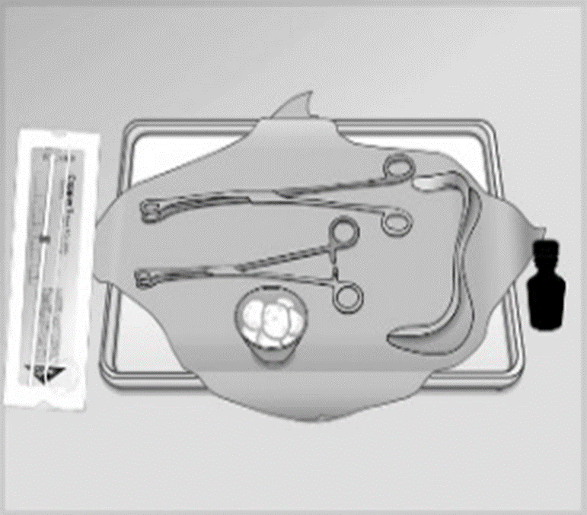
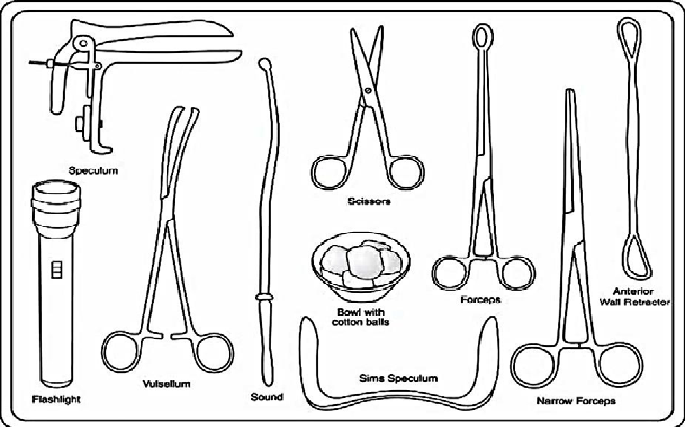
Interval and postpartum IUD kit
Notes:
Conduct Activity #1:The purpose of this activity is to:
•Identify differences between the equipment and supplies needed for PPIUD insertion and those needed for interval insertion.
•Consider differences in the characteristics of clients who come for PPIUD procedures compared with those who come for interval procedures.
See session plan for details of the activity and Activity #1 in the handout tab of this module.
Materials needed: Instruments tray for PPIUD Insertion, Instruments tray for Interval IUD Insertion.

Slide 14
Correcting Rumors and Misinformation
Can be used by women of any age, including adolescents.
Can be used by women who have had children and those who have not.
Rarely lead to PID.
Do not increase the risk of contracting STIs, including HIV.
Do not increase the risk of miscarriage when a woman becomes pregnant after the IUD is removed.
Do not make women infertile.
Do not cause birth defects.
Do not cause cancer.
Do not move to the heart or brain.
Do not rust inside the body
Do not affect breastfeeding
Do not cause discomfort or pain for the woman or the man during sex
Substantially reduce the risk of ectopic pregnancy.
http://www.fphandbook.org
Notes:
Distribute Handout# 9-Rumors and misconceptions about Copper IUDs
Conduct Activity #2 from the handout tab of this module

Slide 15
Providing IUD services
Explaining the Insertion procedure
Talk to the woman before, during, and after the insertion. procedure and obtain consent.
Before the insertion:
Confirm that she still wants the IUD.
Counsel her on the insertion procedure and obtain consent.
Tell her gently, briefly, and in simple language what you are going to do.
Explain to her what she may expect during the procedure - It is generally quick but maybe a little painful.
Postpartum insertions are less painful as the cervical os is open.
Respond to any questions that she may have.
Notes:
Talking to the woman before the procedure helps in reducing anxiety and helps her to relax. She also knows that she may experience some discomfort or a little pain.See session plan for details.

Slide 16
Providing IUD services
During Insertion:
Tell her what is happening, step by step.
Alert her before a step that may cause pain or might startle her.
Ask from time to time if she is feeling okay.
Remind the client that she can request the procedure be paused or discontinued at any time.

Slide 17
Providing IUD services
Post-Insertion
Provide specific post-insertion instructions and reinforce key messages:
Exclusive breastfeeding. The IUD does not affect breastfeeding.
The IUD does not protect from HIV/STIs, so a need to use condoms if at risk.
If it is convenient for the client (not mandatory), schedule a return visit with the client 3-6 weeks after insertion. OR anytime she has problems or experiences the warning signs or wishes to discontinue the method.

Slide 18
Supporting New and Continuing Users
Give specific instructions
Expect cramping and pain –Suggest Ibuprofen 200-400mg, paracetamol 325-1,000mg, or other available pain relievers., except Aspirin as it has anti-clotting effect and may increase the bleeding.
Expect spotting during the first month after insertion
For PPIUD users, If these symptoms are mild and consistent with uterine involution, provide reassurance. Expect Lochia but take note of heavy bleeding or clots indicative of postpartum Hemorrhage
Give the client in writing or a reminder card with:
  Type of IUD
  Date of Insertion
  Month and year for removal or replacement
  Where to go if she has any problem
Follow-up Visit: Schedule a follow–up after the next menses or 3-6 weeks after insertion OR if PPIUD then at 6 weeks at the first postnatal visit.
https://fphandbook.org/supporting-new-and-continuing-users-7

Slide 19
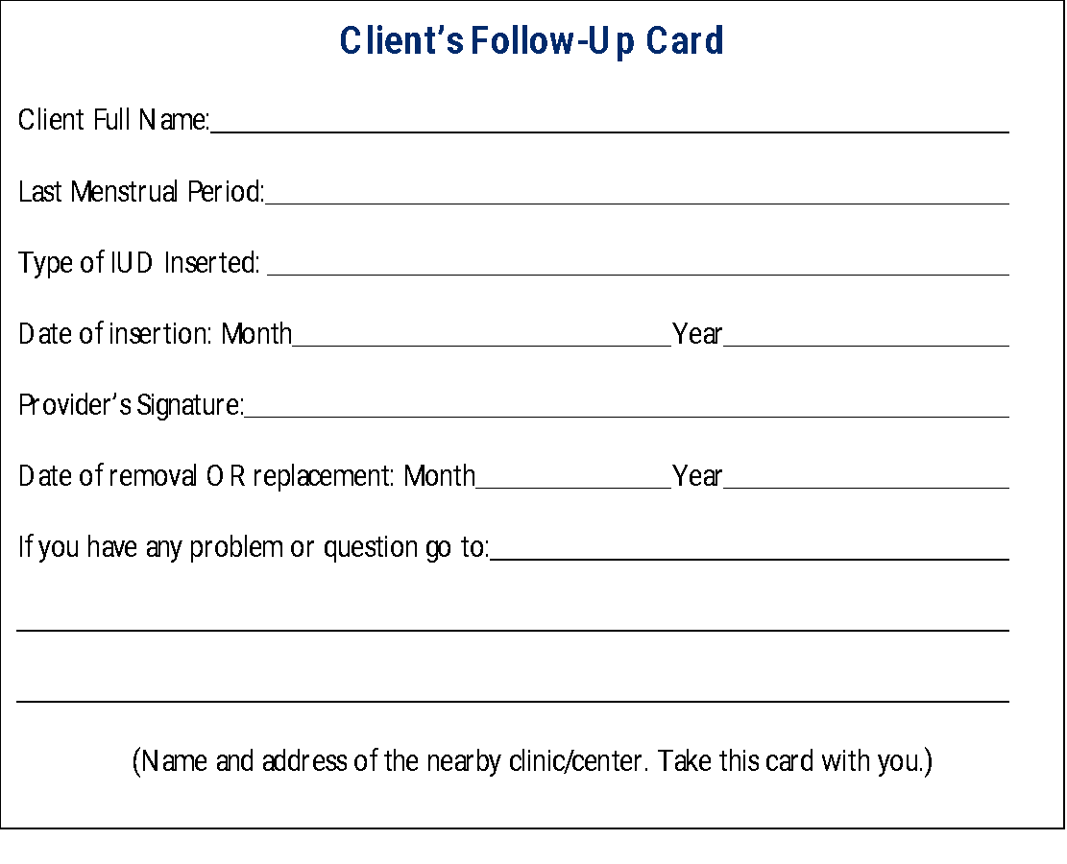
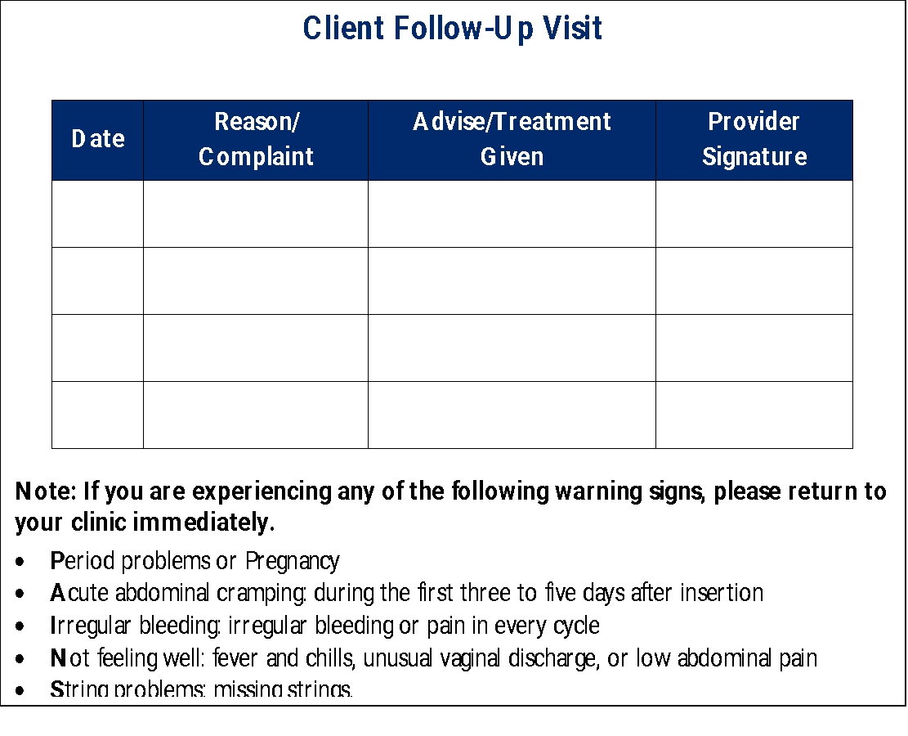
Sample of front and back of client card

Slide 20
How Can a Partner Help?
The client’s partner is welcome to participate in counseling and learn about the method and what support he can give to his partner. A male partner can:
Support a woman's choice of the IUD
Show understanding and support if she has side effects
Use condoms consistently in addition to the IUD if he has an STI/HIV or thinks he may be at risk of an STI/HIV
Help to remember when the IUD is due for removal
How can a partner help?

Slide 21
“Come back anytime": Reasons to return
Assure every client that she is welcome to come back any time:
if she has problems, questions, wants another method or wants a pregnancy. She can discontinue at any time for any reason if:
She has a major change in health status.
The IUD was expelled, or she thinks it may have been expelled from her uterus.
She has symptoms of PID (increasing or severe pain in the lower abdomen, pain during sex, unusual vaginal discharge, fever, chills, nausea, and/or vomiting), especially in the first 20 days after insertion.
She thinks she might be pregnant.
She wants the IUD removed, for whatever reason.
Come back anytime-Reasons to return

Slide 22
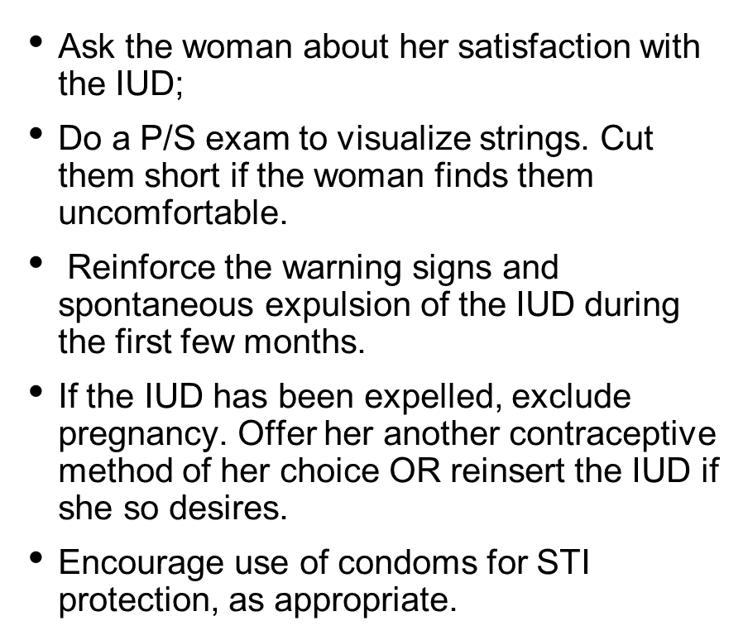
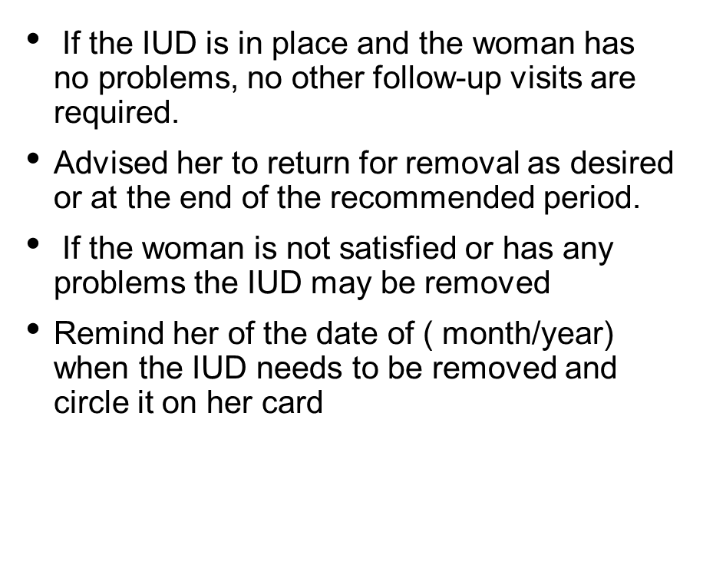
Follow up visit
Notes:
The World Health Organization (WHO) currently recommends at least one postnatal visit by 6 weeks after delivery. This is a good opportunity for women who have had an IUD inserted in the immediate/early postpartum period to receive follow-up services because, by 6 weeks postpartum, the uterus has undergone complete involution.

Slide 23
Warning signs
Period related-bothersome bleeding changes
Abdominal pain
Infection: signs and symptoms of Infection
Not feeling well
String related
Notes:
For PPIUD: If symptoms and physical findings are mild and consistent with postpartum uterine involution, reassure the client, making sure to answer any questions or concerns she may have .

Slide 24
Removing the IUD
IMPORTANT: Providers must not refuse or delay when a woman asks to have her IUD removed, whatever her reason, whether it is personal or medical. All staff must understand and agree that she must not be pressured or forced to continue using the IUD.
The removal process for all IUDs is the same.
Source: CCP and WHO, 2018.

Slide 25
Signs of Possible IUD Complications
Advise client to return immediately in case of:
Bleeding and severe abdominal cramping
within a few days post-insertion perforation
Irregular bleeding or pain every cycle
partial expulsion, perforation
Fever, unusual vaginal discharge, low abdominal pain infection
Missing IUD strings, missed period expulsion, pregnancy (For PPIUD, the strings will be usually visible at 4-6 weeks postpartum)
Source: CCP and WHO, 2018.
Notes:
Tell clients that complications with IUDs are rare and related to provider skills, correct positioning of the IUD, proper screening of the client, and use of infection prevention practices. In the case of PPIUD , expulsion is related to the timing of insertion( See advanced slides 6-8)

Slide 26
Identification of potential complications and their management
Changes in Menstrual Bleeding Patterns
For PPIUD, If symptoms are mild and consistent with uterine involution, provide reassurance.
  Determine severity: How much? How long? Accompanied by pain, or fever?
  Rule out pregnancy by history or available testing.
  Check for IUD expulsion: palpate strings on a bimanual exam or visualize on Per Speculum(P/S).
  Give short course with NSAIDs-Ibuprofen 600-800 mgx3 x5 days
  If bleeding is heavy and prolonged or associated with pallor, or weakness, offer iron replacement,
  Rule out any other gynecologic pathology and refer if indicated.
  If the woman finds bleeding unacceptable, remove the IUD and counsel for other methods.
  If ectopic pregnancy or other serious health condition is suspected, refer at once.

Slide 27
Potential complications and their management
Cramping or pain that may or may not be associated with menstruation
For PPIUD: If symptoms and physical findings are mild and consistent with postpartum uterine involution, reassure.
•She can expect cramping and pain in the first 1–2 days after insertion
•Reassure the client that this is common in the first 3–6 months, not harmful, and usually decreases over time
•Suggest ibuprofen, or other pain reliever (not aspirin if she also has heavy bleeding)
•If cramping continues and/or occurs outside of menstruation, evaluate for partial expulsion or perforation, treat or refer
•If cramping is severe but no underlying condition, discuss removing the IUD

Slide 28
Managing IUD Side Effects or Complications:
Heavy, Prolonged or Irregular Bleeding
Counseling and reassurance are key
Problem | Action/Management
Heavy or prolonged bleeding | Reassure client that this is common and not harmful, usually diminishes after few months For short-term relief offer 5-day course of tranexamic acid or NSAIDs (not aspirin) Provide iron tablets
Irregular bleeding | Reassure client For short-term relief offer ibuprofen or indomethacin 2 times daily after meals for 5 days
Source: CCP and WHO, 2018.
Notes:
Tab Aspirin is not recommended due to its anti-clotting property leading to more bleeding.

Slide 29
Potential complications and their management
Severe pain in Lower abdomen (Rare)
Do abdominal and pelvic examinations to rule out PID, ectopic pregnancy, or perforation.
If a pelvic exam is not possible, suspect PID if she has a combination of the following signs and symptoms in addition to abdominal pain:
Unusual vaginal discharge
Fever or chills
Pain during sex or urination
Bleeding after sex or between monthly bleedings
Nausea and vomiting
A tender pelvic mass
Pain when the abdomen is gently pressed or when gently pressed and then suddenly released.
If PID is suspected, treat with appropriate antibiotics for gonorrhea, chlamydia, and anaerobic bacterial infection or refer for treatment. There is no need to remove the IUD.

Slide 30
Potential complications and their management
Signs and symptoms of Infection
If a woman complains of fever, chills, pain in the abdomen, foul-smelling purulent discharge:
  Start antibiotic per local protocols for gonorrhea, chlamydia, and anaerobic infections. Remove the IUD only in the presence of sepsis or if symptoms do not improve within 72 hours.
  If the woman does not want to keep the IUD in during treatment, remove the IUD 2 to 3 days after antibiotic treatment has begun. If STI is suspected, counsel regarding condom use and recommend treatment for the partner

Slide 31
Potential complications and their management
Expulsion-Complete or Partial
  If complete expulsion of the IUD is confirmed as seen by the woman or on X-ray/ultrasound, replace the IUD immediately, if desired and appropriate (not pregnant or infected), or counsel the client for alternative family planning options.
  If partial expulsion is confirmed (e.g., felt/seen by the woman or clinician), remove it and replace it, if desired and appropriate, or counsel the client for an alternative method.
  If the IUD appears to be embedded in the cervical canal and cannot be easily removed refer for removal by a specially trained provider.
  If complete expulsion of the IUD is confirmed and pregnancy diagnosed( see slide 36 & 37)
Notes:
IUD expulsion occurs in 2-10% of cases and is related to provider skills, correct technique and positioning of the IUD. In the case of PPIUD, the expulsion rate varies with the timing of insertion. See Advanced slide set 6-8

Slide 32
Potential complications and their management
Suspected Perforation
Stop procedure immediately, remove IUD
Observe vital signs every 5-10 min for an hour; check for signs of bleeding
  If rapid pulse, falling blood pressure, or increased pain: refer
  If stable, observe several more hours and send home if no signs or symptoms
Provide alternative contraception
  Advise avoid sex for 2 weeks
Follow-up in a week or as needed
Source: CCP and WHO, 2018.
Notes:
According to the WHO, rates of perforation at the time of insertion are about 1 in 1,000. Perforations are associated almost exclusively with the insertion procedure. and linked to provider skills.

Slide 33
Potential complications and their management
String Related-Long/Short
Long/Short
  Long strings: strings, as needed, up to 3–4 cm from cervical os.
  Short Strings (if bothersome to woman or partner) Reassure the woman and her partner that the strings are very soft and flexible and not harmful.
  If very bothersome, trim shorter so that the string curves around the cervical lip.

Slide 34
Potential complications and their management - Missing strings
Missing Strings
Ask the woman if she thinks her IUD has fallen out. Did she see it come out?
When did she have her last menstrua period? Has she used a back up method since she noticed that the IUD came out?
Rule out pregnancy by history or pregnancy test.
Always start with minor and safe procedures-Probe the cervical canal using a HLD/sterile brush or narrow forceps to locate the strings & gently draw them out into the vaginal canal
If the strings are not located in the cervical canal, refer the woman for an X-ray or Ultrasound to confirm normal intrauterine positioning of the IUD. Provide a backup method while waiting for results. Manage, as appropriate, based on findings:
  If the IUD is located inside the uterus and the woman wants to keep it: Tell her that the IUD is still protecting her from pregnancy, no need to worry, and she will no longer be able to feel the strings. If the woman wants it to be removed, refer her for removal by a specially trained provider.
  If the IUD cannot be visualized in the uterus or the peritoneal cavity, manage as complete expulsion( see slide 36)

Slide 35
Partner can feel strings during sex
Explain that this happens sometimes when strings are cut too short.
If her partner finds the strings bothersome, describe and discuss this option: – Strings can be cut even shorter, so they are not coming out of the cervical canal. Her partner will not feel the strings, but it will make the removal procedure somewhat more difficult (may require a specially trained provider)

Slide 36
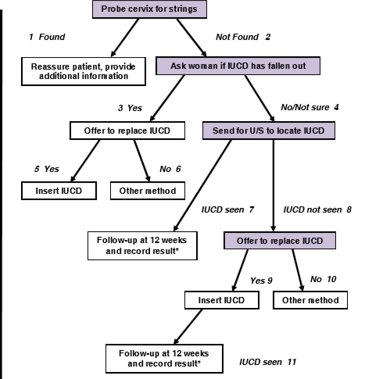
Protocol for missing strings
Notes:
Distribute the Job aid# 2 on protocol for missing strings and review with learners.

Slide 37
Potential complications and their management
Pregnancy with an IUD in place
  Confirm pregnancy and trimester. If 2nd trimester-Refer to higher center
  Rule out ectopic pregnancy by symptoms of severe pain on one side of the abdomen and U/S.
  If ectopic pregnancy is ruled out and 1st-trimester pregnancy is confirmed - Counsel the woman. Removal slightly increases the risk of miscarriage; however, leaving it in place poses a greater risk of 2nd trimester miscarriage, infection, and preterm delivery.
  If the woman requests removal, proceed with immediate removal if the strings are visible. If the strings are not visible, do an ultrasound. If the IUD is still in place and cannot be safely removed, plan to remove the IUD at delivery.
  If the woman declines removal, provide support and arrange close monitoring of the pregnancy by a qualified provider and facility delivery. Stress on returning to the clinic immediately if she experiences signs of spontaneous abortion or infection (e.g., fever, low abdominal pain, and/or bleeding) or any other warning signs.
  For the healthiest outcomes, encourage IUD removal as soon as it is discovered that she is pregnant.

Slide 38
Practice through Role Plays and Case study
Notes:
See Session Plan for instructions

Slide 39
Copper IUDs: Summary
Copper IUDs are:
Safe, highly effective, convenient, reversible,
long-lasting, cost-effective, easy to use, and appropriate for the majority of women.
Providers can ensure safety by:
Informative counseling
Careful screening
Correct procedure techniques
Appropriate infection prevention
practices
Proper follow-up

