Slide 1
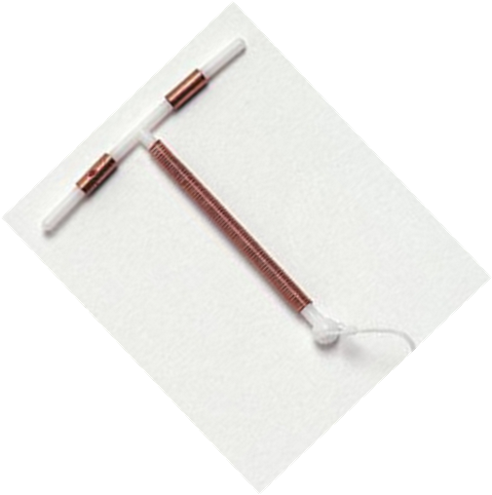
Copper-Bearing IUDs
Interval and Postpartum
Session II: Who Can and Cannot Use Copper IUDs?
Notes:
Illustration credit: Salim Khalaf/FHI

Slide 2
Session Objectives
Describe who can and who cannot use Copper IUDs.
Describe the Medical Eligibility Criteria for the safe use of IUDs in the interval and postpartum timing.
Describe the use of a screening checklist for the safe use of Copper IUDs in the interval and postpartum timing

Slide 3
Copper IUD Is Safe and Suitable for most women, including those who:
Have or have not had children
Are married or not married
Are of any age, including adolescents and women over 40 years
Have just had an abortion or miscarriage (no infection)
Are breastfeeding
  Have had PID
  Have vaginal infections
  Are infected with HIV, whether or not they are on ARVs
  Postpartum
  Have had an ectopic pregnancy
  Do heavy physical work

Slide 4
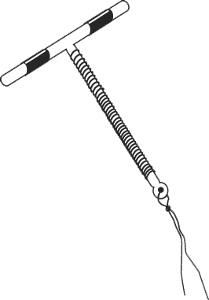




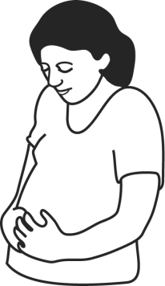

Who Can and Cannot Use the IUD
Copper IUD
Most women can safely use the Copper IUD
But usually cannot use it if :
May be
pregnant
Gave birth more than 48 hrs or less than 4 weeks ago
At high risk for STIs
Unusual vaginal bleeding recently
Infection or problem in female organs

Slide 5
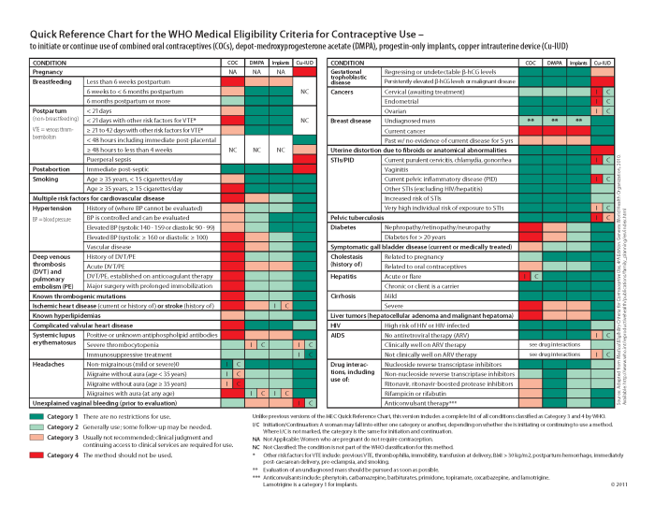
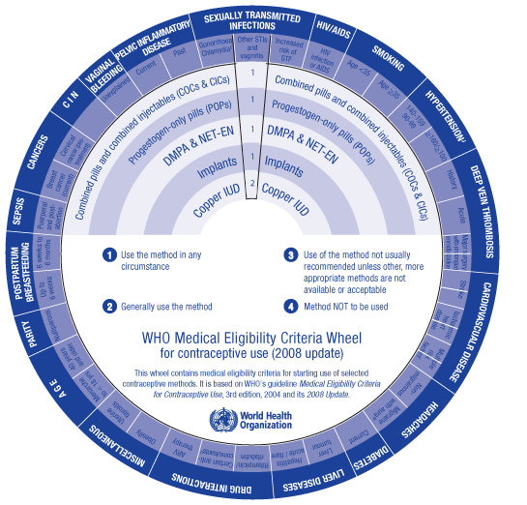
Medical Eligibility Criteria
What are medical eligibility criteria?
Define the categories.
Review the
job aid.

Slide 6
WHO’s Medical Eligibility Criteria
Categories for Contraceptive Use
Category | Description | When clinical judgment is available
1 | No restriction for use | Use the method under any circumstances
2 | Benefits generally outweigh risks | Generally use the method
3 | Risks usually outweigh benefits | Use of method not usually recommended, unless other methods are not available/acceptable
4 | Unacceptable health risk | Method not to be used
Source: WHO, 2015.

Slide 7
WHO’s Medical Eligibility Criteria
Categories for Contraceptive Use
Category | When clinical judgment is limited
1 | Use the method
2
3 | Do not use the method
4
Source: WHO, 2015.

Slide 8
Category 1 and 2 Examples (not inclusive):
Who Can Use Copper IUDs
WHO Category | Conditions (selected examples)
Category 1 | ≥20 years, cervical ectopy, uterine fibroids without distortion of the uterine cavity, irregular bleeding without heavy bleeding, breastfeeding, history of or acute DVT/PE
Category 2 | Menarche to <20 years, nulliparous, heavy or prolonged bleeding, severe dysmenorrhea, anemia
Source: WHO, 2015.

Slide 9
Category 3 and 4 Examples (not inclusive):
Who Should Not Use Copper IUDs
WHO Category | Conditions (selected examples)
Category 3 | 48 hours to <4 weeks postpartum, ovarian cancer/if initiating use, high individual risk of STI/ if initiating use
Category 4 | Pregnancy, unexplained vaginal bleeding (prior to evaluation), current PID or gonorrhea, chlamydia, endometrial or cervical cancer/if initiating use
Source: WHO, 2015.

Slide 10
Assessing women for risk of STIs
A woman who has Gonorrhea or Chlamydia should not have an IUD.
STIs may be difficult to diagnose clinically, and Lab tests are expensive and not always available.
The only indicator can be her behavior which may place her at high risk. Ask the woman to consider her own risk and think if she might have an STI.

Slide 11
Possible Risky Situations for STI Include:
Sexual partner has STI symptoms such as pus from the penis, pain or burning during urination, and open sores on genitalia.
She or her partner was recently diagnosed with an STI.
She has more than one partner recently.
Her sexual partner has had had other partners recently

Slide 12
IUD Use by Women living with HIV Infection
WHO Eligibility Criteria
Condition | Category
 | Initiate | Continue
Asymptomatic or mild HIV clinical disease | 2 | 2
Severe or advanced HIV clinical disease | 3 | 2
High risk of HIV | 2 | 2
IUDs are safe for the majority of women with HIV, whether or not they are on ARVs
Initiation is not recommended if the woman has severe or advanced HIV clinical disease
Encourage dual method use
Source: WHO, 2015.

Slide 13
IUD Use by Postpartum Women
Women less than
48 hours postpartum
can have copper IUD inserted
Women 48 hours to
4 weeks postpartum generally should not initiate IUDs
No restrictions starting at 4 weeks postpartum
Women with current puerperal sepsis should not have IUD inserted
WHO Eligibility Criteria
Characteristic/ Condition | Category
<48 hours | 1
48 hours to <4 weeks | 3
≥4 weeks | 1
Puerperal sepsis | 4
Source: WHO, 2015.

Slide 14
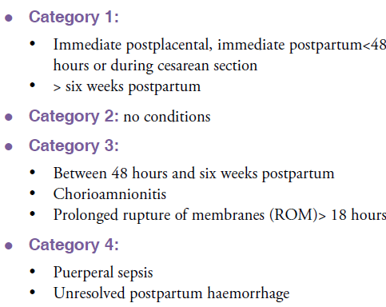
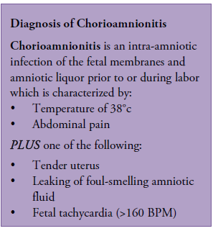
WHO Medical Eligibility Criteria and Screening for PPIUD
Notes:
Medical Eligibility Criteria and Screening​ for PPIUD (15 mins)
Discussion ​
Recap the WHO MEC criteria and determine whether the participants understand these criteria and are comfortable using the MEC wheel and the digital app. ​
Go through the slide -14 and discuss the criteria and conditions eligible for safe use of IUDs in the immediate postpartum period. New app for WHO's Medical eligibility criteria for contraceptive use
Distribute handout # 8the CL for Pre-insertion screening for PPIUD ​ and review the conditions that contradict the insertion of IUDs in the postpartum period If the woman has any of these conditions, counsel her for an alternate method. If she insists on having an IUD, ask her to come back after 4 weeks. These conditions include:
Chorioamnionitis​
Postpartum endometritis/metritis ​
Puerperal sepsis
More than 18 hours from rupture of membranes to delivery of the baby​
Unresolved postpartum hemorrhage​
Extensive genital trauma, the repair of which would be disrupted by the postpartum placement of the IUD​

Slide 15
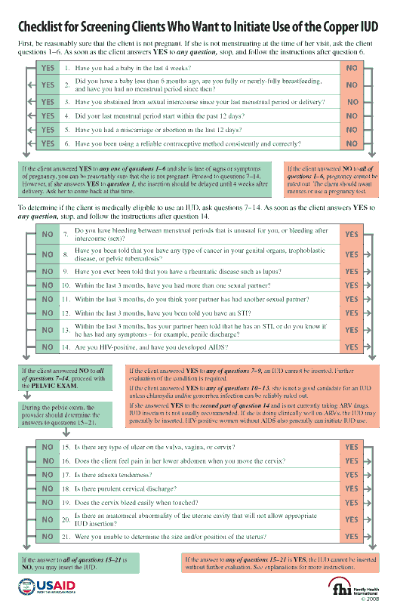
Screening for Interval Insertion
Read questions 7–21 on the checklist and match them with the conditions and categories on the MEC quick reference chart.
This set of questions identifies women who are not pregnant.
  Are postpartum
This set of questions identifies women who should not use IUDs.
The provider uses these questions during the pelvic exam to identify any category 3 and 4 conditions.
Notes:
Distribute the Handout # 7 for the Screening checklist for Interval IUD. Allow participants to review it.
Conduct short case scenarios in the session plan on interval IUDs to allow participants to become familiar and practice using the screening checklist.

