Slide 1
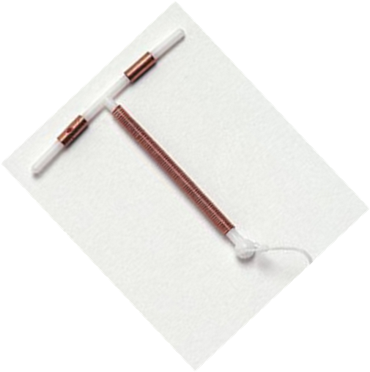
Copper-Bearing Intrauterine Devices (IUDs)
Interval and postpartum
Notes:
Read the session plan for details on conducting this session.

Slide 2
Learning Objectives
Describe the general characteristics of Copper IUDs, their effectiveness, mechanism of action, benefits and limitations, and common side effects.
Demonstrate the ability to screen clients for medical eligibility for interval and postpartum IUDs.
Describe when to initiate IUDs.
Explain what's different about postpartum IUDs.(PPIUD)
Explain to clients how IUDs are inserted and removed in the interval and postpartum periods.
Explain reasons to return to the clinic
Correct rumors and misinformation about Copper IUDs
Describe the management of side effects and potential complications.
Identify conditions that may require clients to discontinue use of Copper IUD OR switch to another method
Describe, demonstrate and practice the technique for the insertion and removal of Copper IUDs in the interval and postpartum periods
Notes:
The objectives of this module are as follows: By the end of this training session, participants will be able to: <click the mouse to advance through the objectives, reading each objective aloud >.
Tell participants that these are the module objectives. The module is broken up into interactive sessions to help you learn, practice, and retain the knowledge and skill(s) being covered. Training sessions include the use of methodologies such as PowerPoint presentations, skills practice in role plays, and discussions, demonstrations, and practice of procedures on models.

Slide 3
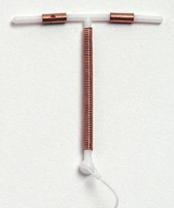
Copper-Bearing IUDs
Interval and postpartum
Session I: Characteristics of Copper IUDs

Slide 4
Copper IUDs:
Session Objectives
Describe key points of IUDs for providers and clients
Describe the basic characteristics of Copper IUDs
Describe the effectiveness of Copper IUDs
Describe the mechanism of action of Copper IUDs
Discuss the benefits, limitations, possible side effects, and complications of Copper IUDs
Discuss "Why do some women like the IUD?"
Notes:
The objectives of this module are as follows: By the end of this training session, participants will be able to: <click the mouse to advance through the objectives, reading each objective aloud >.

Slide 5
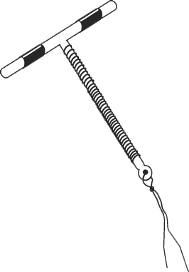
Copper IUDs: Key Points for Providers and Clients
Copper IUD
Very Safe: Copper IUDs act locally on the reproductive tract and have no systemic effects. For this reason, copper IUDs can be used safely by breastfeeding women and by women who cannot use hormonal contraceptives. They are long acting and easily reversible.
Very Effective: More than 99% effective in preventing pregnancies.
IUDS can be used by women who have never had a baby/never been pregnant without having any negative effect of their future fertility.
Notes:
Distribute the Handout # 3 -Copper IUD fact sheet. Review this with participants.
Adapted from WHO’s Decision-making tool for family planning clients and providers.

Slide 6
Copper IUDs: Key Points for Providers and Clients
Copper IUD
Some women have side-effects:
  Side effects usually get better after the first 3 months.
  Side effects include an increase in menstrual bleeding or cramps.
No protection against STIs or HIV/AIDS
  For STI/HIV and AIDS protection, use condoms.

Slide 7
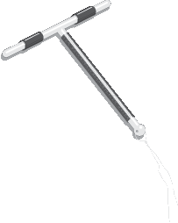
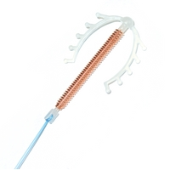
Copper IUDs-Types
  -TCu-380A, “Copper T” is most widely
  used copper IUD
  - Multiload 375 is another copper IUD
  commonly available in some
  countries
Copper T-380A
Multiload 375

Slide 8
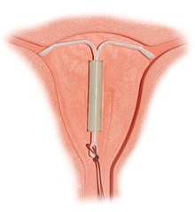
A snapshot of Hormonal IUDs
A T-shaped plastic device that steadily releases a small amount of the hormone levonorgestrel each day.
Insertion/removal procedure is almost similar to Copper IUDs.
Slightly more effective than copper IUDs
Shorter duration of use: 3-5 years, depending on brand.
Works by preventing sperm from fertilizing an egg.
Different side effects: lighter/no bleeding and hormonal side effects (such as headaches)
More expensive than copper IUDs
The details of the H IUD can be found in the method-specific module in the TRP https://www.fptraining.org/training/hormonal-intrauterine-device/sessions
Notes:
This slide is only to introduce H-IUD to trainees. As the H-IUD becomes more available, providers are more likely to hear of it or have a client ask about it. Being able to differentiate it from the copper IUD is valuable. The side effect profile and MEC recommendations are relatively different from the copper IUD due to it being a hormonal method.

Slide 9
Effectiveness of IUDs
In this progression of effectiveness, where would you place copper IUDs?
Implants Male Sterilization Female Sterilization
Progestin-only Injectables Combined Oral Contraceptives
Male Condoms Standard Days Method Female Condoms
Spermicides
More effective
Copper IUDs
Less effective
Notes:
One of the most effective and long-lasting methods.
Less than 1 pregnancy per 100 women using an IUD over the first year (6 per 1000 women who use the IUD perfectly) This means that 994 women out of 1000 women using the IUD will not get pregnant.
A small risk of pregnancy remains after the first year of use.
Studies have found that the CUT 380A is effective for 12 years. It is labeled for up to 10 years of use. Providers should follow national guidelines on when to remove the IUD. http://www.fphandbook.org

Slide 10
Relative Effectiveness of
Family Planning Methods
Method | # of unintended pregnancies among 1,000 women in 1st year of typical use
No method | 850
Withdrawal | 220
Female condom | 210
Male condom | 180
Pill | 90
Injectable | 60
IUD (Copper/ H-IUD) | 8 / 2
Female sterilization | 5
Vasectomy | 1.5
Implant | 0.5
Source: Trussell J., Contraceptive Failure in the United States, Contraception 83 (2011) 397- 404, Elsevier Inc.
Notes:
See the session plan for an activity to practice explaining the effectiveness of IUDs.

Slide 11
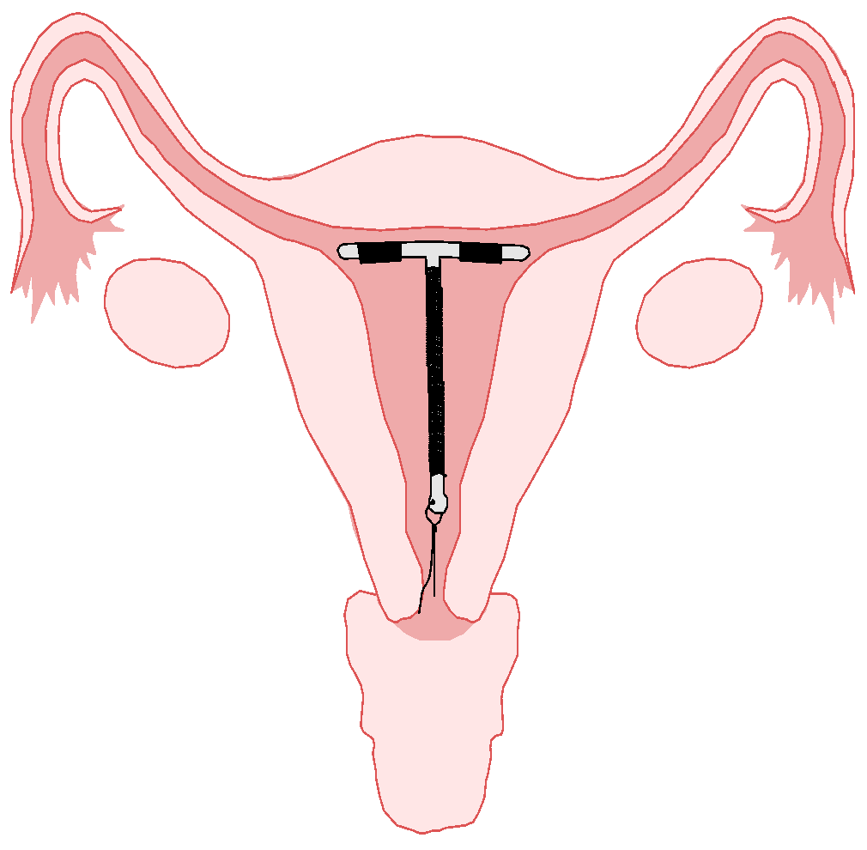
Copper IUDs: Mechanism of Action
It works by causing a chemical change in the uterus that interferes with the movement and viability of the sperm and prevents its ability to reach the egg for fertilization.

Slide 12
Copper IUDs: Characteristics
Safe and highly effective
Require no user action after insertion
Long-acting (up to 12 years)
Rapid return to fertility
No systemic effects
Have health benefits
Trained provider needed to insert and remove
Requires a pelvic examination
Possible pain or discomfort during insertion
Has potential side effects
Complications are rare but may occur
Does not protect against STIs/HIV
Source: CCP and WHO, 2018.
Notes:
See session plan for a group activity on the characteristics of IUDs

Slide 13
Copper IUDs: Health Benefits
IUDs are known to:
Prevent risks of pregnancy
Reduce risk of ectopic pregnancy
  Rate in IUD users is 12 in 10,000
  Rate in women using no contraception is
  65 in 10,000
May help protect against cervical and endometrial cancer

Slide 14
Copper IUDs: Health Risks
Rare:
May contribute to anemia if the woman has low iron reserves before insertion.
Pelvic Inflammatory disease (PID) may occur if the woman has chlamydia or gonorrhea at the time of insertion.

Slide 15

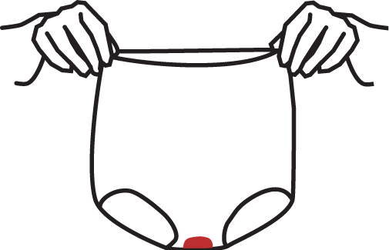
Possible Side-Effects
Copper IUD
If a woman chooses this method, she may have some side-effects.
They are not usually signs of illness. Usually resolve in 3-6 months
After insertion:
Other common side-effects:
Longer and heavier periods
Some cramps for several days
Bleeding or spotting between periods
More cramps or pain during periods
Some spotting for a few weeks
Notes:
Adapted from WHO’s Decision-making tool for family planning clients and providers.

Slide 16
Copper IUDs:
Counseling about Side Effects
Before insertion, describe common side effects:
  Heavier and/or prolonged menstrual bleeding
  Menstrual cramping
  Spotting between periods
Explain the side effects:
  These are not signs of illness
  Usually become less within the first 3–6 months
Encourage the client to come back with questions or concerns anytime.
If a woman finds it bothersome, counseling and support can help. Also, she can have it discontinued at any time she desires for whatever reason.
Notes:
Familiarize participants with the NORMAL tool for counseling bleeding pattern changes related to contraceptive use.

Slide 17
Potential Complications
Complications are rare and related to provider skills and adherence to Infection prevention practices:
Perforation of the wall of the uterus by the IUD or Instrument.
Infection
Expulsion
http://www.fphandbook.org

Slide 18
Why some women say they like the IUD
Very effective.
Long-lasting.
Is private - no one can tell that the woman is using an IUD.
No further action by the user or supplies are needed once the IUD is inserted.
http://www.fphandbook.org

Slide 19
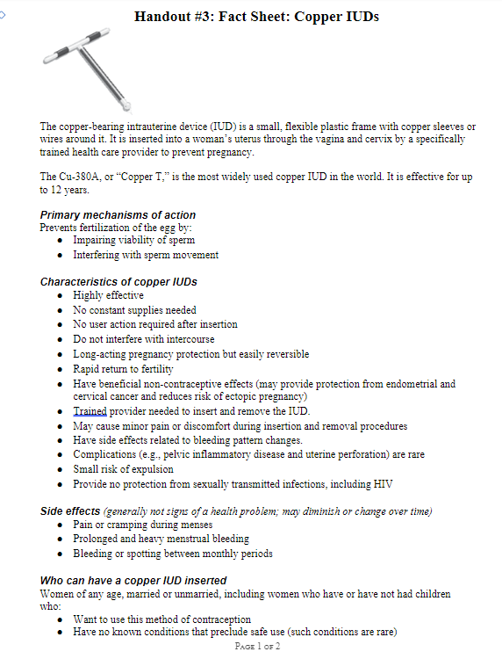
Fact Sheet
Review the fact sheet.
What additional questions or comments do you have about the characteristics of the IUD?
Notes:
Depending upon the option of training, distribute copies of Handout #3a if training for Interval timing OR Handout# 3b if for the postpartum period and both if the training option is combined( Interval and postpartum): Fact Sheet: Introduce the fact sheet and ask participants to review the H-IUD characteristics on the first page. Ask participants:
If there are any additional comments or questions. Discuss and clarify as needed.
To consider how they might be able to use the fact sheet in their work. Remind participants that although it might be useful for helping providers remember important information to share with clients, the fact sheet is not intended to be used as a brochure to be distributed to clients.
To review the rest of the information on the fact sheet, about medical eligibility for H-IUD insertion, Inform the participants that the next segment of the training will address these issues.

Slide 20
Summary
Copper IUD is a small device inserted inside the uterus by a trained provider.
Little action is required by the client once it is inserted.
Are very effective (more than 99 percent effective) in preventing pregnancy.
Are long-acting and easily reversible.
IUDs can work up to 12 years (depending on type) and can be easily removed by a provider whenever the woman wants.
Rapid return to fertility after an IUD is removed.
IUDs can be used by women who have never had a baby without having any negative effect on their future fertility.
IUDs can be used in the Immediate Postpartum period before discharge from the facility after childbirth. It is not recommended between 48 hrs-4-6 weeks after birth.
Are very safe.
They might increase menstrual bleeding or cramps.
They do not protect against STIs or HIV and AIDS

