Slide 1
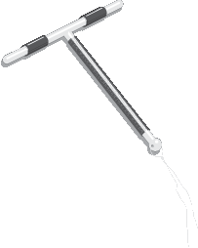
Copper-Bearing Intrauterine Devices (IUDs)
Advanced Slide Set
Copper T 380A

Slide 2
Copper IUDs:
Effectiveness
Spermicides
Female condom
Standard Days Method
Male condom
Oral contraceptives
DMPA
IUD (TCu-380A)
Female sterilization
Pregnancy rate when used correctly and consistently
Male sterilization
Pregnancy rate as commonly used
Implants
0
5
10
15
20
25
30
Percentage of women pregnant in first year of use
Source: Trussell, 2011.
Notes:
IUDs are among the most effective reversible methods of contraception, with failure rates of less than 1 percent. This chart compares the pregnancy rates for the Copper T IUD with the rates for other contraceptive methods.
The red rectangles show pregnancy rates for correct and consistent use, reflecting how often a contraceptive fails when it is used both correctly and consistently. The blue rectangles show pregnancy rates for methods as they are commonly used, reflecting how often a contraceptive fails in real-life situations, when it may not always be used correctly and consistently.
With IUDs there is virtually no difference between the pregnancy rates for correct and consistent use and pregnancy rates as commonly used. As the chart shows, other reversible contraceptive methods, such as barrier methods or oral contraceptives, may have low pregnancy rates with correct and consistent use but much higher rates for typical use.
With the IUD, the woman does not need to do anything on a regular basis. (If she wants, she can check for IUD strings once a month to make sure that it is still in place, but this is not mandatory). Because the effectiveness of IUDs does not depend on daily user compliance, pregnancy rates for the IUD are extremely low even as commonly used.
Women who use the IUD have about the same pregnancy rate as women who have chosen sterilization, which is a non-reversible method.
References: https://nam11.safelinks.protection.outlook.com/?url=https%3A%2F%2Fwww.ncbi.nlm.nih.gov%2Fpmc%2Farticles%2FPMC3638209%2Fpdf%2Fnihms458000.pdf&data=05%7C02%7CNeeta.Bhatnagar%40jhpiego.org%7Ca518bff647f247612b0808dc94840a86%7C26ef7fd22a7f4135a2e4de9acf168b2a%7C0%7C0%7C638548543734670326%7CUnknown%7CTWFpbGZsb3d8eyJWIjoiMC4wLjAwMDAiLCJQIjoiV2luMzIiLCJBTiI6Ik1haWwiLCJXVCI6Mn0%3D%7C0%7C%7C%7C&sdata=r%2FhOCI8xEVKqYie%2BNLeveaH%2B4my9oLtt9S1PEeKgcUs%3D&reserved=0

Slide 3
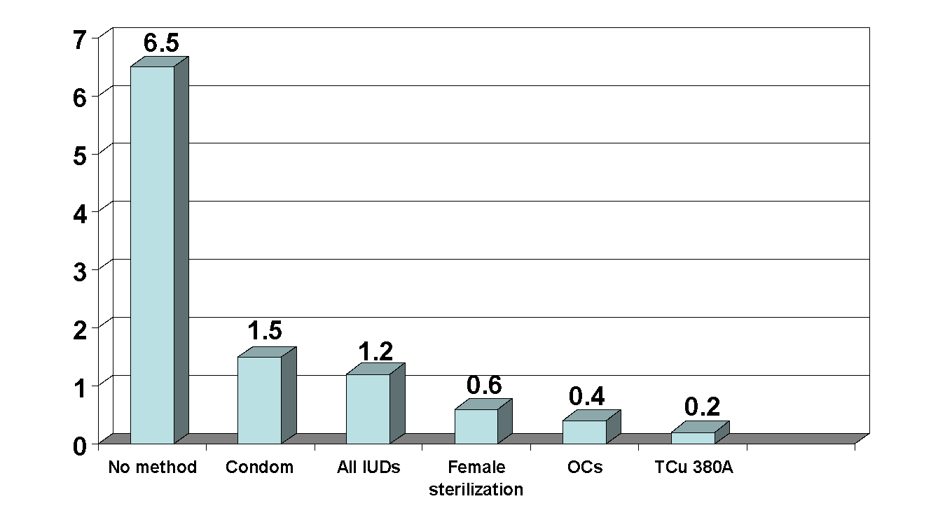
IUDs Reduce Risk of Ectopic Pregnancy
Ectopic pregnancy rate per 1000 woman years
Source: Sivin, 1991.
Notes:
Suggested script:
This slide displays the results of a study estimating risk of ectopic pregnancy for copper IUD users, for users of other contraceptive methods, and for women who do use any contraceptive method. If a pregnancy does occur in an IUD user, the risk of it being an ectopic pregnancy is slightly higher than in women using other methods. However, because the IUD is very effective in preventing pregnancy, the overall number of ectopic pregnancies is lower among users of the Copper T than among women who use other contraceptives and much lower compared to women who use no method of contraception.¹
Reference:
1. Sivin I. Alternative estimates of ectopic pregnancy risks during contraception. Am J Obstet Gynecol. 1991;165(6 Pt 1):1900.

Slide 4
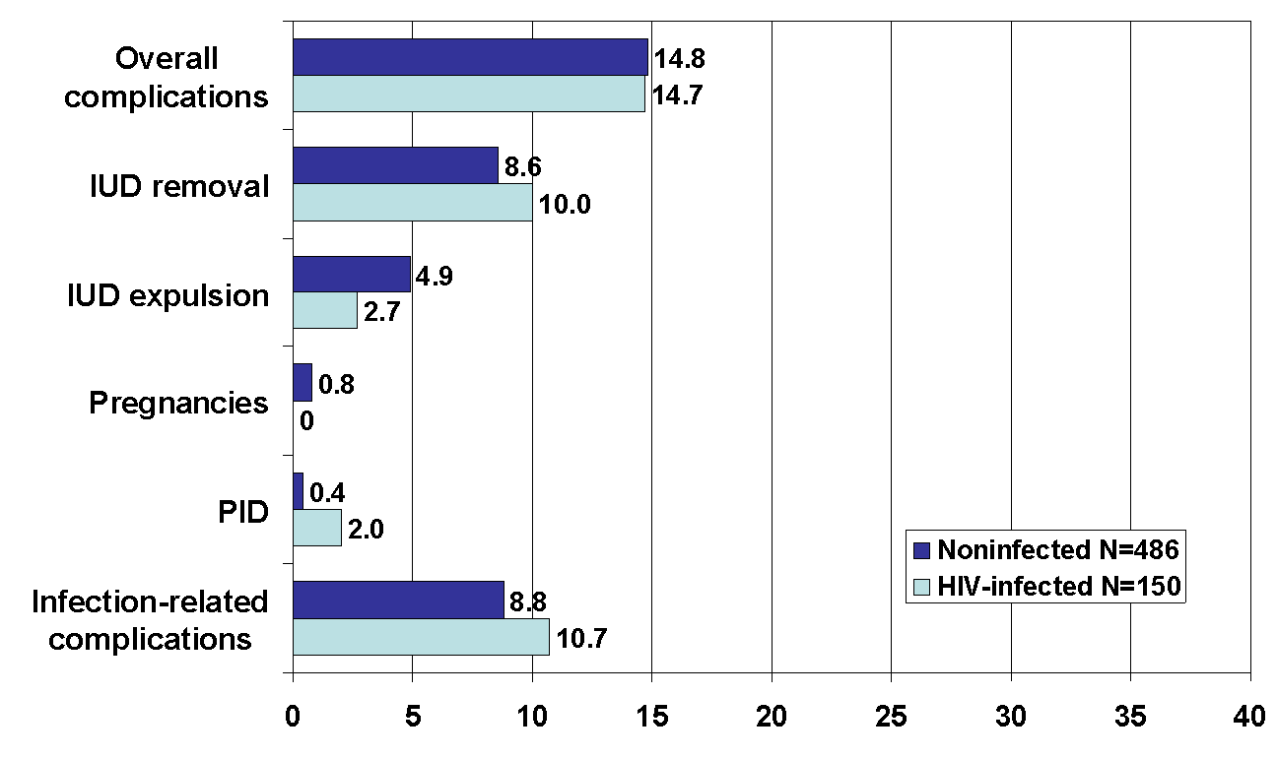
IUDs: Safe for Women with HIV
Little difference in complications between IUD users with and without HIV.
Percentage of women in Kenyan study
Source: Morrison, 2001.
Notes:
Suggested script:
Research suggests that it is safe for women with HIV to use IUDs. A two-year long study conducted in Kenya evaluated the health of two groups of women who received an IUD. The first group included 486 women who were HIV-negative. The second group was made up of 150 women who had HIV. Researchers looked for problems after insertion, such as IUD expulsion, pregnancy, and pelvic inflammatory disease. They also noted how often IUDs were removed due to infection, bleeding, or pain.
As you can see in this chart, the percentage of women reporting complications after IUD insertion was almost identical for the two groups—14.7 percent among women with HIV and 14.8 percent among women without HIV. The percentage of women reporting problems related to some type of infection—including pelvic tenderness or pain—was 10.7 percent among those who were HIV-positive and 8.8 percent among those who were HIV-free. Although women with HIV tended to have slightly more problems related to infection, this difference was not statistically significant.
There was little difference in side effects and infection-related complications between the two groups. Overall, 85 percent of the women—regardless of HIV status—had no problems with IUD use. These findings suggest that the IUD is an appropriate contraceptive method for women with HIV. This is especially true for women who want to limit births for an extended period of time, and for women who live in places were access to sterilization services is limited.¹
Reference:
Morrison CS, Sekadde-Kigondu C, Sinei SK, et al. Is the intrauterine device appropriate contraception for HIV-1-infected women? Br J Obstet Gynaecol 2001;108(8):784-90.
Additional references:
Browne H, Manipalviratn S, Armstrong A. Using an intrauterine device in immunocompromised women. Obstet Gynecol 2008;112:667–9.
Heikinheimo O, Lahteenmaki P. Contraception and HIV infection in women. Hum Reprod Update. 2009 Mar-Apr;15(2):165-76.
Stringer EM, Kaseba C, Levy J, et al. A randomized trial of the intrauterine contraceptive device vs. hormonal contraception in women who are infected with the human immunodeficiency virus. Am J Ob Gyn August 2007; 197(2): 144: e2 – e8.

Slide 5
IUD Use Does Not Increase HIV Transmission
Theoretical concern:
Does IUD use by women with HIV increase the risk of transmission to her partner?
Research found:
No post-insertion increase in cervical shedding
No increased risk of partner
exposure to higher dose of virus
Source: Richardson, 1999.
Notes:
Suggested script:
A theoretical concern about IUD use by women with HIV is that it could increase cervical shedding of HIV, thus increasing the risk of transmission to a sexual partner.
In a study conducted in Kenya, researchers calculated rates of cervical shedding of HIV-infected cells before IUD insertion and four months after insertion. The results showed no significant differences in cervical shedding among women with HIV before and after insertion. In other words, current evidence suggests that IUDs do not raise the amount of virus to which a woman’s sexual partner is exposed.¹
Reference:
1. Richardson BA, Morrison CS, Sekadde-Kigondu C, et al. Effect of intrauterine device on cervical shedding of HIV-1 DNA. AIDS 1999;13(15):2091-97.

Slide 6
Risk of PID Greatest in the First Few Weeks after IUD Insertion
8
7
6
5
(per 1,000 Woman-Years)
PID Rate
4
3
2
1
0
0
1
2
3
4
5
6
7
8
9
10
11
12
2
3
4
5
6
7
8+
Month (first year)
Year
Time Since IUD Insertion
Source: Farley, 1992.
Notes:
Suggested script:
This chart presents the risk of PID among IUD users per 1,000 woman years. It shows that the risk of an IUD user developing PID is greatest during the first month after insertion. This is most likely because if infection is present in the cervix at a time of insertion, inserting an IUD can carry bacteria from the lower to the upper genital tract. The risk decreases after the first month and remains low, similar to rates among non-IUD users.¹
It is important to note that, while the relative risk of PID among IUD users is higher in the first month, in terms of actual risk, it is still very low—993 out of 1,000 women-years do not develop PID in the first month.
Reference:
1. Farley TM, Rosenberg MJ, Rowe PJ, et al. Intrauterine devices and pelvic inflammatory disease: an international perspective. Lancet. 1992 Mar 28;339(8796):785-788.

Slide 7
Infertility is Linked to STIs,
Not to IUDs
 | IUD use in the past |  | Chlamydia antibodies
 | No | Yes | No | Yes
Infertile women with tubal occlusion | 93.6% | 6.4% | 61.7% | 38.3%
Infertile women without tubal occlusion (controls) | 94% | 6% | 64.6% | 35.4%
Pregnant women (controls) | 93.2% | 6.8% | 77.4% | 22.6%
Source: Hubacher, 2001.
Notes:
Suggested script:
Primary infertility is associated with a history of chlamydia infection, but is not associated with past IUD use. One case-control study conducted in Mexico compared 358 women with primary infertility and tubal occlusion, to 953 women with primary infertility who did not have tubal occlusion and to 584 first-time pregnant women.
Researchers collected information about the women's past use of contraceptives, including copper IUDs, previous sexual relationships, and history of genital tract infections. Each woman's blood was tested for antibodies to chlamydia.
As it shows in this table, the study found that approximately the same number of women in each group had used an IUD in the past, but that more women in the two infertile groups tested positive for chlamydia antibodies.¹
Reference:
1. Hubacher, D. et al. Use of copper intrauterine devices and the risk of tubal infertility among nulligravid women. New England Journal of Medicine 2001;345(8):561-567.

Slide 8
Expulsion Rates are Higher for Postpartum Insertion
Timing of Insertion | Expulsion Rates
Interval (> 4 weeks after delivery) | 1.8%
Intracesarean | 2.3%
Immediate after vaginal delivery (within 10 minutes) | 27.4%
Between 10 min and 4 weeks postpartum | 36.8%
Source: Averbach et al., 2020
Notes:
Though an expulsion is not a serious complication, an undetected expulsion puts the woman at risk of pregnancy. Studies have shown that the expulsion rate is generally higher during the postpartum period due to the changes the uterus undergoes as it returns to its normal size.
The systematic review and meta analysis from Source-Averbach et al, 2020 looked at Copper and LNG IUDs expulsion rates during various postpartum intervals and based on different types of delivery (vaginal vs. cesarean). For IUDs placed during the interval time period (defined as more than four weeks after delivery), the risk of complete expulsion was 1.8% among 13 studies. The pooled rate of complete LNG-IUD expulsion was still low when placed after cesarean delivery – 2.3%. Among women with LNG-IUDs placed immediately after vaginal deliveries, the pooled complete expulsion rates was much higher – 27.4%. Expulsion rates were unacceptably high among women with IUD placed between 10 min and 4 weeks postpartum – 36.8%. In this study, no data were provided separately for the first 48 hours postpartum (which is considered less risky in terms of expulsion than the time between 48 hours and 4 weeks after delivery).
MEC guidelines support placement of LNG-IUDs up to 48 hours after birth; however, data on early postpartum placement (>10 min but <48 hours) is limited, as many studies do not differentiate this period from late postpartum (48 hours to 4 weeks). Therefore, when feasible, provision of IUDs immediately postpartum (within 10 minutes after placental delivery) may result in a lower expulsion risk than early postpartum placement and a significantly lower expulsion rate than late postpartum placement.
Clients choosing to have the IUD inserted immediately postpartum should be counseled that the risk of expulsion is greater if the IUD is inserted during this period. The client choosing postpartum insertion should also be counselled on immediate vs late postpartum insertion in order for the client to be able to make an informed choice regarding postpartum insertion.
Reference: Sarah H Averbach , et al. Expulsion of intrauterine devices after postpartum placement by timing of placement, delivery type, and intrauterine device type: a systematic review and meta-analysis. Am J Obstet Gynecol. 2020 Aug;223(2):177-188

