Slide 1
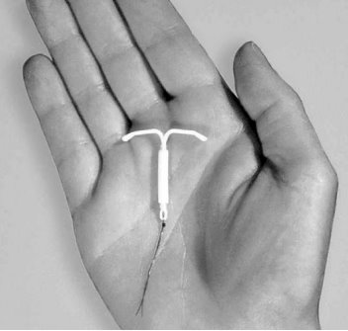
Hormonal Intrauterine Devices (H-IUDs)
Session III: Providing H-IUDs

Slide 2
Session Objectives
Describe the timings for initiation of H-IUDs.
Correcting rumors and misinformation about H- IUDs
Describe in simple language what a client can expect before, during, and after an IUD insertion.
Describe and discuss the management of side effects and potential complications

Slide 3
You May be Able to Get Your H-IUD Now
Having menstrual cycles or switching from a non-hormonal method | If menstrual bleeding started in last 7 days, can insert IUD now. No back up needed If menstrual bleeding started more than 7 days ago, can insert IUD now if reasonably certain she is not pregnant. No need to wait for next menstrual period. Need a backup method for the first 7 days after insertion.
Switching from a hormonal method, if she has been using method consistently and correctly or otherwise certain not pregnant. | If menstrual bleeding started in last 7 days, can insert IUD now. No backup method needed. If menstrual bleeding started more than 7 days ago, can insert H-IUD now. Need a backup method for the first 7 days after insertion. If switching from an injectable, can have the H-IUD inserted when the repeat injection would have been given. No backup method needed.
Notes:
Discuss the timing of H-IUD insertion:
Having menstrual cycles or switching from a non-hormonal method:
The H-IUD can be inserted within the first 7 days after the start of menstrual bleeding or anytime during the menstrual cycle, as long as the woman is not pregnant. There is no need for a backup method.
Note that some providers prefer to insert an H-IUD during the last few days of menstruation when the cervical opening is a little larger than usual and pregnancy can be ruled out based on the fact the woman is currently menstruating. However, it is easier to examine for signs of reproductive tract infections when a woman is not menstruating. Therefore, it is recommended that H-IUDs can be inserted at the client’s convenience if the provider can be reasonably sure the client is not pregnant.
If it is more than 7 days after the start of her monthly bleeding, she can have the H-IUD inserted any time if it is reasonably certain she is not pregnant. She will need a backup method for the first 7 days after insertion.
If switching from a hormonal method:
An H-IUD can be inserted immediately if she was using the method consistently and correctly or if it is otherwise reasonably certain she is not pregnant. Additionally:
If her monthly bleeding started within the last 7; no need for a backup method
If it is more than 7 days after the start of her monthly bleeding, she will need a backup method for the first 7 days after insertion.
If she is switching from an injectable, she can have the H-IUD inserted when the repeat injection would have been given. No need for a backup method.
Remind participants that backup methods include abstinence, male and female condoms, spermicides, and withdrawal. Spermicides and withdrawals are the least effective contraceptive methods. If possible, give her condoms.

Slide 4
You May be Able to Get Your H-IUD Now
No monthly bleeding (not related to childbirth or breastfeeding) | Can be inserted any time if reasonably certain that she is not pregnant. Use a backup method for the first 7 days after insertion.
H-IUD can be inserted in first 2 days after you give birth, whether or not you are breastfeeding | Can insert within 48 hours after birth (if no postpartum infection). Special training needed. Can be inserted during a cesarean delivery after removal of placenta and before closure of uterus
More than 2 days but less than 4 weeks after giving birth | Between 48 hours and 4 weeks after birth, delay insertion. Offer condoms or another method if she is not fully breastfeeding
Notes:
No monthly bleeding (not related to childbirth or breastfeeding)
An H-IUD can be inserted any time if it can be determined that she is not pregnant. Use a backup method for the first 7 days after insertion.
Postpartum insertion (regardless of breastfeeding status):
An H-IUD can be inserted within 48 hours postpartum if the provider has received adequate training in the procedure and there is no infection or bleeding complications.
The client should be counseled appropriately prior to delivery, during antenatal contacts, early labor or following delivery when she is comfortable.
H-IUD insertion within 48 hours after giving birth is considered safe, including immediately after a caesarean section delivery.
An H-IUD insertion following a vaginal delivery can be done during the first 10 minutes after delivery of the placenta.
It would be helpful to note insertion for cesarean (the timing) as well
If it is more than 48 hours after giving birth, delay until 4 weeks or more postpartum, when the uterus returns to its normal size. If a women is not fully breastfeeding, a backup method should be offered to be used until she can return for insertion.
Although the expulsion rate for postpartum insertions is generally higher, it may be advantageous for women who may not be able to return for insertion later.
Clients choosing to have the H-IUD inserted immediately postpartum should be counseled that the risk of expulsion is greater if the H-IUD is inserted during this period.

Slide 5
You May be Able to Get Your H-IUD Now
If not inserted within 2 days after birth, H-IUD can be inserted any time after 4 weeks postpartum, for fully or nearly fully breastfeeding women | If monthly bleeding has not returned and less than 6 months postpartum, can insert IUD anytime. No backup method needed. If monthly bleeding has not returned and more than 6 months postpartum, can insert IUD anytime if reasonably certain that woman is not pregnant. Use backup method for first 7 days after insertion. If monthly bleeding has returned, can have H-IUD inserted as advised for women having menstrual cycles (as discussed earlier)
If not inserted within 2 days after birth, H-IUD can be inserted any time after 4 weeks postpartum, for women who are partially breastfeeding or not breastfeeding | If monthly bleeding has not returned, insert anytime if it can be determined that she is not pregnant. Use backup method for first 7 days after insertion. If monthly bleeding has returned, can have H-IUD inserted as advised for women having menstrual cycles (as discussed earlier)
Notes:
Fully or nearly fully breastfeeding:
If not inserted within 48 hours after birth, H-IUD can be inserted anytime after 4 weeks postpartum.
If less than 6 months postpartum and monthly bleeding has not returned, an H-IUD can be inserted anytime from 4 weeks to 6 months after giving birth. No need for a backup method.
If more than 6 months postpartum and monthly bleeding has not returned, H-IUD can be inserted anytime if reasonably certain she is not pregnant. A backup method should be used for the first 7 days after insertion.
If monthly bleeding has returned, she can have the H-IUD inserted as advised for women having menstrual cycles (as discussed earlier).
Partially breastfeeding on not breastfeeding:
If not inserted within 48 hours after birth, H-IUD can be inserted anytime after 4 weeks postpartum.
If her monthly bleeding has not returned, she can have the H-IUD inserted anytime if reasonably certain she is not pregnant. She will need a backup method for the first 7 days after insertion.
If her monthly bleeding has returned, she can have the H-IUD inserted as advised for women having menstrual cycles, (as discussed earlier).

Slide 6
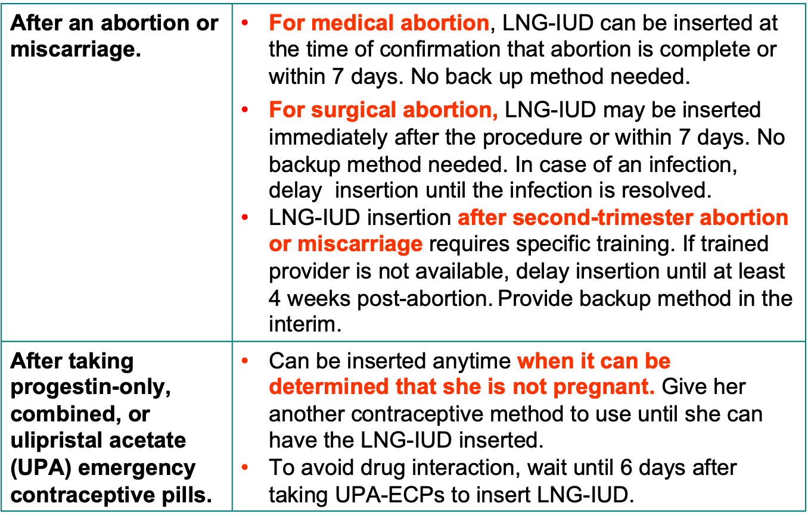
You May be Able to Get Your H-IUD Now
H-IUD
H-IUD
H-IUD
H-IUD
H-IUD
Notes:
After an abortion or miscarriage:
After medical abortion: An IUD can be inserted, at the time of confirmation that abortion is complete or within 7 days. No back up needed. Note that other contraceptive methods (oral contraceptive pills, patch, ring, contraceptive implant or injectables), can be initiated at the time of administration of the first pill of the medical abortion regimen.
After surgical abortion: H-IUD may be inserted immediately after the procedure or within 7 days. No back up needed
If infection is present, an H-IUD can be inserted after infection is treated and fully resolved. Offer condoms or another method to use in the meantime.
H-IUD insertion after second-trimester abortion or miscarriage requires specific training. If not specifically trained, delay insertion until at least 4 weeks after miscarriage or abortion. Provide an optional method in the interim.
After taking emergency contraceptive pills -- progestin-only or combined regimen, or ulipristal acetate (UPA):
H-IUD, can be inserted at any time when it can be determined that she is not pregnant (for example, after the start of her next monthly bleeding).
After taking UPA, in order to avoid drug interaction, wait for 6 days to insert H-IUD.
Give her a backup method or oral contraceptive pills to use until she can have the H-IUD inserted.

Slide 7
Correcting Rumors and Misconceptions about H-IUDs
Rumor/Misconception | Reality
Causes pain during sex | Does not cause pain during sex. Occasionally the partner can feel the strings if they are cut too short or too long.
It prevents pregnancy by causing an abortion | The mechanism of action of the H-IUD is to prevent the egg and sperm from meeting.
Absence of monthly bleeding means the woman is no longer fertile. | When the device is removed, bleeding will return and fertility is quickly restored.
Absence of bleeding is unhealthy. Dirty blood remains accumulated in the body. | Bleeding is reduced or stopped as the hormone in the H-IUD thins the lining of the uterus, so there is no bleeding. Dirty blood is not collected in the body. This helps in improving anemia.Women prefer reduced bleeding and amenorrhea.
Can move through the body, including to the heart and brain. | The IUD stays within the uterus like a seed within a shell. In very rare cases, during insertion, the device can go through the wall into the abdominal cavity.

Slide 8
Correcting Rumors and Misconceptions about H-IUDs
Rumor/Misconception | Reality
Increases risk of ectopic pregnancy | Reduces the risk of ectopic pregnancy. However, on a very rare occasion when an H-IUD fails, the risk of the pregnancy being ectopic is high.
Are only for women who have had children | Can be used by women who have had children and those who have not.
Are not safe for adolescents | Can be used by women of any age, including adolescents
An H-IUD can’t be inserted immediately postpartum | It can be inserted by a trained provider immediately after a vaginal delivery(within 10 minutes of delivery of the placenta) or up to 48 hours following vaginal delivery. It can be inserted during a cesarean section.
Increase the risk of getting STIs, including HIV | Do not increase the risk of any STI, including HIV.
Must be inserted during monthly bleeding | Can be inserted at any time during menstrual cycle when it is reasonably certain that the woman is not pregnant.

Slide 9
Providing IUD services
Explaining the Insertion procedure
Talk to the woman before, during, and after the insertion procedure and obtain consent.
Before the insertion:
Confirm that the woman still wants the IUD.
Counsel her on the insertion procedure and obtain consent.
Tell her gently, briefly, and in simple language what you are going to do.
Explain to her what she may expect during the procedure - It is generally quick but she may experience pain during placement. Postpartum insertions are less painful as the cervical os is open.
Respond to any questions that she may have
Notes:
Talking to the woman before the procedure helps in reducing anxiety and helps her to relax. Tell her that she may experience some pain during placement. Counsel her on the options for pain management, as given in the next slide.She also knows that she may experience some discomfort or a little pain.See session plan for details.

Slide 10
Pain management during IUD placement
All clients should be counseled on the potential pain experienced during IUD placement as well as the risks, benefits, and alternatives of different options for pain management.
Experience of pain during IUD placement is individualized and varies from discomfort to real pain.
Pain management includes provider concerns about ease of insertion especially in nulliparous women and women with a previous caesarean section.
A supportive environment, talking with the client throughout the procedure, and using breathing techniques may be helpful.
Paracervical block using 20 ml of 1% Lidocaine is recommended for pain management.
Ibuprofen (200–400 mg), paracetamol (325–1,000 mg), or other pain reliever may be given 30 mins before insertion to reduce cramping and pain
CDC Recommends

Slide 11
Providing IUD services
During Insertion:
Tell the woman what is happening, step by step.
Having a support person hold her hand and talking with her helps relieve anxiety
Alert her before a step that may cause pain or might startle her.
Ask from time to time if she is feeling okay.
Remind the client that she can request the procedure be paused or discontinued at any time.
Notes:
When the woman is relaxed, the insertion is easier for both the provider and the woman herself.

Slide 12
Providing IUD services
Post Insertion
Provide specific post-insertion instructions and reinforce key messages:
Tell the client to expect cramping and spotting or light bleeding for a few days after the insertion, in addition to other common side effects. For postpartum insertion, this is consistent with normal postpartum bleeding and cramps. Take note of heavy bleeding, indicative of Postpartum Hemorrhage.
Ask the woman to inspect the pads/cloth she uses during menses or the postpartum period for possible expulsion of the H-IUD. If expulsion is noticed, she should start using a backup method and come back as soon as possible to have the H-IUD reinserted or to decide on another method.
A client should return to the clinic immediately if she experiences any signs of possible complications such as excessive bleeding, pain abdomen, foul-smelling discharge, fever, string related issues.
The IUD does not affect breastfeeding. The woman can exclusively breastfeed her baby.
The IUD does not protect from HIV/STIs, so need to use condoms if at risk.
If convenient for the woman, schedule a return visit along with the first postnatal visit, OR any time she has problems or experiences the warning signs or wishes to discontinue the method.
Provide her with a client card with details of the type of IUD, date of insertion and date of removal/replacement.

Slide 13
Supporting New and Continuing Users
Give specific instructions
Expect cramping and pain –Suggest Ibuprofen 200-400mg, paracetamol 325-1,000mg, or other available pain relievers., except Aspirin as it has anti-clotting effect and may increase the bleeding.
Expect spotting during the first month after insertion
For PPIUD users, If these symptoms are mild and consistent with uterine involution, provide reassurance. Expect lochia but take note of heavy bleeding or clots indicative of postpartum Hemorrhage
Give the client in writing or a reminder card with:
  Type of IUD
  Date of Insertion
  Month and year for removal or replacement
  Where to go if she has any problem
Follow-up Visit: Schedule a follow–up after the next menses or 3-6 weeks after insertion OR if PPIUD then at 6 weeks at the first postnatal visit.
https://fphandbook.org/supporting-new-and-continuing-users-8

Slide 14
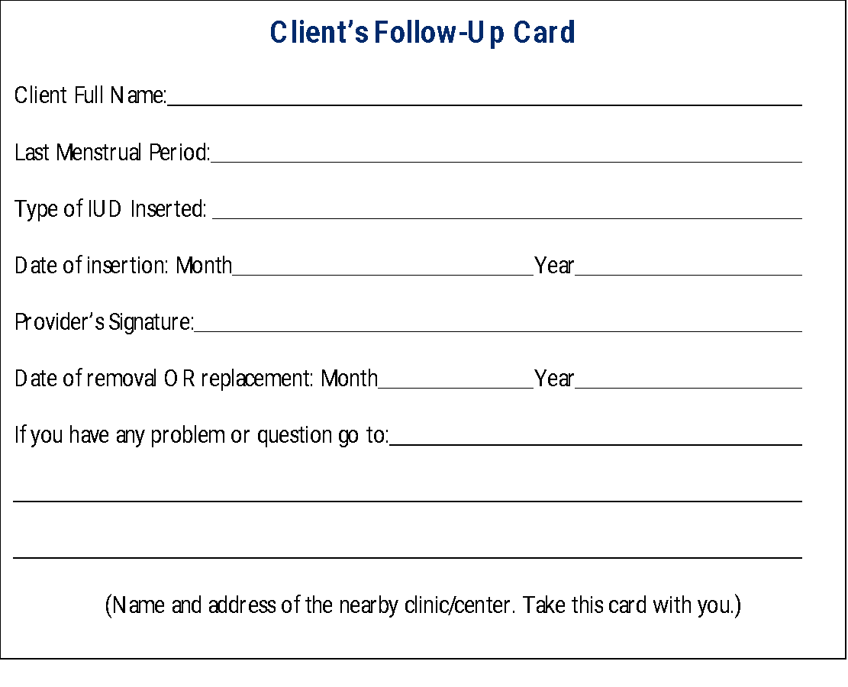
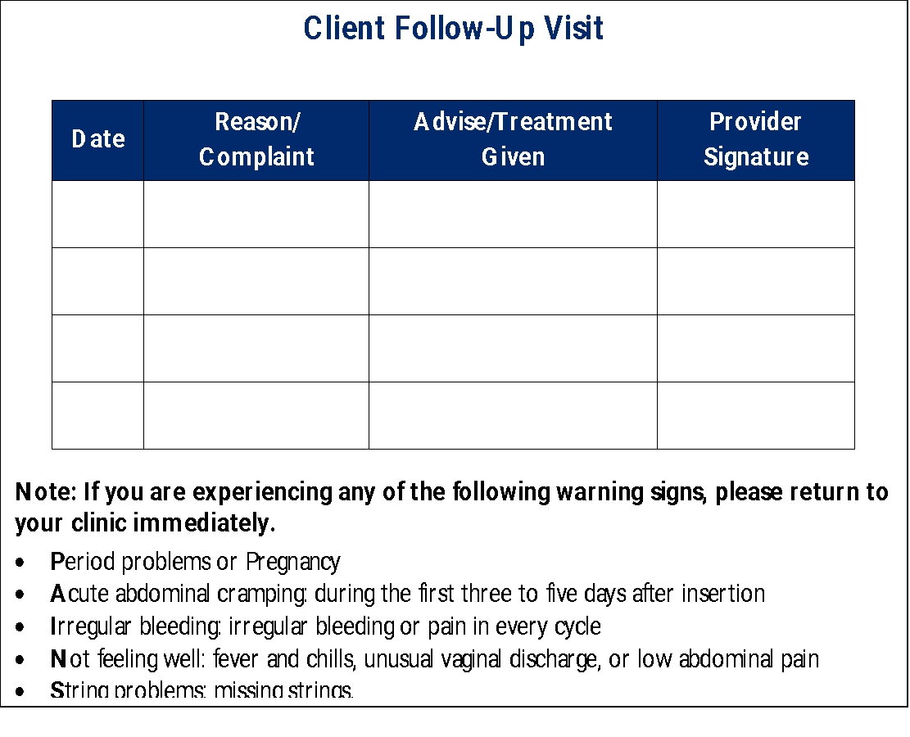
Sample of front and back of client card

Slide 15
How Can a Partner Help?
The client’s partner is welcome to participate in counseling and learn about the method and what support he can give to his partner. A male partner can:
Support a woman's choice of the IUD
Show understanding and support if she has side effects
Use condoms consistently in addition to the IUD if he has an STI/HIV or thinks he may be at risk of an STI/HIV
Help to remember when the IUD is due for removal
How can a partner help

Slide 16
“Come back anytime": Reasons to return
Assure every client that she is welcome to come back any time:
if she has problems, questions, wants another method or wants a pregnancy. She can discontinue the method at any time for any reason if:
She has a major change in health status.
The IUD was expelled, or she thinks it may have been expelled from her uterus.
She has symptoms of PID (increasing or severe pain in the lower abdomen, pain during sex, unusual vaginal discharge, fever, chills, nausea, and/or vomiting), especially in the first 20 days after insertion.
She thinks she might be pregnant.
She wants the IUD removed, for whatever reason
“Come Back Any Time”: Reasons to Return

Slide 17
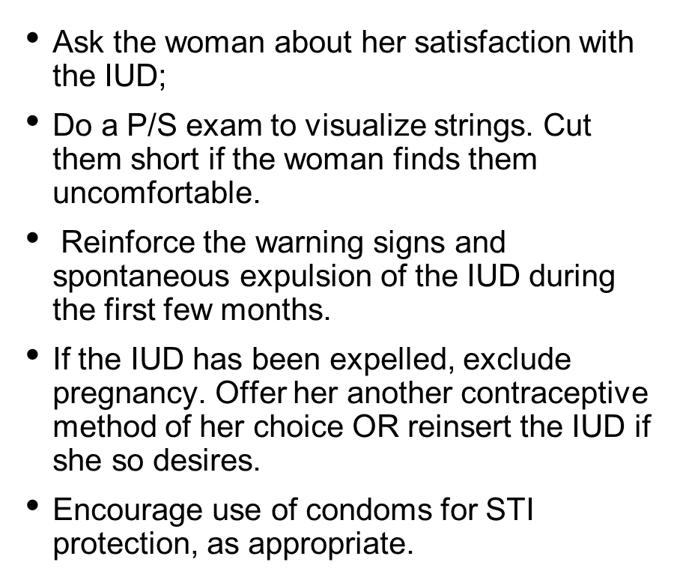
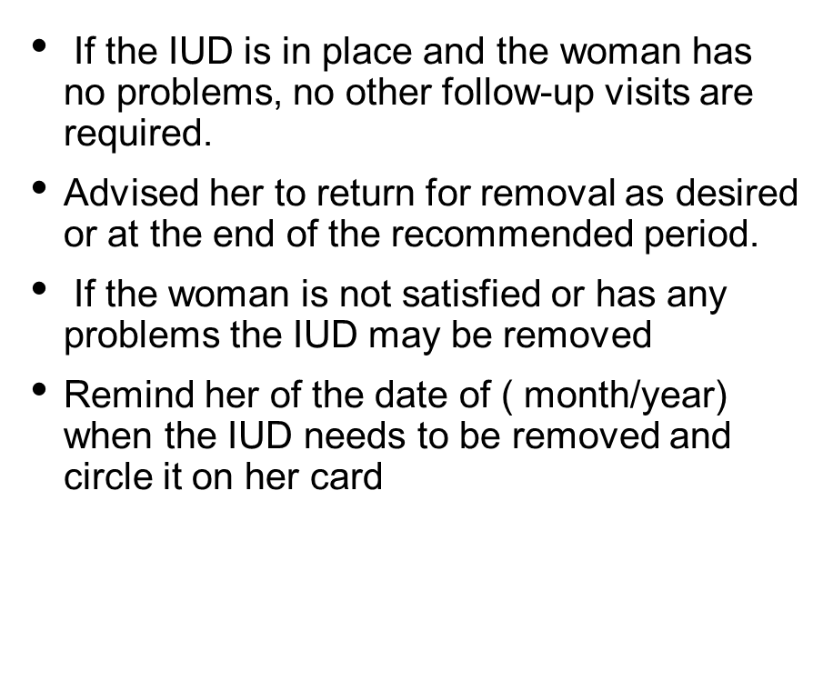
Follow up visit
Notes:
The World Health Organization (WHO) currently recommends at least one postnatal visit by 6 weeks after delivery. This is a good opportunity for women who have had an IUD inserted in the immediate/early postpartum period to receive follow-up services because, by 6 weeks postpartum, the uterus has undergone complete involution.
Remind the woman that she can have the IUD removed at anytime for any reason.

Slide 18
Warning signs
Period-related-bothersome bleeding changes
Abdominal pain
Infection: signs and symptoms of Infection-fever with chills, pain in the lower abdomen, foul-smelling discharge.
Not feeling well
String related- long, or missing strings or partner feeling the strings
Notes:
For PPIUD: If symptoms and physical findings are mild and consistent with postpartum uterine involution, reassure the client, making sure to answer any questions or concerns she may have .

Slide 19
Explaining the Removal Procedure to Client
IUD removal is quick and usually painless.
The provider:
Inserts a speculum to see the cervix and IUD strings.
Cleans the cervix and vagina with an antiseptic.
Asks woman to take slow, deep breaths, and to tell the provider if she feels pain during the procedure.
Using forceps, pulls the IUD strings slowly and gently until the IUD is completely out of uterus
Shows the removed IUD to the woman
A new IUD can be inserted at the same sitting if the woman so desires.
Source: CCP and WHO, 2018.
Notes:
Providers must not refuse or delay when a woman asks to have her H-IUD removed, whatever her reason, whether it is personal or medical. All staff must understand and agree that the client must not be pressured or forced to continue using the H-IUD. However, if a woman wants to remove the H-IUD because she finds side effects difficult to tolerate, first discuss the problems she is having. See if she would rather try to manage the problem than to have the H-IUD removed immediately.
Prior to removal, a provider should describe to the client what will happen during the removal procedure. Providers should explain that H-IUD removal is quick, and usually quite painless.
The simplified description is: <ask participants to take turns reading the steps aloud>
The provider inserts a speculum to see the cervix and H-IUD strings.
The provider carefully cleans the cervix and vagina with an antiseptic solution.
The provider asks the woman to take slow, deep breaths and to relax. The woman should say if she feels pain during the procedure.
The provider uses forceps to grab and pull the IUD strings slowly and gently until the H-IUD is completely out of the uterus.
Another H-IUD may be inserted immediately, if desired.
Removing an H-IUD is usually simple. It can be done any time of the month. Removal may be easier during monthly bleeding, when the cervix is naturally softened. If removal is not easy (e.g. H-IUD strings are inside of the uterine cavity or perforation is suspected), refer the woman to an experienced clinician who can use an appropriate removal technique.

Slide 20
Managing Side Effects and Complications of H-IUDs
Problem | Risk | Linked to | Reduced through/by
Expulsion | Generally low (about 10 per 100 users over 3 years) | Provider skill; age and parity of woman; timing of insertion | Provider training, supportive supervision
PID | Estimated at approximately 1 in 666 (depending on STI prevalence) | Presence of cervical infections or chlamydia/ gonorrhea at time of insertion | Screening women for risk of STIs prior to insertion
Perforation | Very low, 1 in 1,000 insertions | Provider skills/correct insertion technique; careful pelvic exam to determine size and position of uterus; breastfeeding status and time since delivery | Provider training, supportive supervision
Source: CCP and WHO, 2018.
Notes:
Ask participants: Among your colleagues and at work, what concerns do you hear about serious complications with H-IUD use? <allow participants to respond; click the mouse to reveal the information on the slide>
Potential complications of H-IUDs include:
Expulsions
PID
Perforations
Tell participants that complications, such as expulsions and PID are generally rare, and are linked to provider training/supportive supervision, skill and experience of the provider, and careful screening of the client for the risk of STIs prior to insertion.
CHOICE study (2014) found about 6 expulsions per 100 IUD users over the first year, with cumulative rate of about 10 expulsions per 100 IUD users over 3 years¹.
Although perforations are very rare, it is a potentially serious event if it does occur. According to the WHO, rates of perforation at the time of insertion are about 1 in 1,000.
The risk of perforation is directly linked to the skill and experience of the provider. Provider training, availability of the supportive supervision, and carefully following the instructions for H-IUD insertion reduces the risk of perforation the uterus.
Breastfeeding status and time since delivery are known risk factors for perforation. A study conducted in 2017 identified breastfeeding and delivery within the last 36 weeks as two factors that independently raised the risk of perforation to up to 5.6 per 1,000 insertions
References:
Madden T, McNicholas C, Zhao Q, Secura GM, Eisenberg DL, Peipert JF. Association of age and parity with intrauterine device expulsion. Obstet Gynecol. 2014;124(4):718–726
Barnett C, Moehner S, Do Minh T, Heinemann K. Perforation risk and intra-uterine devices: results of the EURAS-IUD 5-year extension study. Eur J Contracept Reprod Health Care. 2017 Dec;22(6):424-428)

Slide 21
Signs of Possible H-IUD Complications
Advise client to return immediately in case of:
Signs and symptoms | Possible Cause
Bleeding and severe abdominal cramping within a few days post-insertion | Perforation
Unexplained vaginal bleeding (e.g. after a pattern of bleeding has been established) or pain in every cycle | Partial expulsion, perforation, infection, dislocated IUD
Fever, chills, unusual/foul-smelling vaginal discharge, low abdominal pain | Infection (PID)
Missing IUD strings, missed period or symptoms of pregnancy | Expulsion, perforation, pregnancy
Notes:
During counseling, providers need to discuss the signs of possible H-IUD complications and advise the client to return immediately if any of the following signs or symptoms appear:
Bleeding or severe abdominal cramping during the first few days after insertion could indicate that the uterus may have been perforated at the time of the H-IUD insertion. For PPIUD users, If these symptoms are mild and consistent with uterine involution, provide reassurance. Expect Lochia but take note of heavy bleeding or clots indicative of postpartum Hemorrhage
Unexplained vaginal bleeding (e.g. unusual bleeding that occurs after a bleeding pattern has been established) or pain in every cycle could indicate partial expulsion of the H-IUD, uterine perforation, or infection.
Fever and chills, unusual/foul-smelling vaginal discharge, and lower abdominal pain could indicate an infection, such as pelvic inflammatory disease (PID), which is a concern, especially during the first month after the H-IUD is inserted. This is when PID, although rare, is most likely to develop.
Missed menstrual period (if occurs during the month following H-IUD insertion or after a regular bleeding pattern was established) or missing H-IUD strings could indicate H-IUD expulsion, uterine perforation, or/and pregnancy, either uterine or ectopic.

Slide 22
Managing H-IUD Side Effects and Complications:
Understanding the Client’s Concerns
Talk with the client, ensuring respectful care, privacy, and confidentiality.
Listen carefully and respectfully to the client’s concerns.
Discuss side effects, if any, and take her concerns seriously.
Tailor counseling to the client’s needs. Focus on key information and use words the client understands.
Check the client’s understanding.
Respect and support the client’s decisions.
Invite the client to come back at any time for any reason.
Source: CCP and WHO, 2018.
Notes:
Ask participants: What is the most important thing that you can do for women who experience side effects? <participants brainstorm; accept responses from several participants and click mouse to reveal the information on the slide>
Remind participants that:
Good counseling helps clients choose and use family planning methods that suit them best. The best counseling is tailored to the individual client’s needs. Go through the steps of successful counseling on the slide.
Counseling is part of the H-IUD competency-based counseling checklist.
Distribute copies of Handout#8 Counselling and screening for LNG -IUDs and review counselling steps with participants.

Slide 23
Managing H-IUD Side Effects and Complications:
Changes in Bleeding Patterns
Problem | Action/Management
Irregular bleeding/ spotting | Reassure client that this is common and not harmful, usually diminishes after few months
No monthly bleeding | Reassure her that many women eventually stop having monthly bleeding when using H-IUD and this is not harmful. Blood is not building up inside her. There is no need to lose blood every month.
Heavy or prolonged bleeding | Reassure client that this is common and not harmful, usually diminishes after few months Provide iron tablets If heavy bleeding continues, consider evaluating for other underlying causes
Counseling and reassurance are key
Source: CCP and WHO, 2018.
Notes:
Tell participants: As we have discussed, the best way to reduce the anxiety some women feel when they experience side effects is to provide detailed information about possible side effects during counseling, before the client decides to use the H-IUD. If side effects occur, the first step is to address the client’s concerns through a follow-up counseling and reassurance.
If a client is concerned about irregular bleeding or spotting:
Reassure that some women using H-IUDs experience irregular bleeding. It is not harmful and usually becomes less or stops after the first several months of use.
If irregular bleeding starts after several months of no bleeding, or you suspect that something may be wrong for other reasons, consider underlying conditions unrelated to method use.
If a client is concerned about absence of monthly bleeding:
Reassure that many women eventually stop having monthly bleeding when using the H-IUD and this is not harmful. There is no need to lose blood every month. It is similar to not having monthly bleeding during pregnancy. Having no bleeding doesn’t mean she is pregnant or infertile. Blood is not building up inside her. Some women are happy to be free from monthly bleeding.
If a client reports heavier or prolonged bleeding (longer than 8 days):
Reassure her that some women using H-IUDs experience heavier or prolonged bleeding. This is generally not harmful and usually becomes less or stops after the first 3-6 months of use.
Provide iron tablets if possible and tell her it is important for her to eat foods containing iron.
If heavier or prolonged bleeding continues or starts after several months of no bleeding, or if you suspect that something may be wrong for other reasons, consider underlying conditions unrelated to method use.
Distribute copies of Handout #9, NORMAL tool and review with participants

Slide 24
Managing H-IUD Side Effects and Complications:
Cramping and Mild Pain
Counseling and reassurance are key
Problem | Action/Management
Cramping and mild pain | She can expect cramping and pain in first 1–2 days after insertion Suggest ibuprofen/paracetamol, other pain reliever (not aspirin if she also has heavy bleeding) If cramping continues evaluate for other causes such as partial expulsion or perforation, displaced IUD. treat or refer. If cramping is severe but no underlying condition, discuss removing the H-IUD and. switching to another method For PPIUD, these symptoms may be consistent with postpartum uterine involution. Reassure the client and address any concerns that she may have.
Source: CCP and WHO, 2018.
Notes:
If a client reports cramping and pain:
Inform her she can expect some cramping and pain for the first day or two after insertion.
Suggest aspirin (325–650 mg), ibuprofen (200–400 mg), paracetamol (325–1000 mg), or other pain reliever. If she also has heavy or prolonged bleeding, aspirin should not be used because it may increase bleeding
If cramping continues beyond the first 2 days, evaluate for partial expulsion or perforation.

Slide 25
Managing H-IUD Side Effects and Complications:
Severe Pain in Lower Abdomen (Rare)
Rule out PID, ectopic pregnancy, ovarian cyst, perforation.
If ectopic pregnancy is suspected:
  Refer immediately to higher center for management..
If PID is suspected:
  Treat with appropriate antibiotics for gonorrhea, chlamydia and anaerobic bacterial infection.
  There is no need to remove the H-IUD.
If ovarian cyst or enlarged ovarian follicles suspected:
  Reassure client that they usually disappear on their own.
  No need to treat unless they grow abnormally large, twist, or burst.
  Can continue to use H-IUD.
  Follow up in 6 weeks to ensure the problem resolving.
Source: CCP and WHO, 2018.
Notes:
Many conditions can cause severe abdominal pain. Be particularly alert for additional signs or symptoms of ectopic pregnancy, which is rare but can be life threatening. The H-IUD reduces the risk of ectopic pregnancy but does not eliminate risk altogether. Refer at once for immediate diagnosis and care if ectopic or other serious health condition is suspected.
If ectopic pregnancy ruled out, assess for PID.
If possible, do abdominal and pelvic exam
If pelvic exam not possible, assess based on signs and symptoms
Treat immediately with appropriate antibiotics aimed at all possible causes of PID (gonorrhea, chlamydia, and anaerobic bacteria) or immediately refer for treatment
No need to remove IUD, unless infection does not improve then consider removing the IUD while continuing antibiotics
Closely monitor woman’s health
If ectopic pregnancy, PID, and perforation (discussed on the next slide) are ruled out, consider enlarged ovarian follicles or cysts

Slide 26
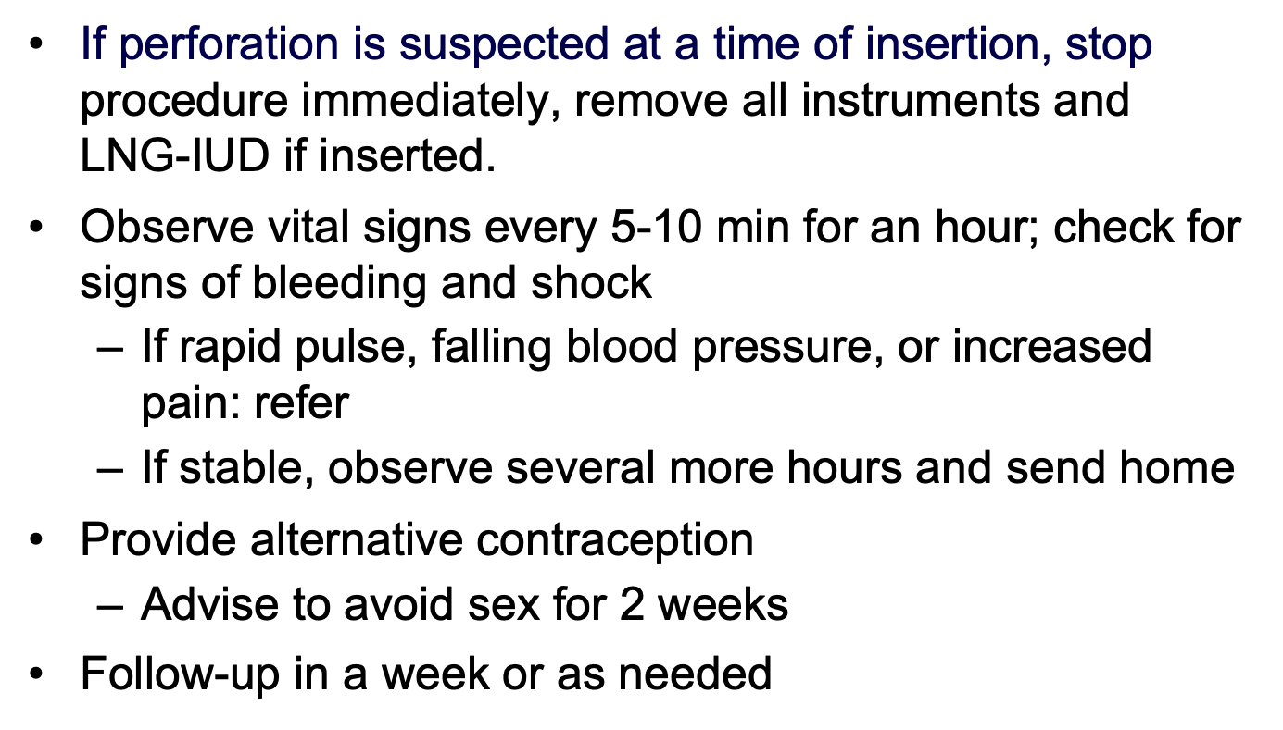
Managing H-IUD Side Effects and Complications:
Suspected Perforation
H-IUD
Source: CCP and WHO, 2018.
Notes:
If perforation is suspected at the time of insertion or sounding of the uterus, stop the procedure immediately (and remove the H-IUD if inserted). Observe the client in the clinic carefully.
For the first hour, keep the woman at bed rest and check her vital signs (blood pressure, pulse, respiration, and temperature every 5 to 10 min)
Check for signs of intraabdominal bleeding, such as low hematocrit or hemoglobin or rebound tenderness on abdominal examination. Observe for several more hours. If she has no signs or symptoms, she can be sent home. Help her choose another method.
If she has a rapid pulse and falling blood pressure or increasing pain around the uterus, refer her to a higher level of care.
If uterine perforation is suspected, based on clinical symptoms, within 6 weeks or more after insertion, refer the client for evaluation to a clinician experienced at removing such H-IUDs.

Slide 27
Managing H-IUD Side Effects and Complications:
Missing Strings
Ask the client:
  Whether and when she saw the H-IUD come out
  When did she have her last monthly bleeding
  If she has any symptoms of pregnancy
  If she has used a backup method since she noticed the H-IUD come out
Perform pelvic exam, gently probe for strings in cervical canal
If cannot locate strings, consider x-ray (if pregnancy can be ruled out) or ultrasound, or refer. Provide a backup method in meantime in case H-IUD came out and the woman did not notice.
Insert another H-IUD if expulsion is confirmed and she is not pregnant and still wants to use an H-IUD.
Source: CCP and WHO, 2018.
Notes:
Ask the client:
Whether and when she saw the H-IUD come out
When she had her last monthly bleeding
If she has any symptoms of pregnancy
If she has used a backup method since she noticed H-IUD come out
Always start with minor and safe procedures and be gentle. Check for the strings in the folds of the cervical canal with forceps. About half of missing H-IUD strings can be found in the cervical canal.
If string cannot be located in the cervical canal, either they have gone up into the uterus or the H-IUD has been expelled unnoted. Refer for ultrasound (or x-ray, if pregnancy ruled out). Give her a backup method to use in meantime, in case H-IUD came out and the woman did not notice.
Insert another H-IUD if expulsion is confirmed and she is not pregnant and still wants to use an H-IUD.

Slide 28
Managing H-IUD Side Effects and Complications:
Suspected Pregnancy
When pregnancy is suspected based of absence of bleeding and/or symptoms of pregnancy:
Assess for pregnancy, including ectopic pregnancy by pregnancy test or other means (e.g. ultrasound).
If the client is pregnant and wishes to continue the pregnancy:
  Explain that an IUD in the uterus during pregnancy increases the risk of preterm delivery or miscarriage often complicated with infection
  If possible, remove the H-IUD
If she chooses to keep the H-IUD, advise close follow-up for signs of miscarriage (with or without infection).
Source: CCP and WHO, 2018.
Notes:
When pregnancy is suspected based of absence of bleeding and/or symptoms of pregnancy:
Assess for pregnancy, including ectopic pregnancy, by pregnancy test and/or other means (e.g. ultrasound).
Explain that exposure of the fetus to an H-IUD does not increase the risk of birth defects. However, an H-IUD in the uterus during pregnancy increases the risk of preterm delivery or miscarriage, including infected (septic) miscarriage during the first or second trimester, which can be life-threatening.
If the woman does not want to continue the pregnancy, counsel her according to program guidelines.
If she continues the pregnancy:
Advise her that it is best to remove the IUD
Explain the risks of the pregnancy with an IUD in place. Early removal of the IUD reduces these risks, although the removal procedure itself involves a small risk of miscarriage.
If she agrees to removal and IUD strings are visible, gently remove the IUD or refer for removal
If she chooses to keep the H-IUD, explain that she could return at once if she develops any signs of miscarriage (vaginal bleeding, cramping, pain, abnormal vaginal discharge, or fever). A nurse or doctor should follow her pregnancy closely. She should see a nurse or doctor at once if he develops any signs of septic miscarriage.
If the H-IUD strings are not visible and cannot be found in the cervical canal, the H-IUD cannot be safely retrieved. Refer for ultrasound, if possible, to determine whether the H-IUD is still n the uterus. If it is (or if the ultrasound is not available) the H-IUD should be left in place, but her pregnancy should be followed closely. She should seek care at once if she develops any signs of septic miscarriage.
See Session Plan to conduct Role Plays and Case studies.

Slide 29
Managing H-IUD Side Effects and Complications:
Displaced OR Malpositioned IUDs
To achieve maximum effectiveness, IUDs should be positioned at the uterine fundus. Malposition happens when it is not at the fundus. This may happen due to anatomical uterine abnormalities, too small or too large uterus, inexperienced provider releasing the IUD in the cavity.
Malposition and displaced IUDs should be corrected especially if causing symptoms such as abnormal bleeding and pain and if pregnancy protection cannot be guaranteed.
Copper IUDs are more likely to result in contraceptive failure if they are dislocated than the H-IUD due to their mode of action. As long as the H-IUD remains within the cavity it seems that it will provide adequate protection.
Mal positioned IUDs can be diagnosed on a 3D ultrasound. If mal positioned, it should be removed and replaced or another effective method offered.
Malposition
Notes:
When pregnancy is suspected based of absence of bleeding and/or symptoms of pregnancy:
Assess for pregnancy, including ectopic pregnancy, by pregnancy test and/or other means (e.g. ultrasound).
Explain that exposure of the fetus to an H-IUD does not increase the risk of birth defects. However, an H-IUD in the uterus during pregnancy increases the risk of preterm delivery or miscarriage, including infected (septic) miscarriage during the first or second trimester, which can be life-threatening.
If the woman does not want to continue the pregnancy, counsel her according to program guidelines.
If she continues the pregnancy:
Advise her that it is best to remove the IUD
Explain the risks of the pregnancy with an IUD in place. Early removal of the IUD reduces these risks, although the removal procedure itself involves a small risk of miscarriage.
If she agrees to removal and IUD strings are visible, gently remove the IUD or refer for removal
If she chooses to keep the H-IUD, explain that she could return at once if she develops any signs of miscarriage (vaginal bleeding, cramping, pain, abnormal vaginal discharge, or fever). A nurse or doctor should follow her pregnancy closely. She should see a nurse or doctor at once if he develops any signs of septic miscarriage.
If the H-IUD strings are not visible and cannot be found in the cervical canal, the H-IUD cannot be safely retrieved. Refer for ultrasound, if possible, to determine whether the H-IUD is still n the uterus. If it is (or if the ultrasound is not available) the H-IUD should be left in place, but her pregnancy should be followed closely. She should seek care at once if she develops any signs of septic miscarriage.
See Session Plan to conduct Role Plays and Case studies.

Slide 30
H-IUDs: Summary
H-IUDs:
Are safe, private, highly effective, convenient, reversible, long lasting, cost-effective, easy to use, and appropriate for the majority of women
Offer important health benefits, including protection from endometrial cancers, and reduction of menstrual cramping and bleeding.
Providers can ensure safety by:
Informative counseling
Careful screening
Adherence to infection prevention practices
Proper technique and follow-up.
Notes:
H-IUDs have characteristics that make them a desirable family planning method for many women.
They are safe for almost all women.
They are highly effective and easy to use.
Fertility returns without a delay after having H-IUD removed
They have important health benefits
Appropriate counseling and screening for medical eligibility play an important role in the provision of safe and quality H-IUD services. Providers can use a simple screening tool to determine medical eligibility. Counselors must ensure that clients are aware of potential side effects, understand how H-IUD is inserted and can identify situations that require attention and follow-up. Providers can also ensure safety by adherence to infection prevention practices when inserting H-IUDs and following the correct technique of insertion and removal.. Family planning programs that offer H-IUDs benefit their clients by increasing their contraceptive options.
Distribute copies of Handout #11: Global handbook pages for LNG IUD for participants to read and refer as needed.

