Slide 1
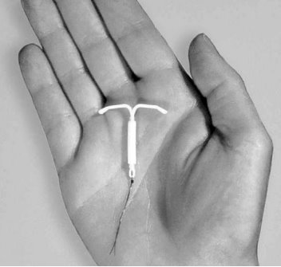
Hormonal IUDs (H-IUDs)
Interval and Postpartum
Session II: Who Can and Cannot Use H-IUDs?

Slide 2
Session Objectives
Describe who can and who cannot use H-IUDs.
Describe the Medical Eligibility Criteria for the safe use of H-IUDs in the interval and postpartum period.
Describe the use of a screening checklist for the safe use of H-IUDs in the interval and postpartum timing

Slide 3
H-IUDs are Safe for Most Women
Most women can use the H-IUD safely, including those who:
  Have or have not had children or never been pregnant
  Are married or not married.
  Are of any age, including adolescents
  Have just had an abortion or miscarriage (no infection)
  Are breastfeeding
  Have had PID in the past (treatment must have been completed)
  Have anemia
  Have asymptomatic or mild HIV, whether or not they are taking ARVs
  Are at a high risk of acquiring HIV
Notes:
Use slides to show women who can safely use H-IUDs:
Nearly all women can use H-IUDs safely and effectively.
Most health conditions do not affect safe and effective use of H-IUDs and only few conditions or situations may affect a woman’s eligibility to use H-IUDs.
The WHO medical eligibility criteria were developed to reassure providers about conditions that do not interfere with safe use of contraceptives and highlight all the conditions that affect a woman’s eligibility to use any given contraceptive method safely.
Source: CCP and WHO, 2018

Slide 4
Who Cannot Use the H-IUDs
  A woman should not use H-IUD if she:
  Has current untreated pelvic infection, current STI or is at high individual risk of STI
  Gave birth more than 48 hours but less than 4 weeks ago
  Was told that she has cancer of the uterus or cervix, or breast cancer
  Has unexplained vaginal bleeding
  Has serious liver disease, such as severe cirrhosis or liver tumor
  Has acute deep venous thrombosis (DVT)
  Has anatomical abnormality of the uterine cavity (e.g. uterine fibroid) that will not allow appropriate insertion
Notes:
Show this slide to describe the conditions when it is not recommended to insert the H-IUD.

Slide 5
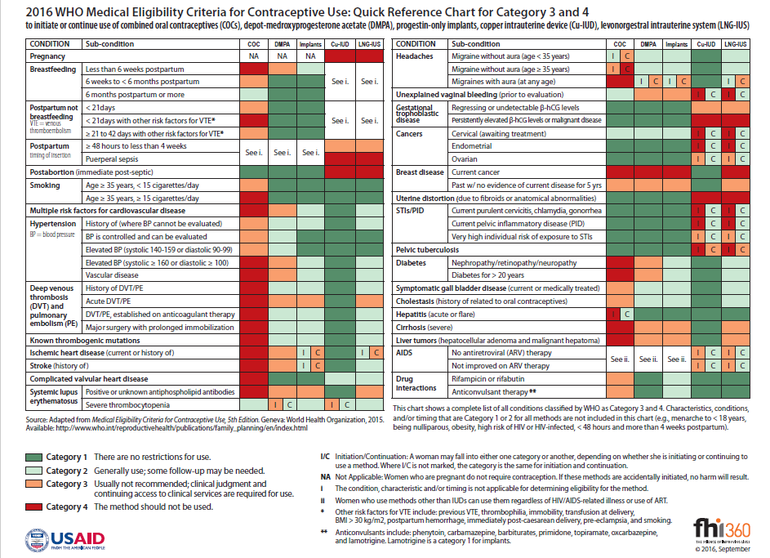
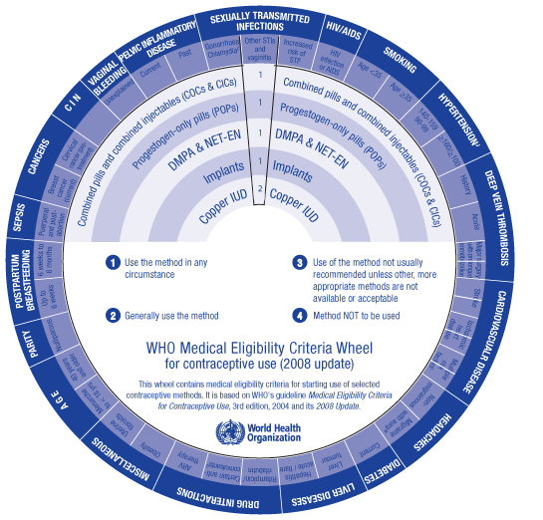
Medical Eligibility Criteria
What are the medical eligibility criteria?
Define the categories.
Review the
job aid.
Notes:
Discussion (5 min.)
This activity has two purposes:
To give participants an opportunity to share what they know about the eligibility criteria used in their national family planning guidelines or the WHO medical eligibility criteria (WHO MEC) so that the facilitator can determine whether the participants understand the criteria and how they are used or whether they need additional background information before proceeding.
To introduce job aids that help participants understand eligibility criteria (and that they may also use at their worksites), such as the WHO Medical Eligibility Criteria Wheel for Contraceptive Use, or the Quick Reference Chart for the WHO Medical Eligibility Criteria for Contraceptive Use, NEW App for WHOs MEC for contraceptive
WHO Digital app

Slide 6
WHO’s Medical Eligibility Criteria
Categories for Contraceptive Use
Category | Description | When clinical judgment is available
1 | No restriction for use | Use the method under any circumstances
2 | Benefits generally outweigh risks | Generally use the method
3 | Risks usually outweigh benefits | Use of method not usually recommended, unless other methods are not available/acceptable
4 | Unacceptable health risk | Method not to be used
Source: WHO, 2015.
Notes:
Use this slide to provide an overview of WHO MEC categories.
Category 1: For women with these conditions or characteristics, the method presents no risk and can be used without restrictions.
Category 2: For women with these conditions or characteristics, the benefits of using the method generally outweigh the theoretical or proven risks. Women with Category 2 conditions generally can use the method, but careful follow-up may be required.
Category 3: For women with these conditions or characteristics, the theoretical or proven risks of using the method usually outweigh the benefits. Women with Category 3 conditions generally should not use the method. However, if no better options for contraception are available or acceptable, the provider may judge that the method is appropriate, depending on the severity of the condition. In such cases, ongoing access to clinical services and careful follow-up will be required.
Category 4: For women with these conditions or characteristics, the method presents an unacceptable health risk and should not be used.
In some cases, a particular condition or characteristic is assigned to one category for initiation and another for continuation of the method. In other words, the category may depend on whether a woman with the condition wishes to initiate the contraceptive method or was already using that method when she developed the condition.

Slide 7
WHO’s Medical Eligibility Criteria
Categories for Contraceptive Use
Category | When clinical judgment is limited
1 | Use the method
2
3 | Do not use the method
4
Source: WHO, 2015.
Notes:
Explain that in situations where clinical judgment is limited, the four-category classification framework can be simplified into two categories. When simplified for these situations, categories 1 and 2 indicate that the method can be used, while categories 3 and 4 indicate that the woman is not medically eligible to use the method.
Distribute and demonstrate how to use the handout#4 WHO MEC Wheel or the handout#5 Quick Reference Chart.
Introduce the NEW App for WHOs MEC for contraceptive
Help the participants to install and access the digital app.This digital tool will facilitate the task of family planning providers in recommending safe, effective and acceptable contraception methods for women with medical conditions or medically-relevant characteristics.
Continue with slides 7-10 to provide some examples of the medical eligibility criteria for H-IUDs.

Slide 8
Category 1 and 2 Examples :
Who Can Use H-IUDs
WHO Category | Conditions (selected examples)
Category 1 | Post abortion 1st trimester, smoking (any number of cigarettes), obesity, varicose veins, heavy or prolonged bleeding (initiation only), cervical ectopy, uterine fibroids without distortion of the uterine cavity, endometriosis, irregular bleeding without heavy bleeding, anemia, hypertension with BP of less than 160/100 mmHg,
Category 2 | Menarche to <20 years, nulliparous, post abortion 2nd trimester, elevated blood pressure of ≥160/≥100 , PID (continuation), vascular disease, diabetes, history of DVT or stroke, migraine with aura (initiation)
Source: WHO, 2015.

Slide 9
Category 3 and 4 Examples (not inclusive):
Who Should Not Use H-IUDs
WHO Category | Conditions (selected examples)
Category 3 | Migraine with aura (continuation), severe cirrhosis, high individual risk of STI (initiation), acute DVT/PE, lupus with positive (or unknown) antiphospholipid antibodies
Category 4 | Pregnancy, unexplained vaginal bleeding (initiation prior to evaluation), puerperal sepsis or immediate post-septic abortion, current PID or cervical infection (initiation) Current breast cancer, distorted uterine cavity incompatible with IUD insertion"
Source: WHO, 2015.
Notes:
Activity (5mins):
After discussing the information on the slides 7-8, allow the participants to practice using the MEC Wheel and/or the Quick reference chart and the mobile app https://www.who.int/reproductivehealth/mec-app/en/ .
List 10-15 medical criteria on a flip chart. Ask participants to find the appropriate category on the WHO MEC Wheel , mobile app or the Quick Reference Chart. If time allows, this exercise can be made into a game using teams to determine the correct answers. Note that Quick Reference Chart focuses on Category 3-4 only, so if the condition is not there, it means the method can be used Ask several participants to share one thing that they know about the eligibility criteria in their national family planning/reproductive health guidelines (if they exist) or the WHO MEC.
Answer any questions that participants have about general medical eligibility issues or how to use the Quick Reference Chart or MEC Wheel and MEC app before moving on to the next slides.

Slide 10
Assessing women for risk of STIs
A woman who has current gonorrhea or chlamydia should not have an IUD inserted.
STIs may be difficult to diagnose clinically, and lab tests are expensive and not always available.
The only indicator can be her behavior which may place her at high risk. Ask the woman to consider her own risk and think if she might have an STI.

Slide 11
Possible Risky Situations for STI Include:
Sexual partner has STI symptoms such as pus from the penis, pain or burning during urination, and open sores on genitalia.
She or her partner was recently diagnosed with an STI.
She has more than one partner recently.
Her sexual partner has had had other partners recently
Notes:
https://fphandbook.org/contraceptives-clients-stis-including-hiv

Slide 12
H-IUD Use by Women with HIV Infection
WHO Eligibility Criteria
Condition | Category
 | Initiate | Continue
Asymptomatic or mild HIV clinical disease | 2 | 2
Severe or advanced HIV clinical disease | 3 | 2
High risk of HIV | 1 | 1
H-IUDs are safe for majority of women with HIV, whether they are on ARV or not.
Initiation is not recommended if the woman has severe or advanced HIV clinical disease.
Women at a high risk of acquiring HIV can safely use H IUDs
A woman who develops advanced or severe clinical disease while already using an H-IUD can continue to use the device
Encourage dual method use

Slide 13
H-IUD Use by Postpartum Women
WHO Eligibility Criteria
Characteristic/ Condition | Category
<48 hours, non-breastfeeding | 1
<48 hours, breastfeeding | 2
≥48 hours hours to <4 weeks | 3
≥4 weeks | 1
Puerperal sepsis | 4
Women less than
48 hours postpartum
can have H-IUD inserted
Women between 48 hours to 4 weeks postpartum generally should not get the IUDs
No restrictions starting at 4 weeks postpartum
Women with current puerperal sepsis should not have H-IUD inserted
Source: WHO, 2015.
Notes:
Tell participants: Let us take a closer look at the conditions and categories pertaining to postpartum clients.
Use slides to present the following:
Women less than 48 hours postpartum can safely have the H-IUD inserted, whether or not they are breastfeeding
Women who are between 48 hours and 4 weeks postpartum should generally not initiate H-IUD use because of the increased risk of expulsion.
After 4 weeks postpartum, women can have the H-IUD inserted anytime, whether or not they are breastfeeding, as long as it is reasonably certain they are not pregnant
H-IUD use has not been demonstrated to have a detrimental effect on breastfeeding when inserted, at 4 weeks postpartum or later. One study showed that insertion of the H-IUD immediately postpartum (less than 48 hours) was associated with decreased breastfeeding duration compared with delayed insertion, but other studies have not found this. It is generally considered safe for breastfeeding women to have the H-IUD inserted immediately postpartum (category 2).
Women with puerperal sepsis should NOT have the H-IUD inserted
Note to facilitator: Consider using this slide if the participants will be offering services to postpartum clients. It provides a concise overview of medical eligibility issues related to H-IUD use by these clients.

Slide 14
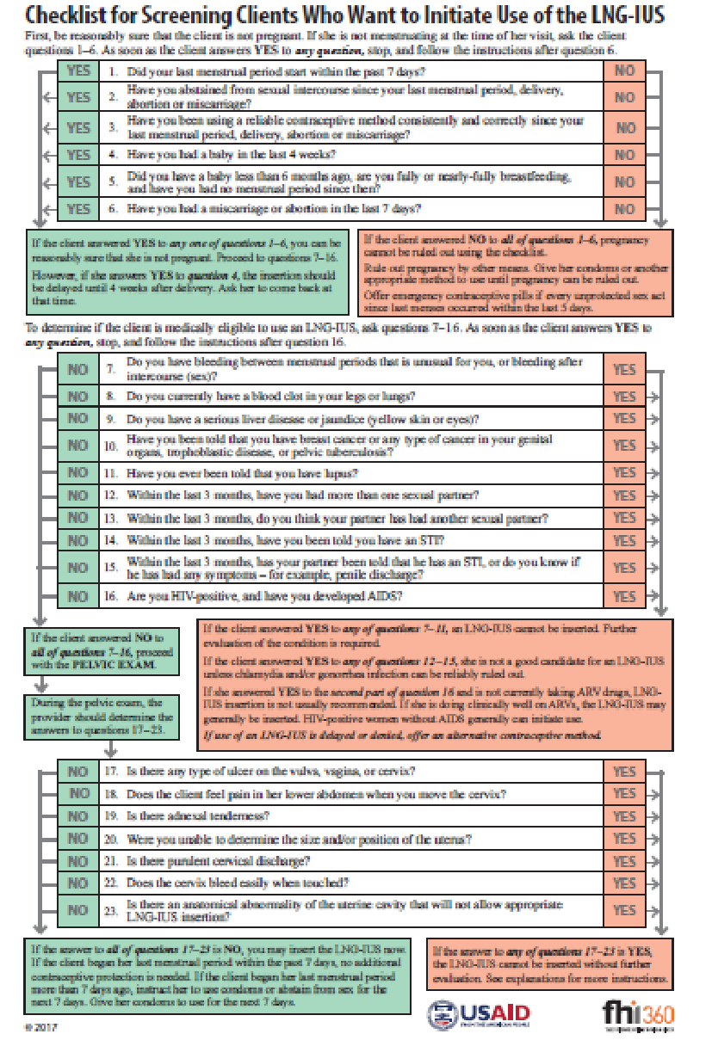
Understanding the H-IUD Checklist for interval timing
Read questions 7–23 on the checklist and match them with the conditions and categories on the MEC quick reference chart.
This set of questions identifies women who are not pregnant.
This set of questions identifies women who should not use IUDs.
The provider uses these questions during the pelvic exam to identify any category 3 and 4 conditions.
Notes:
The purpose of this activity is to introduce participants to the Checklist for Screening Clients Who Want to Initiate Use of the H-IUD, to provide an overview of its purpose, and to show how to use it.
Distribute the Handout #6 “Screening checklist for clients who want to initiate LNG IUD” to each participant.
When introducing the checklist, explain that it should be used by providers to determine whether a client is medically eligible to use the method that she selected during an informed decision-making process.
The questions 1-6 on the checklist allow a provider to determine with reasonable certainty that a client is not pregnant
The questions 7-23 on the checklist identify women who have health conditions that make it unsafe for them to use H-IUDs (WHO category 3 and 4).
To use the checklist, providers ask the questions on the checklist and follow the instructions based on the client’s responses.
Refer to the Session Plan for the exercise on using the Checklist

Slide 15
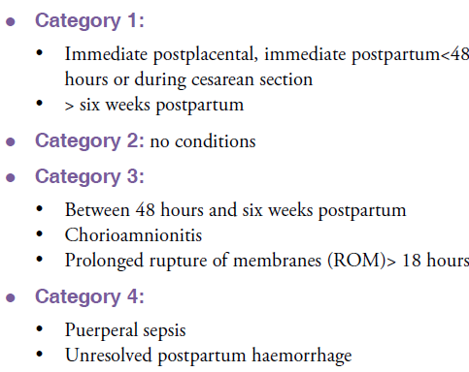
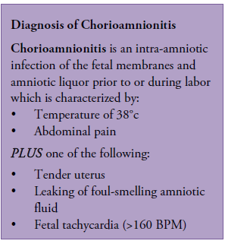
WHO Medical Eligibility Criteria and Screening for PPIUD
Notes:
Medical Eligibility Criteria and Screening​ for PPIUD (15 mins)
Discussion ​
Recap the WHO MEC criteria and determine whether the participants understand these criteria and are comfortable using the MEC wheel and the digital app. ​
Go through the slide -14 and discuss the criteria and conditions eligible for safe use of IUDs in the immediate postpartum period. New app for WHO's Medical eligibility criteria for contraceptive use
Distribute handout # 8the CL for Pre-insertion screening for PPIUD ​ and review the conditions that contradict the insertion of IUDs in the postpartum period If the woman has any of these conditions, counsel her for an alternate method. If she insists on having an IUD, ask her to come back after 4 weeks. These conditions include:
Chorioamnionitis​
Postpartum endometritis/metritis ​
Puerperal sepsis
More than 18 hours from rupture of membranes to delivery of the baby​
Unresolved postpartum hemorrhage​
Extensive genital trauma, the repair of which would be disrupted by the postpartum placement of the IUD​

