Slide 1
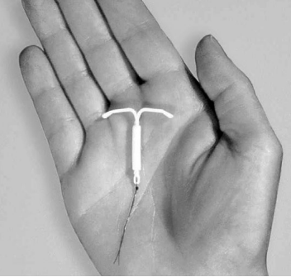
Hormonal IUDs (H-IUDs)
Interval and Postpartum
Notes:
Greet participants and introduce yourself.
Introduce the H IUD Module
This module provides an overview of the knowledge, skill, and attitude needed to provide quality and safe services to clients who are interested in using H IUDs in the interval and postpartum timings to regulate their fertility
The module is divided into interactive sessions to help participants learn, practice, and retain the knowledge and skills imparted. It includes sessions on the characteristics of H-IUDs, how to counsel and screen clients who are interested in H-IUD use, who can and who cannot use H-IUD, and providing H-IUDs including the Insertion and removal of H-IUDs in the interval and postpartum periods as appropriate to the participant’s scope of work and job description.
During this training participants will learn and demonstrate skills through role plays, case studies, simulated practice, and other activities and will be encouraged to think about what it will be like to perform these tasks on the job.

Slide 2
Learning Objectives
Describe the general characteristics of H-IUDs in a manner that clients can understand.
Demonstrate the ability to screen clients for medical eligibility to use the H-IUD safely in the interval and postpartum period.
Describe the timing for initiating the use of H-IUDs
Address common concerns and misinformation about H-IUDs.
Explain the insertion and follow-up procedures to clients, and reasons to return to the clinic.
Counsel clients on how to manage side effects. ​
Identify and manage side effects and potential complications related to H –IUDs.
Explain what is different about the postpartum period.
Describe, demonstrate, and practice the technique for the insertion and removal of H-IUDs in the interval and postpartum periods.

Slide 3
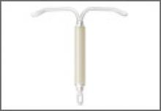
Hormonal IUDs
Interval and Postpartum
Session I: General characteristics of H-IUDs
H-IUD
Notes:
Introduce Session1

Slide 4
Session Objectives
Describe key points of H-IUDs for providers and clients
Describe the general characteristics of H-IUDs
Describe the effectiveness of H-IUDs in preventing pregnancies.
Describe the mechanism of action of H-IUDs.
Discuss the benefits, limitations, possible side effects, and complications of H-IUDs.
Discuss "Why do some women like the IUD?"

Slide 5
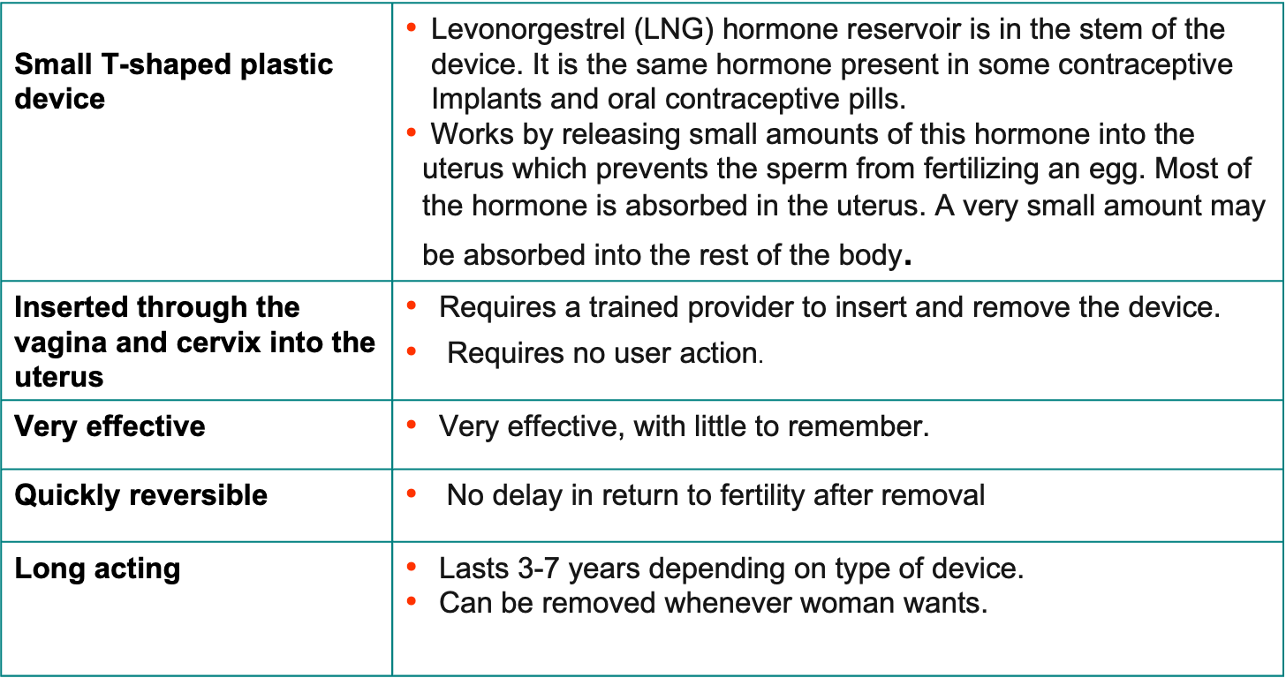
H-IUDs: Key Points for Providers and Clients
Effectiveness
8
Notes:
Discussion (10 min.)
Ask the participants:
What are H-IUDs? <allow participants to answer>.
What are some qualities of H-IUDs that are unique to this method? <allow participants to answer>.
Now display the slide:
Explain: H-IUDs are small plastic devices inserted through the vagina and cervix into the uterus. The key points to remember about H-IUDs include:
They are small devices that fit inside the womb.
Work by releasing small amounts of levonorgestrel hormone into the uterus which prevents the sperm from fertilizing an egg. This is the same hormone used in some implants and oral contraceptive pills.
Are very effective in preventing pregnancy
Are long-acting and easily reversible. H-IUDs can work for 3-7 years (depending on type) and can be easily removed by a provider whenever the woman wants.
Return to fertility is not delayed after removal.

Slide 6
H-IUDs: Key Points for Providers and Clients
Very safe | H-IUDs are very safe. They act locally on the reproductive tract, making systemic hormonal side effects side effects less pronounced. Most women can use H-IUDs, including women who are breastfeeding, adolescents, and women who have never been pregnant.
Some women have side-effects | Most common side effects are changes in bleeding patterns, including lighter or no monthly bleeding Mild hormonal side effects include headaches, breast tenderness. Side-effects usually get better after first 3-6 months.
No protection against STIs or HIV | IUDs do not protect against STIs/HIV. For protection use condoms.
Notes:
Tell participants that H-IUDs:
Are very safe. It has been shown that the H-IUD can be used by women who have never had a baby without having any negative effect on their future fertility.
Most common side effects are changes in bleeding patterns, including lighter or no monthly bleeding
Mild hormonal side effects include headaches and breast tenderness.
Side effects usually get better after the first 3-6 months.
They do not protect against STIs or HIV and AIDS.

Slide 7
H-IUDs: Types and Brands
May be unbranded or may be marketed under names such as Mirena, Liletta, Avibela, Skyla, Kyleena, and Jaydess.
Though they all work the same way, the type, size of the inserter and average amount of LNG hormone released by the IUD may be different for different types of the H-IUD.
The size of the H-IUD frame and inserter tube for Kyleena, Skyla, and Jaydess are slightly smaller than the Mirena, Avibela, and Liletta.
Notes:
Ask the participants: What are the types of H-IUDs in use today? <allow participants to respond>. How do they differ? <allow participants to answer and add to the participants’ responses as needed;
Different IUDs work the same way to prevent pregnancies but differ in inserter types( one-handed or two-handed), size and in the amount of the hormone released per day.
Ask the participants: Which types/brands of H-IUDs are available in the facility/country where they work ? Allow participants to answer and add to the participants’ responses as needed.

Slide 8
Similarities: Copper IUDs vs. H-IUDs
Both Copper IUDs and H-IUDs:
Are very effective and safe
Are long-acting and reversible
Return to fertility is not delayed upon removal
Can be removed anytime the woman wants
Requires a trained provider to insert and remove
Protects against the risks of pregnancy- uterine and ectopic and protect against endometrial and cervical cancer.
Can be inserted at any time in the cycle if reasonably sure that the woman is not pregnant
Can be inserted post-abortion and postpartum if no evidence of complications.
Notes:
Copper IUDs are another type of IUD, which is covered in a separate module.
Ask the participants: How are Copper IUDs different from H-IUDs? <allow participants to answer>; probe for the information on this and the following slide. Discuss similarities and differences.
Differences between copper IUDs and H-IUDs are summarized in the table on the next slide

Slide 9
Differences: Copper vs H-IUDs
 | Copper IUDs | H-IUDs
Appearance | T-shaped plastic device with copper sleeves or wire wrapped around them | T-shaped plastic device with the hormone reservoir in the stem of the T frame
Duration: | 10-12 years depending on brand and national guidelines | 3-8 years depending on brand and national guidelines
Effectiveness | Very effective;less than 1 pregnancy per 100 woman, using it perfectly will become pregnant in the first year. | Very effective; less than 1 pregnancy per 100 women using perfectly will become pregnant in first year.
Hormones | No hormones | Small amounts of the hormone levonorgestrel
Works by | Causing a chemical change that Interferes with sperm motility and prevents sperm and egg from meeting | Thickens cervical mucosa, Interferes with movement of the sperm, so the sperm and the egg do not meet.
Side effects | Changes in bleeding patterns including prolonged and heavy monthly bleeding, more cramps and pain during monthly bleeding. | Changes in bleeding patterns including lighter bleeding, fewer days of bleeding, or no bleeding. Mild systemic side effects such as headaches, breast tenderness.
Additional considerations | May contribute to anemia if woman has low iron stores. May be more easily available and less expensive than H-IUDs. Can be used as emergency contraception. | Helps protect against iron-deficiency anemia. Reduces menstrual cramps, heavy monthly bleeding, and pelvic pain and irregular bleeding from uterine fibroids and endometriosis. Not used as Emergency Contraception. Must wait for at least 6 days to insert for after taking UPA emergency contraception to avoid drug interaction.
Notes:
Discuss the differences between Copper IUDs and H-IUDs as presented on the slide.
Show and pass around samples of both types of IUDs to participants and allow them to see and feel the devices

Slide 10
Effectiveness of H-IUDs
In this progression of effectiveness, where would you place H-IUDs?
Implants Male Sterilization Female Sterilization Copper IUDs
Lactational amenorrhea (LAM) Progestin-only Injectables Combined Oral Contraceptives (COCs) Progestin-only pills (POPs)
Male Condoms Standard Days Method (SDM) Female Condoms
Spermicides
More effective
H-IUDs
Less effective
Notes:
Ask participants: Where would you put H-IUDs on this list?
After participants respond, click the mouse to reveal the answer
The purpose of this activity is to emphasize the effectiveness of H-IUDs
Inform: The list on these slides categorizes contraceptive methods from more effective to less effective as commonly used. In this list, the most effective methods are contraceptive implants, male/female sterilization, and IUDs (both copper and hormonal, though H-IUDs are slightly more effective). Spermicides are the least effective method

Slide 11
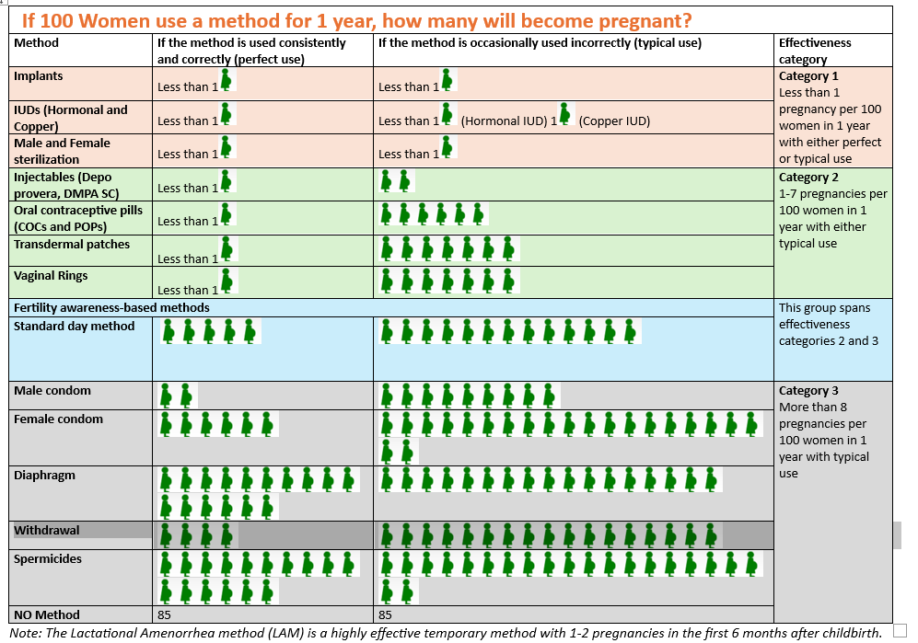
Relative Effectiveness of Family Planning Methods
Notes:
Explain that there is another way to look at effectiveness. In this slide, we look at how effective FP methods are as they are commonly used. The slide shows the number of women who would get pregnant if 1,000 women used a method for one year. So, if 1,000 fertile women were having sex, but not using any protection from pregnancy, 850 of them would become pregnant. But, if the same 1,000 women were using COCs, 70 would become pregnant. Ask participants- what if these same women were using an H-IUD? How many would become pregnant? As part of good counseling, it is important to inform clients about how effective each method is.
Distribute copies of Handout #1: Comparing Effectiveness of Family Planning Method and Handout#2Alternate Effectiveness chart- If 100 Women Use a Method for One Year, How Many will Become Pregnant?
See Session Plan for conducting role play.
Source: Trussell J., Contraceptive Failure in the United States, Contraception 83 (2011) 397- 404, Elsevier Inc.

Slide 12
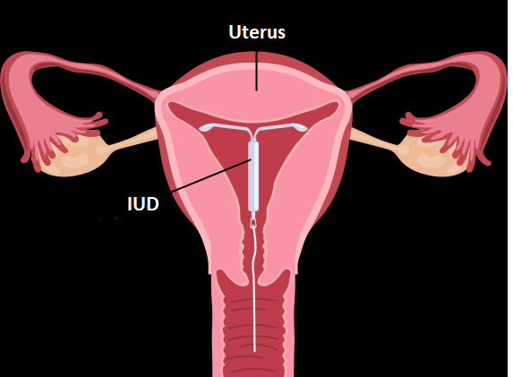
H-IUD: Mechanism of Action
Prevents fertilization of the egg and sperm by:
Thickening of cervical mucus
Interfering with movement of the sperm
Notes:
Present the mechanism of action and proceed with the activity to keep participants focused on how they translate technical information into concepts that their clients can understand.
For women who are interested in this method, how will you explain how H-IUDs work?
Ask participants to brainstorm ideas about how to explain how H-IUDs work to prevent pregnancy, using simple language the client will understand. For example, “When you use an H-IUD, it becomes more difficult for sperm to move to meet eggs.” Encourage participants to use pages or illustrations from counseling tools to help with their explanations.

Slide 13
H-IUD: Characteristics
Benefits
Safe and highly effective
Requires no user action once in place.
Private
Long-acting (3-8 years depending on type)
No delay in return to fertility after removal
Has health benefits
No further costs once inserted
Limitations
Trained provider needed to insert and remove
Requires a pelvic exam
Possible pain or discomfort during insertion
Have potential side effects
Complications are rare, but may occur
Does not protect against STIs/HIV
Source: CCP and WHO, 2018.
Notes:
Note to facilitator: Conduct the activity first and then display the slide and initiate a discussion(10 mins):
Tell participants that they will do an activity that will allow them to think about how a client’s perception of a particular characteristic of H-IUDs may be affected by the client’s situation or lifestyle. Ask participants:
To share the reasons that women in their community may like the H-IUD. For example: H-IUDs are long-lasting; and private (usually no one else can tell a woman is using contraception; this makes bleeding lighter and can prevent monthly bleeding for many women).
To consider why women in different situations may prefer to avoid the use of LNG-IUDs because of a particular characteristic. For example, a woman may not be comfortable having a pelvic exam or have no access to a trained provider to insert the H-IUD.
Activity Instructions:
Ask participants to work in teams to create a list of the benefits of H-IUDs and the limitations on separate sheets of flip chart paper. Encourage participants to think about their own experiences with clients who have used H-IUDs.
Give the team 5 mins to create their lists.
Ask teams to present their lists to the larger group. After all the groups have presented, ask participants to examine the lists and compare whether all the groups agreed about whether particular characteristics were perceived as being beneficial or as a limitation to use. Ask the participants to consider whether there may be clients who would perceive certain “beneficial” characteristics to be undesirable, and vice versa.
Show the slide now and discuss any point that may have been missed and correct any misunderstandings. Remind participants that women with similar characteristics in similar situations may have different reasons for making method choices. When counseling women, it is important to help clients consider how these method characteristics fit their lifestyles and reproductive health goals and desires.
As you review the next few slides in the presentation, refer to the lists that the participants developed.
Source: CCP and WHO, 2018

Slide 14
H-IUD: Health Benefits
( Non contraceptive benefits)
Apart from preventing pregnancy and associated health risks, H-IUDs are known to:
Reduce menstrual cramps, heavy monthly bleeding, and symptoms of endometriosis (Irregular bleeding and pelvic pain)
Protect against iron-deficiency anemia
Reduce risk of ectopic pregnancy
  Rate in H-IUD users is 10 ectopic pregnancies in 10,000 women
  Rate in women using no contraception is 65 ectopic pregnancies in 10,000 women
May help protect against endometriosis, endometrium hyperplasia and endometrial cancer
Notes:
Discussion (10 min.)
Ask participants to think back to the discussion of why women like H-IUDs. One reason that women tend to like H-IUDs is their effect on the menstrual cycle.
Ask participants: What are some of these effects? <accept responses from several participants>
Ask participants: What are some of the health benefits of LNG-IUDs that you have heard about? <accept responses from several participants>
Then use slides to present information on the non-contraceptive health benefits of IUDs
Source; FDA insert. 2008, Bayer HealthCare Pharmaceuticals Inc.

Slide 15
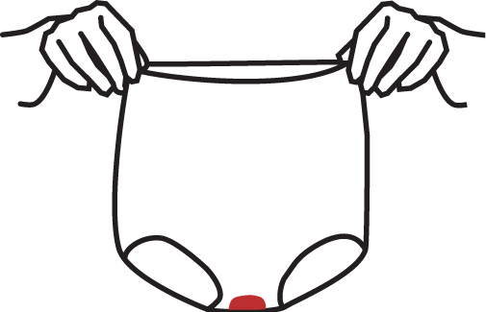
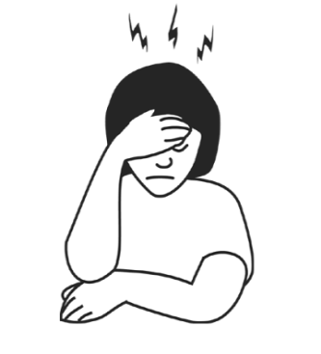
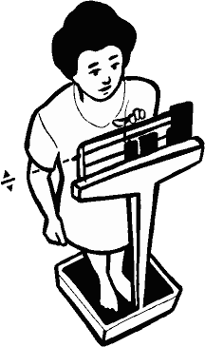

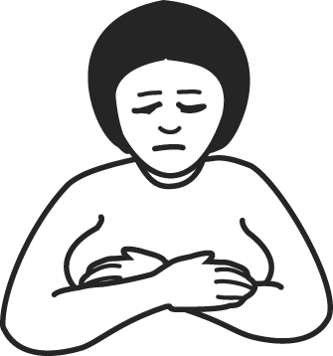


Possible Side-Effects
These are not usually signs of illness. Get better in 3-6 months of insertion.
Most common:
Less common:
Changes in bleeding patterns (lighter, irregular, infrequent or no monthly bleeding)
Tender breasts
Mood changes or headaches
Nausea
(upset stomach)
Slight weight gain
Acne
Dizziness
Notes:
Remind participants that as with many contraceptive methods, there are some side effects associated with H-IUDs that are not harmful but may be unpleasant.
Women’s preferences for certain methods are often related to side effects.
Ask participants: What side effects of H-IUDs, have you heard about?
As we have acknowledged, some women who take H-IUDs experience certain side effects. The most common side effect of H-IUDs is changes in the bleeding pattern.
Most women experience a reduction in the amount of menstrual bleeding. Many women experience amenorrhea while others have breakthrough bleeding, or irregular bleeding between periods. This bleeding ranges from spotting to light bleeding episodes.
Because some cultures or religions restrict sexual and religious activities during menstruation, breakthrough bleeding may interfere with a woman’s daily life. Breakthrough bleeding is generally not harmful to a woman’s health.
H-IUDs may help prevent iron-deficiency anemia by reducing monthly bleeding.
Other side effects may include nausea, mood changes, headaches, tender breasts, dizziness, acne, or slight weight gain.
It is important to remember that many H-IUD users do not experience any side effects or only experience bleeding changes.
Typically, side effects diminish within a few months after a woman begins H-IUD use.
Side effects have an important impact on users’ experience with an FP method and should be addressed upfront during counseling and follow-up visits. This is discussed in depth in Session III: Providing LNG-IUDs.
Adapted from WHO’s Decision-making tool for family planning clients and providers.

Slide 16
Counseling about Side Effects
Before insertion, describe common side effects:​
-Changes in bleeding patterns
Irregular, lighter or no menstrual bleeding​
For many women, the reduced bleeding or amenorrhea may be an appealing factor for choice.
Explain the side effects:​
-These are not signs of illness​
-Encourage the client to come back with questions or concerns anytime.​
If a woman finds the side effects bothersome, counseling and support can help. Also, she can have the device discontinued at any time she desires for whatever reason.

Slide 17
Potential Complications
Complications are rare and related to provider competence, screening of the client and adherence to Infection prevention practices:​
Perforation of the wall of the uterus by the IUD or Instrument. ​
Infection​
Expulsion​
http://www.fphandbook.org
Notes:
Tell the participants that they will be addressing complications in details in another session.

Slide 18
Why Some women say they like the H-IUD
Prevents pregnancy very effectively
Makes bleeding lighter and can prevent monthly bleeding for many months (amenorrhea
Is long-lasting
Is private—usually no one else can tell a woman is using contraception (sometimes a partner may feel the strings during sex)
Has no further costs for supplies after the IUD is inserted
Does not require the user to do anything once the IUD is inserted
Notes:
Refer to Why Some Women Say They Like the LNG-IUD from the Global FP handbook 2022

Slide 19
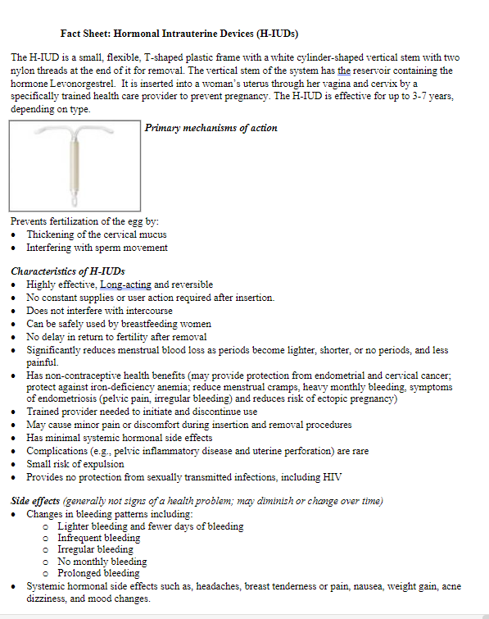
Fact Sheet
Review the fact sheet.
What additional questions or comments do you have about the characteristics of the H-IUD?
Notes:
Depending upon the option of training, distribute copies of Handout #3a if training for Interval timing OR Handout# 3b if for the postpartum period and both if the training option is combined( Interval and postpartum): Fact Sheet: Introduce the fact sheet and ask participants to review the H-IUD characteristics on the first page. Ask participants:
If there are any additional comments or questions. Discuss and clarify as needed.
To consider how they might be able to use the fact sheet in their work. Remind participants that although it might be useful for helping providers remember important information to share with clients, the fact sheet is not intended to be used as a brochure to be distributed to clients.
To review the rest of the information on the fact sheet, about medical eligibility for H-IUD insertion, Inform the participants that the next segment of the training will address these issues.

Slide 20
Summary
Hormonal IUD is a small device inserted inside the uterus by a trained provider.​
Little action is required by the client once it is inserted.​
Are very effective (more than 99 percent ) in preventing pregnancy.​
Are long-acting and easily reversible. ​
Can work up to 3-8 years (depending on type) and can be easily removed by a provider whenever the woman wants.​
Rapid return to fertility after removal.​
Can be used by women who have never had a baby without having any negative effect on their future fertility. ​
Can be used in the Immediate Postpartum period before discharge from the facility after childbirth. It is not recommended between 48 hrs-4-6 weeks after birth.​
Are very safe. ​
They may reduce or stop menstrual bleeding .​
They do not protect against STIs or HIV and AIDS​

