Slide 1
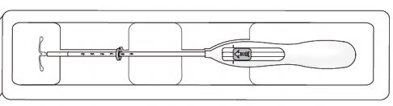
Hormonal-IUDs
Session V:
Loading, Insertion & Removal Using The One-Handed Inserter
Interval Timing
Notes:
Reference:
Illustration credits: https://www.bayer.co.uk

Slide 2
Session Objectives
At the end of the session, participants will:
Describe infection prevention requirements during insertion and removal of the H-IUD.
Describe and demonstrate steps for H-IUD insertion procedure using the one-handed inserter for the interval timing.
Describe steps to remove the H-IUD.
Demonstrate and practice the one-handed insertion and removal procedure for the interval timing on an anatomical model.
Notes:
Session objectives
Lecturette (5 min.)
This session describes the steps for loading, inserting a H-IUD using a one-handed Inserter and removing a H-IUD. It also includes practices for preventing infection during insertion and removal of the H-IUD.
Complications such as perforation of the uterus or expulsion are rare and associated mainly with provider skill.
Extensive practice on models, observations of master clinicians and supervised practice are necessary for the provider to be skillful in the H-IUD insertion and removal procedures.
During this session, we will first review the steps of H-IUD loading, insertion and removal, using the slides. This will be followed by a demonstration and return demonstration and practice by participants on anatomical models, using competency-based checklists to monitor progress.
Note to Facilitator: this session is focused solely on the mechanics of the clinical procedures involved in H-IUD insertion and removal. Refer to Session III for guidance about counseling users and other H-IUD-related issues.

Slide 3
Providing Interval H-IUD services
Clinical assessment - Pre-Insertion screening
  Once the woman has confirmed her choice for the H- IUD:
  Check that the screening has been completed and the IUD is a safe option for her.
If the woman has cleared the screening-
Briefly explain to her what you will be doing and what she should expect
Tell her that she will experience some pain, discomfort or cramping during the procedure.
Offer her pain management options( session 3)
Ask her to tell you anytime she feels the pain.
Tab Ibuprofen 200-400 mg, paracetamol, 325-1,000 mg may be given 30 mins before the procedure to help reduce the pain.
Notes:
If the woman has any of these conditions counsel for an alternate method. If a woman insists on IUD, she can have it after 4 weeks
Distribute the handout # 7-Screening CL for Interval IUDs and review it with participants.
.

Slide 4
Important:
While working with models and clients, it is strongly recommended that the trainers and participants practice and promote autonomy, dignity, comfort, respect, and privacy.
Ensure audio visual privacy during procedures.
Always ensure that the model is draped when not in use.
When demonstrating with models, talk with the ‘model’ about what is being done as you would to a real client.
Be sure to ask the clients for their consent, invite them to ask questions before starting, and remind the client that they can request the procedure be paused or discontinued at any time. Consent is an ongoing process
Role modeling by the trainers will encourage participants to practice respectful behavior on models and real clients at their workplaces.

Slide 5
Interval H-IUD insertion technique
Reviewing the Clinical skill checklist & Video watch
Review the clinical skill competency checklists with the participants.
Distribute Handout # 14 showing the illustrations for loading and inserting the loaded IUD
Show the video and pause for any questions or clarifications
Notes:
Introduce the session. Tell participants that they will now learn the insertion and removal of Interval IUDs..
Distribute the clinical skills checklist Evaluation Tool # 4 , checklist for insertion and removal of IUDs in the interval timing, and review with participants, going through every step carefully. Pause for any questions or clarifications.

Slide 6
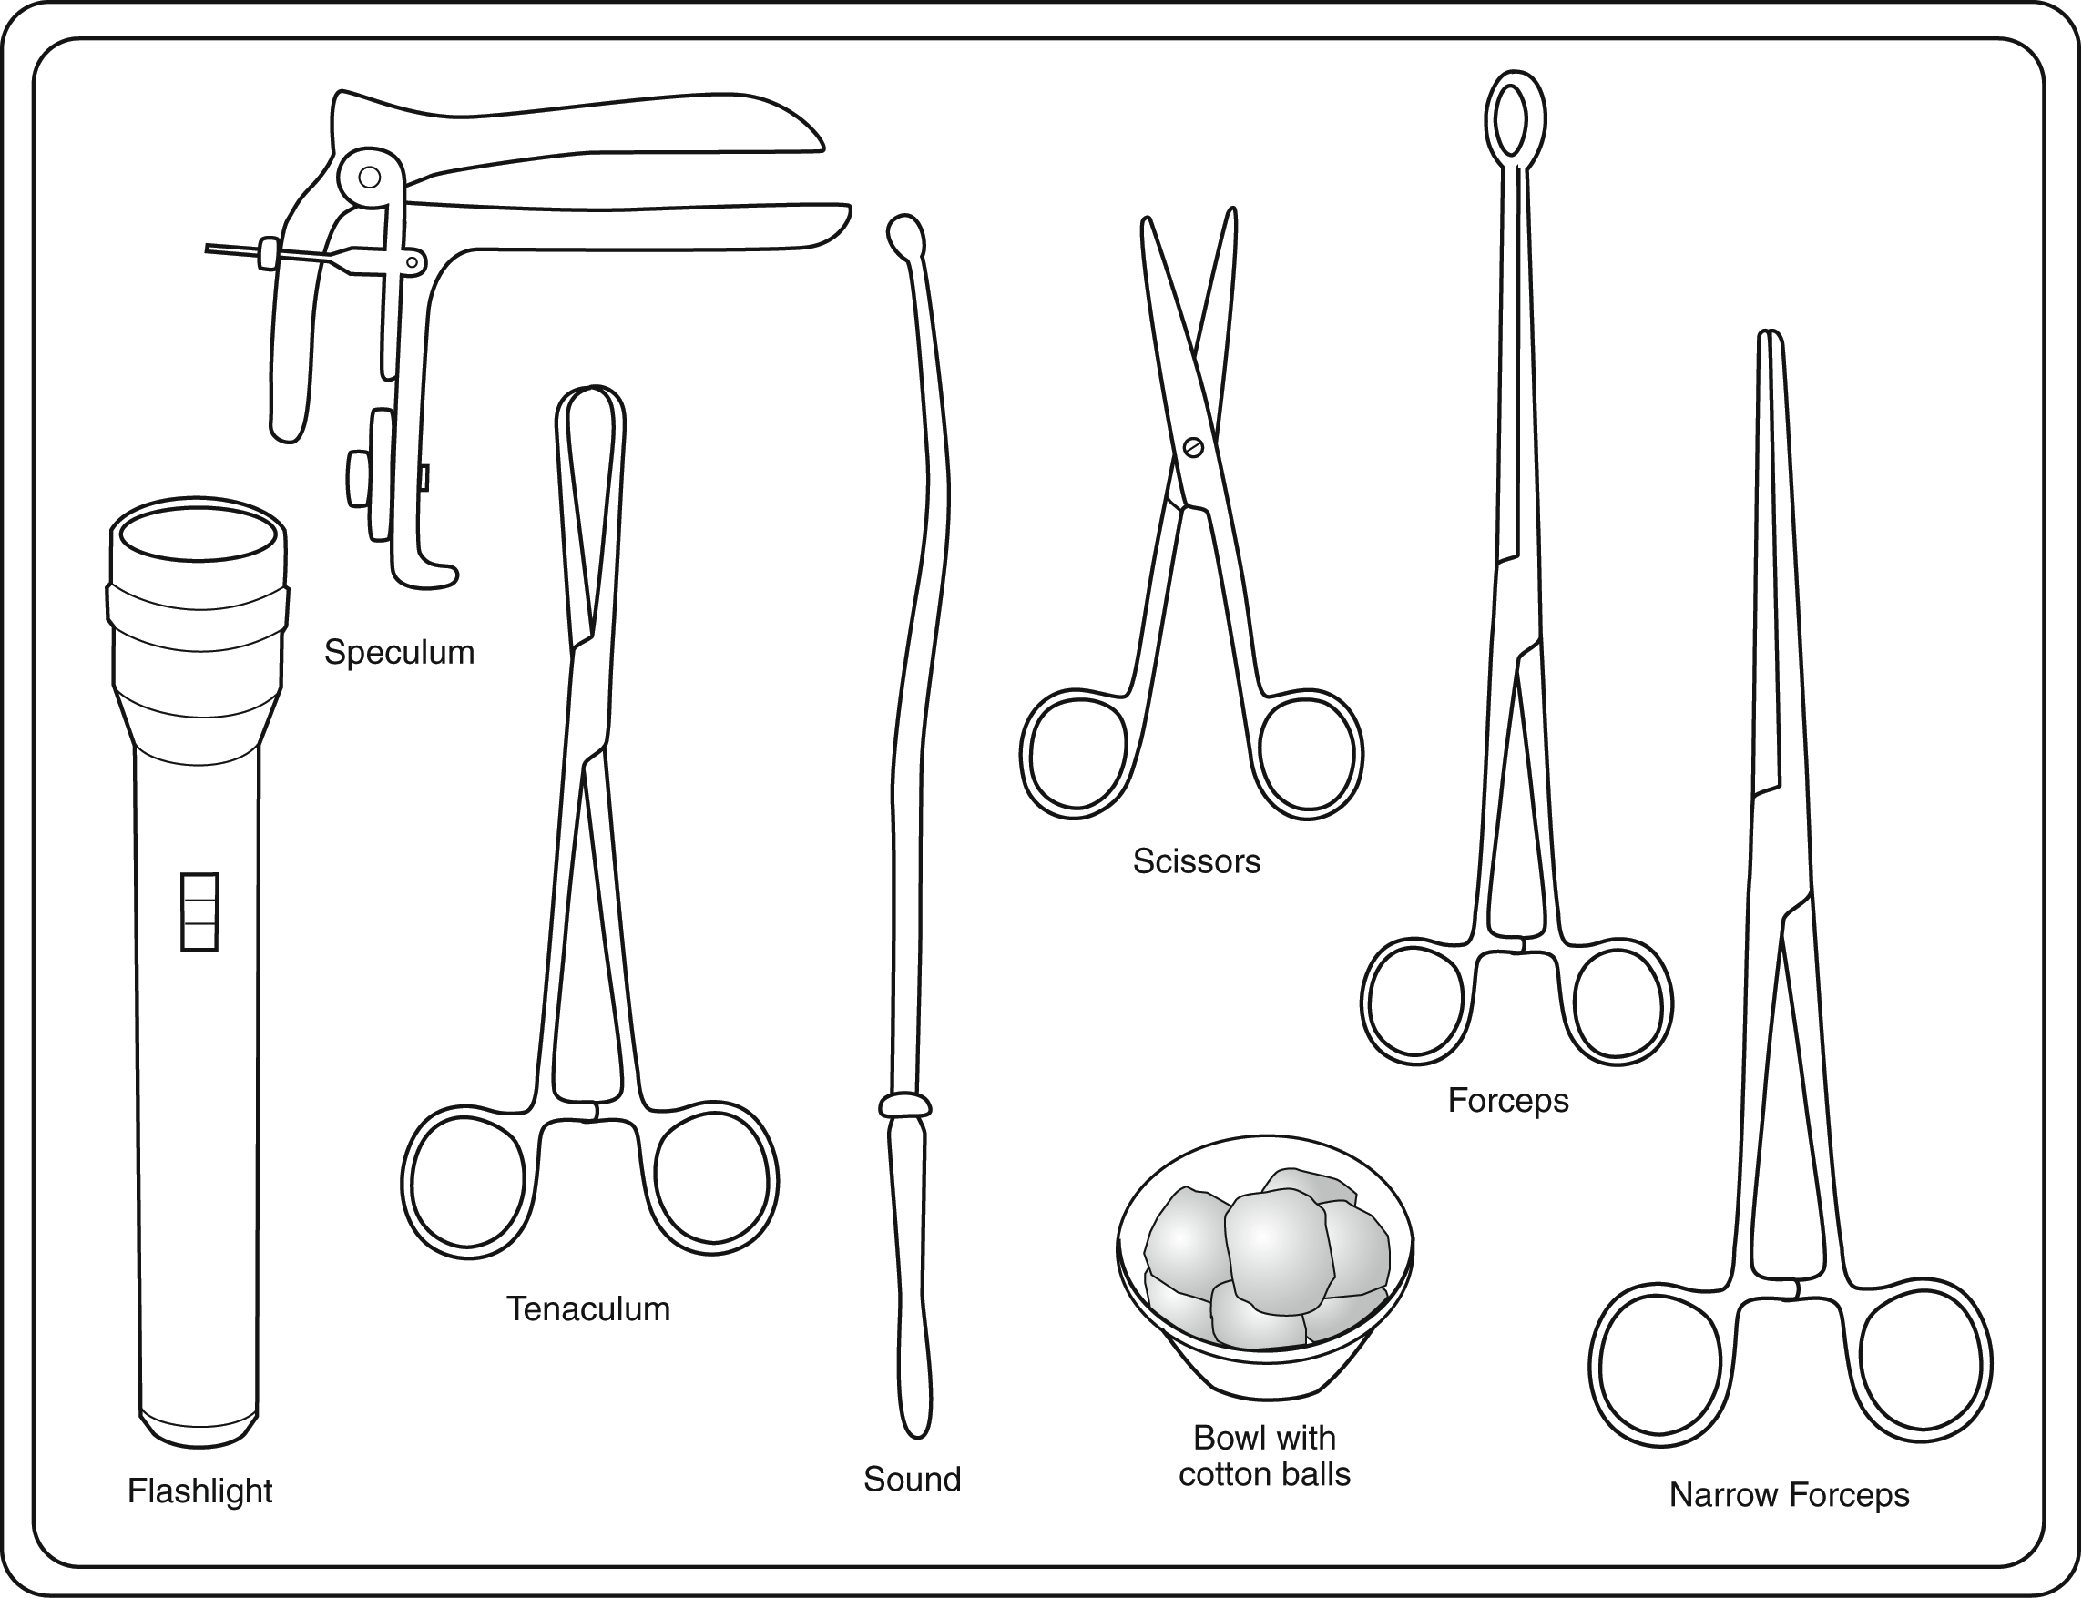
Instruments and Supplies
IUD in an undamaged, sterile package
Bivalve speculum
Tenaculum
Uterine sound
Ring forceps
Sharp scissors with blunt tip
Narrow forceps (e.g. artery or Kelly)
Notes:
H-IUD Insertion Procedure: Instruments and Supplies
Lecturette (5 min.)
Note to Facilitator: review the list of recommended supplies and equipment for H-IUD insertion procedures on Slides 3 and 4. Adapt this list as needed to be consistent with national guidelines.
The recommended supplies and equipment include:
H-IUD in an unopened, undamaged, sterile package that is not beyond its expiration date.
Bivalve speculum
Tenaculum
Uterine sound
Ring forceps
Sharp scissors with the blunt tip for trimming H-IUD strings
Narrow forceps, such as artery or Kelly.

Slide 7
Instruments and Supplies
(continued)
Light source to visualize cervix
Gloves (single use disposable, HDL, or sterile)
Bowl for antiseptic solution
Antiseptic solution
Sterile gauze/cotton balls
Drape/cloth to cover table and woman’s pelvic area
Notes:
Lecturette (5 min.)
Additional required items include:
Light source to visualize cervix
Gloves (single use disposable, or HDL, or sterile)
Bowl for antiseptic solution
Antiseptic solution
Sterile gauze/cotton balls
Drape/cloth to cover table and woman’s pelvic area

Slide 8
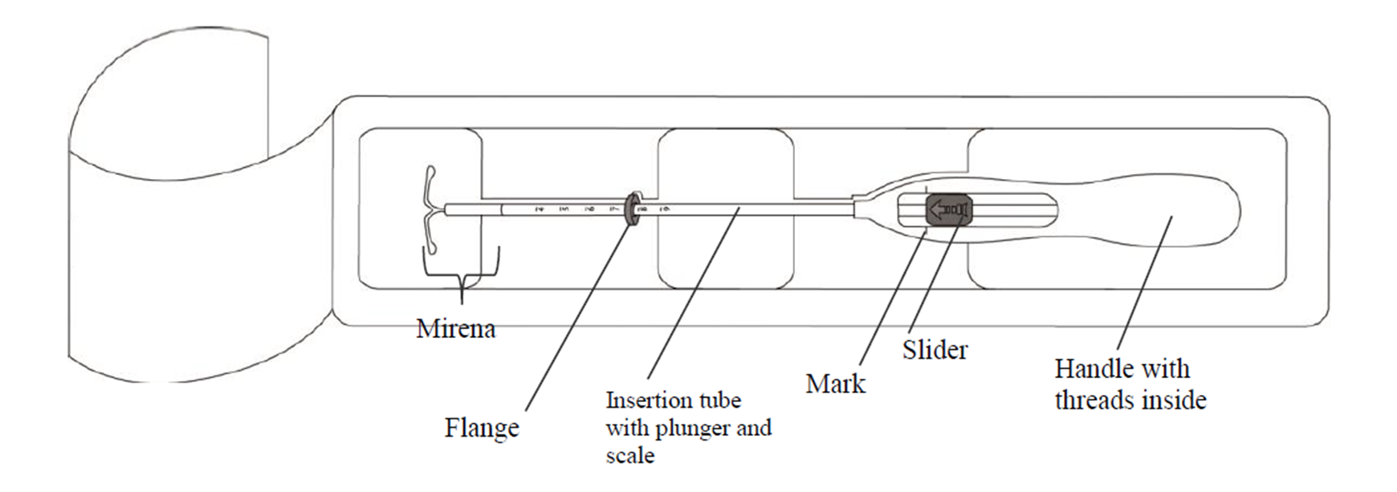
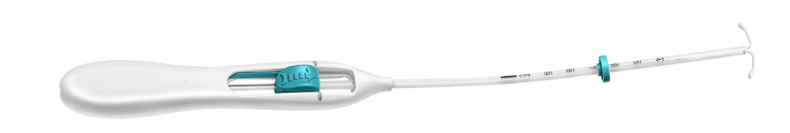
One-Handed Inserter: Components
Notes:
Demonstrate the parts of the one-handed inserter.

Slide 9
Preventing Infection During Insertion
Wash hands thoroughly with soap and water before and after procedure
Put on examination/HLD/sterile gloves on both hands.
Use HLD/sterile instruments.
Have the woman wash her labia and around the vaginal area if possible
Clean the cervix os and vaginal walls thoroughly with an antiseptic at least two times.
Load the H-IUD using “no-touch” technique
Notes:
The following procedures should be followed at the time of insertion to minimize the risk of infection:
Wash hands thoroughly with soap and water before and after each procedure or use alcohol hand rub.
When possible, have the client wash her genital area before doing the screening pelvic examination.
Use sterilized or high-level disinfected instruments and disposable clean examination/HLD/Sterile gloves (both hands).
After inserting the speculum and while looking at the cervix, thoroughly apply antiseptic solution at least two times to the cervix and vagina before beginning the procedure.
Load the H-IUD using “no-touch” technique
Distribute Handout#13: Infection Prevention Practices during loading, insertion and removal of H-IUDs.

Slide 10
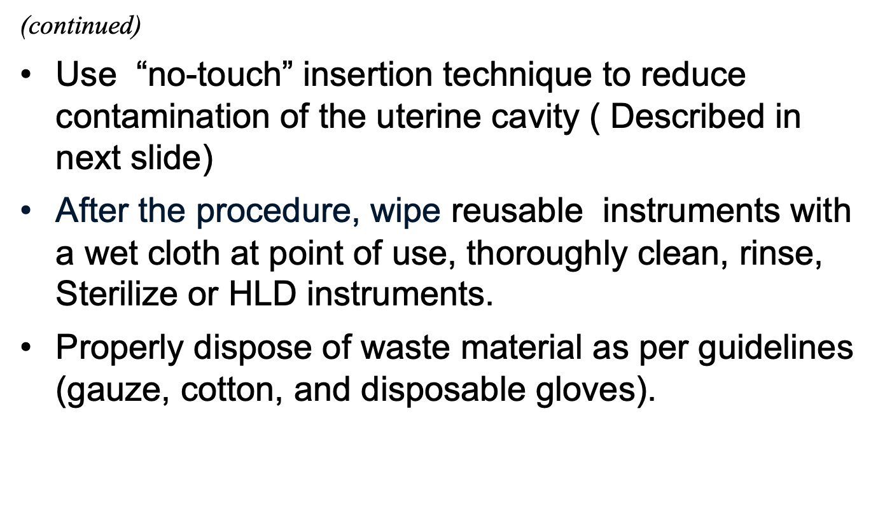
Preventing Infection During Insertion

Slide 11

The “no-touch” insertion technique is safest and means not letting the loaded H-IUD or uterine sound touch any unsterile surfaces. It involves:
  Ensuring not to touch the vaginal wall or speculum blades with the uterine sound or loaded H-IUD inserter
  Not passing both the uterine sound or the loaded H-IUD inserter more than once through the cervical canal

Slide 12
Performing Pelvic Exam
Pelvic exam is an essential part of IUD insertion procedure:
Do a bimanual pelvic exam to establish the size, shape and position of the uterus.
Do a speculum pelvic exam by gently inserting the HLD/sterile speculum to:
  Visualize the cervix and check for signs of infection, such as purulent vaginal discharge, cervical discharge, ulcers, lesions or sores.
  Clean the cervical os and vaginal walls thoroughly with antiseptic at least twice.
Notes:
Before inserting the H-IUD, provider should perform pelvic examination (both bimanual and speculum exam), to screen for medical eligibility and assess the size and position of the uterus.
If no signs of infection are found during the pelvic exam (no ulcers, cervical tenderness, adnexal tenderness, purulent cervical discharge, and cervix does not bleed easily when touched), the provider should proceed with the remaining steps of H-IUD insertion.
If any of the infection signs or symptoms are present, diagnose and treat as appropriate. Reassess the woman’s eligibility for insertion after treatment is completed.
The provider also determines the position of the uterus so he/she knows in which direction to point the uterine sound and H-IUD inserter (uterus could be tilted up or down).

Slide 13
Sounding the Uterus
Grasp the cervix with an HLD/sterile tenaculum and apply gentle traction.
Insert the HLD/sterile sound using “no-touch” technique.
Advance the sound into the uterine cavity until a slight resistance is felt.
Slowly withdraw the sound and assess the level of mucus/blood to determine the depth of the uterus (average depth 6-8 cm)
Notes:
The next step before insertion is the sounding of the uterus.
Describe steps as outlined on the slide. Emphasize that the average depth of uterus is 6 to 8 cm.
Tell participants:
It is important to note that the position of the uterus is determined during the pelvic examination, not during sounding. If uterine position is not correctly determined before sounding, the sound may be inserted incorrectly and cause uterine perforation.
Distribute the Handout#14-Passing a uterine sound. Review the steps with participants.

Slide 14
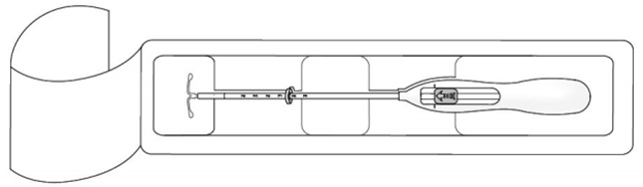
H-IUD loading procedure
Step 1: Open the package
Open the sealed H-IUD package. The contents of the package are sterile.
With sterile gloves, lift the handle of the sterile inserter from the sterile package
https://www.mirenahcp.com/insertion-and-removal
Notes:
Open the sterile package
The contents of the package are sterile. Open the package, lift the handle of the sterile inserter and remove from the sterile package.
Remind participants that loading should be done no more than 5 minutes before introducing the H-IUD into the uterus. When the arms of the H-IUD stay folded for too long, they may not return to their original shape when the H-IUD is released from the inserting tube inside the uterine cavity.
Providers should begin the loading procedure after performing the pelvic exam, after they have determined that the woman is eligible for the H-IUD and after sounding the uterus.
Distribute Handout#15_JA-Loading and Insertion- one handed inserter and Handout #17_ Clinical Skill Checklist for one handed inserter.

Slide 15
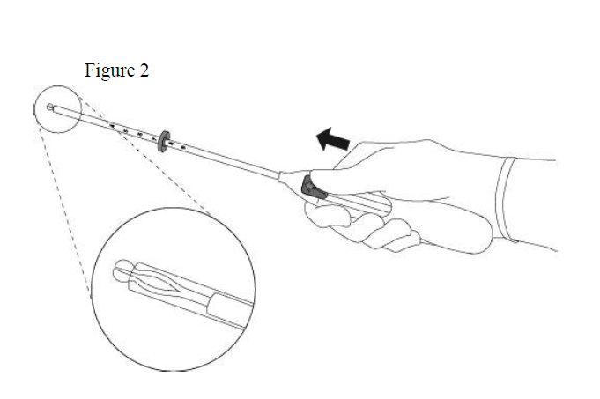
H-IUD loading procedure
Step 2: Move slider all the way to forward position
Move slider all the way to forward position to load H-IUD
The tips of the H-IUD arms will meet to form a rounded dome that extends slightly beyond the insertion tube.
Maintain forward pressure with your thumb or forefinger on the slider to avoid releasing strings prematurely.
https://www.mirenahcp.com/insertion-and-removal
Notes:
Move slider all the way to forward position
Move the slider forward as far as possible in the direction of the arrow thereby moving the insertion tube over the IUD T-body to load IUD into the insertion tube . The tips of the arms will meet to form a rounded dome that extends slightly beyond the insertion tube. Maintain forward pressure with your thumb or forefinger on the slider. DO NOT move the slider downward at this time as this may prematurely release the threads of the IUD. Once the slider is moved below the mark, the IUD cannot be re-loaded.

Slide 16
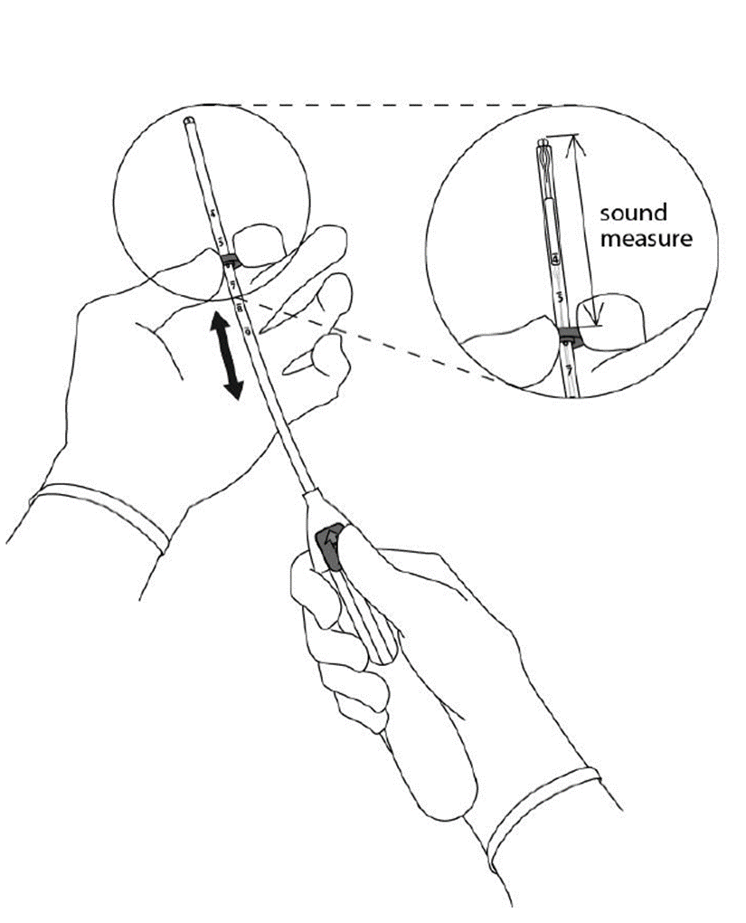
H-IUD loading procedure
Step 3: Set the flange to uterine depth
While maintaining forward pressure on the slider, set the upper edge of the flange to correspond to the uterine depth (in centimeters) measured during sounding.
https://www.mirenahcp.com/insertion-and-removal
Notes:
Set the flange to uterine depth
Holding the slider in this forward position, set the upper edge of the flange to correspond to the uterine depth (in centimeters) measured during sounding

Slide 17
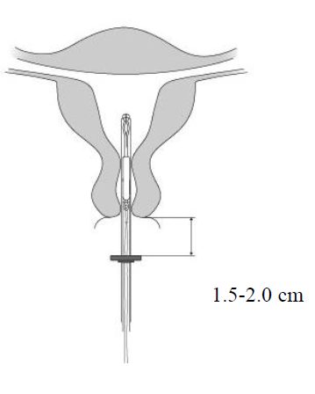
H-IUD insertion procedure
Step 4: Advancing insertion tube
Apply gentle traction on the tenaculum to straighten the alignment of the cervical canal and uterine cavity
Maintaining the slider in forward position, advance the loaded H-IUD insertion tube through the cervical canal until the upper edge of the flange is 1.5-2.0 cm. from the cervical os.
https://www.mirenahcp.com/insertion-and-removal
Notes:
Advancing insertion tube
H-IUD is now ready to be inserted. To proceed:
Apply gentle traction on the tenaculum to straighten the alignment of the cervical canal and uterine cavity. Maintain traction throughout the insertion procedure.
Maintaining the slider in forward position, advance the loaded H-IUD insertion tube through the cervical canal until the upper edge of the flange is 1.5 cm to 2.0 cm from the cervical os.

Slide 18
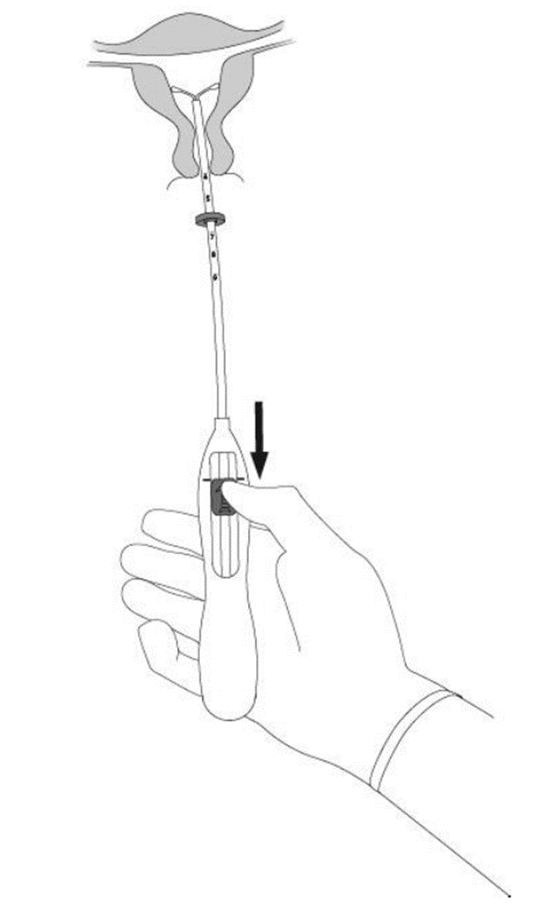
H-IUD insertion procedure
Step 5: Release the arms of the H-IUD
While holding the inserter steady, move the slider down to the mark to release the arms of the H-IUD.
Wait 10 seconds for the horizontal arms to open completely.
Notes:
Release the arms of the H-IUD
While holding the inserter steady, move the slider down to the mark to release the arms of the H-IUD.
Wait 10 seconds for the horizontal arms to open completely.

Slide 19
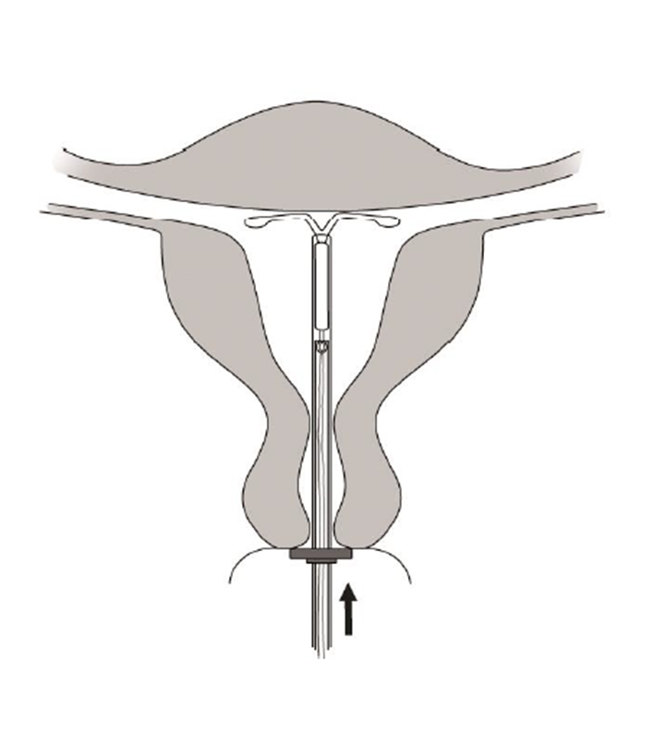
H-IUD insertion procedure
Step 6: Place IUD in fundal position
Advance the inserter gently towards the fundus of the uterus until the flange touches the cervix.
  If you encounter fundal resistance do not continue to advance.
H-IUD is now in the fundal position. Fundal placement is important to prevent expulsion
https://www.mirenahcp.com/insertion-and-removal
Notes:
Place IUD in fundal position
Advance the inserter gently towards the fundus of the uterus until the flange touches the cervix. If you encounter fundal resistance do not continue to advance.
H-IUD is now in the fundal position. Fundal placement is important to prevent expulsion

Slide 20
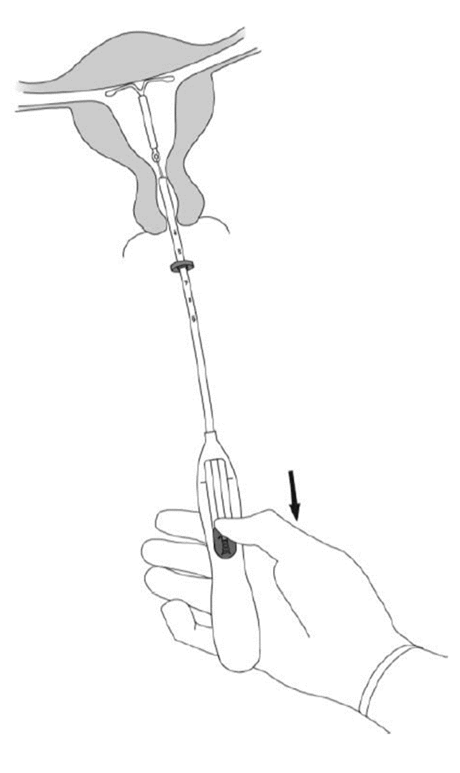
H-IUD insertion procedure
Step 7: Release H-IUD and Withdraw Inserter
Holding the inserter firmly in place, release H-IUD by moving the slider all the way down
Keep holding the slider down while gently withdrawing the inserter from the uterus
https://www.mirenahcp.com/insertion-and-removal
Notes:
Release H-IUD and withdraw the inserter.
Holding the entire inserter firmly in place, release LNG by moving the slider all the way down.
Continue to hold the slider all the way down while you slowly and gently withdraw the inserter from the uterus

Slide 21
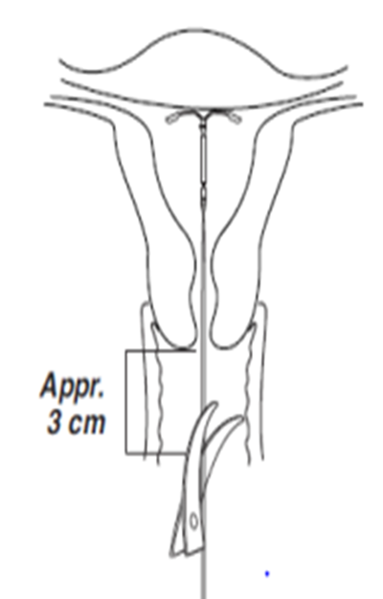
H-IUD insertion procedure
Step 8: Cut the threads
Using a sharp, blunt-tipped, scissors, cut the threads perpendicular to the thread length, leaving about 3 cm outside of the cervix, while strings ends are still in the inserter tube (cutting threads at an angle may leave sharp ends) .
Do not apply tension or pull on the threads when cutting to prevent displacing the H-IUD
https://www.mirenahcp.com/insertion-and-removal
Notes:
Cut the threads
Using a sharp, blunt-tipped, scissors, cut the threads perpendicular to the thread length, leaving about 3 cm outside of the cervix, while strings ends are still in the inserter tube (cutting threads at an angle may leave sharp ends) .
Do not apply tension or pull on the threads when cutting to prevent displacing the H-IUD

Slide 22

Post-insertion Tasks
Before removing gloves:
Wipe used instruments with a wet cloth or soaks them in a bucket of tap water for point of use cleaning and further processing.
Segregate and dispose of waste materials in appropriate leak proof containers with lids
Wipe surfaces that may have been contaminated with blood or discharges with 0.5% chlorine solution.
Take gloves off, wash hands thoroughly with soap and water, and dry them.
Allow the woman to rest
Notes:
Illustration credit: Adapted from World Health Organization Department of Reproductive Health and Research (WHO/RHR) and Johns Hopkins Bloomberg School of Public Health/Center for Communication Programs (JHU/CCP), Knowledge for Health Project.

Slide 23
Post-insertion Tasks
Provide post-insertion instructions; remind client:
  No protection against STIs; need to use condoms if at risk
  Possible side effects, especially bleeding changes
  When to return to the clinic
Complete the H-IUD reminder card and give it to the client. Explain that the user card shows the name and type of the H-IUD, the date of insertion, the clinic name, and the intended date of removal. Remind client that she can have the IUD removed at any time for any reason.
Complete the client record
Post-insertion Tasks​
Post-insertion Tasks​

Slide 24
Removal Steps
  Follow infection prevention guidelines.
  Counsel client that cramping/bleeding may occur.
  Gently insert the HLD/sterile speculum
  Visualize the strings, and clean the cervical os and vaginal wall with antiseptic
Notes:
Use the information on the Slide to describe steps in the H-IUD removal procedure.
• H-IUD removal is usually routine and uncomplicated.
• The H-IUD can be removed at any time, although removal during menses may make the procedure easier for the provider.
Any trained health care provider, including a nurse or midwife, can remove the H-IUD.
• As with H-IUD insertion, the provider should follow standard infection prevention guidelines to minimize the risk of infection.
Let the woman know that some cramping and/or bleeding is normal during removal.

Slide 25
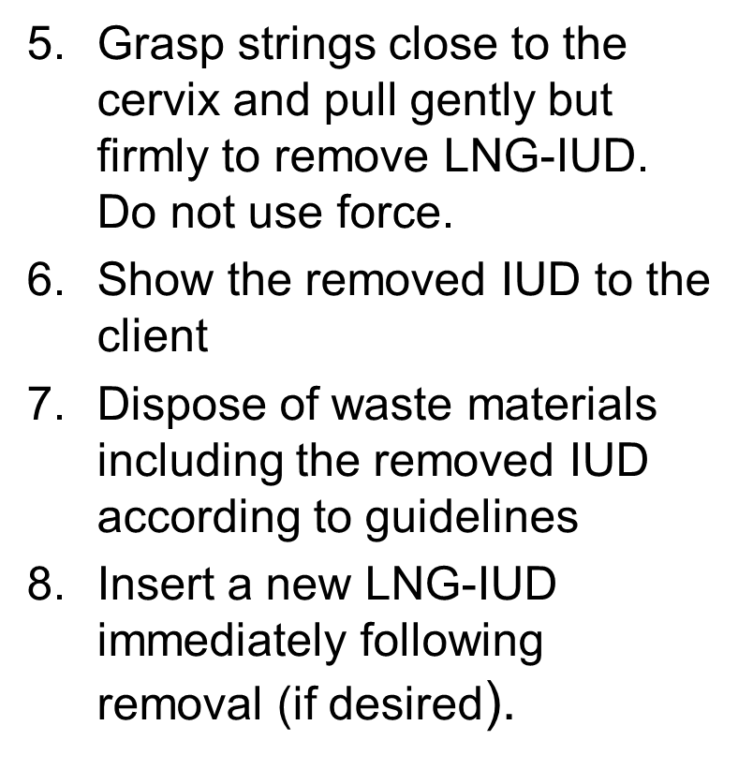
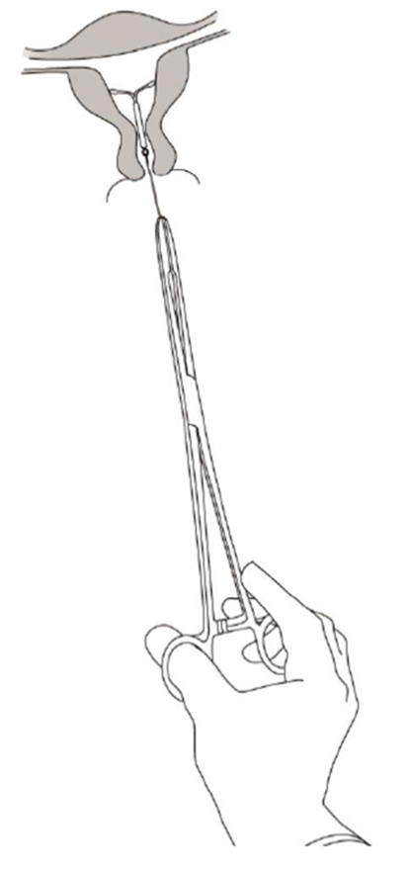
Removal steps contd...
Notes:
Grasp strings close to the cervix and pull gently but firmly to remove H-IUD. Do not use force, but apply slow, gentle traction to avoid breaking the strings.
A woman returning to the clinic to have an old H-IUD replaced can have a new H-IUD inserted at the same time.
Refer the client to a specially trained or experienced clinician for difficult removals

Slide 26
Demonstration and practice session
Demonstrate the following procedures using the checklists and allow participants to practice on models under guidance of the facilitator:
Pelvic examination
Loading the Copper IUD in the sterile package
Insertion of IUD using the "No Touch" technique
Removal Procedure
Notes:
See Session Plan for details.

