Slide 1
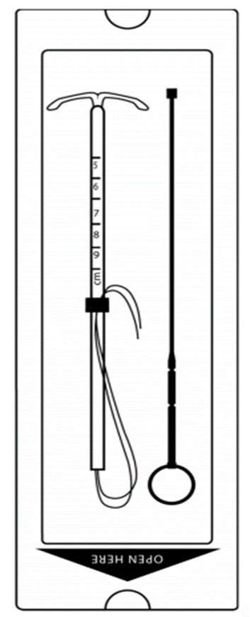
Hormonal IUDs
Session IV:
Loading, Insertion & Removal
Using The Two-Handed Inserter
Interval Timing
Notes:
Reference:
Illustration credit: Reproductive Health Supplies Coalition on Unsplash
Medical Illustration credit: Copyright Medicines360 2019

Slide 2
Session Objectives
By the end of this session participants will:
Describe infection prevention requirements for insertion and removal of the H-IUD
Describe and demonstrate steps for loading and insertion of H-IUD in the interval timing using the 2-handed inserter.
Describe steps to remove the H-IUD.
Demonstrate and practice the 2-handed insertion and removal procedure for interval timing on a model.
Notes:
This session describes the steps for loading H-IUD within its sterile package, inserting H-IUD using two a two-handed inserter, and removing the H-IUD. It also describes practices to prevent infection during insertion and removal.
Complications such as perforation of the uterus or expulsion are associated mainly with provider skill.
Extensive practice on models, observations of master clinicians and supervised practice are necessary for the provider to be skillful in the H-IUD insertion and removal procedures.
During this session, we will first review the steps of H-IUD loading, insertion and removal, using the slides. This will be followed by a demonstration, return demonstration and practice by participants on anatomical models, using competency-based checklists to monitor progress.
Note to Facilitator: this session is focused solely on the mechanics of the clinical procedures involved in H-IUD insertion and removal. Refer to Session III for guidance about counseling clients and other H-IUD-related issues.

Slide 3
Providing Interval H-IUD services
Clinical assessment - Pre-Insertion screening
  Once the woman has confirmed her choice for the H-IUD:
  Check that the screening has been completed, and the IUD is a safe option for her.
If the woman has cleared the screening-
Briefly explain to her in simple terms what you will be doing and what she should expect.
Tell her that she will experience some pain, discomfort or cramping during the procedure.
Counsel her about pain management options ( Session 3, slide #10)
Ask her to tell you anytime she feels the pain.
Tab Ibuprofen 200-400 mg, paracetamol, 325-1,000 mg may be given 30 mins before the procedure to help reduce the pain.
Notes:
If the woman has any of these conditions counsel for an alternate method. If a woman insists on IUD, she can have it after 4 weeks
Distribute the handout # 7-Screening CL for Interval IUDs and review it with participants.
.

Slide 4
Important
While working with models and clients, it is strongly recommended that the trainers and participants practice and promote autonomy, dignity, comfort, respect, and privacy.
Ensure audio visual privacy during procedures.
Ensure that the model is draped when not in use.
When demonstrating with models, talk with the ‘model’ about what is being done as you would with a 'real client'.
Be sure to ask the clients for their consent, invite them to ask questions before starting, and remind the client that they can request the procedure be paused or discontinued at any time. Consent is an ongoing process
Role modeling by the trainers will encourage participants to practice respectful behavior on models and real clients at their workplaces.

Slide 5
Interval H-IUD insertion technique
Reviewing the Clinical skill checklist & Video watch
Review the clinical skill competency checklists with the participants.
Distribute Handout #15 showing the illustrations for loading and inserting the loaded IUD
Show the video and pause for any questions or clarifications
Notes:
Introduce the session. Tell participants that they will now learn the insertion and removal of Interval IUDs..
Distribute the clinical skills checklist Evaluation Tool # 4 , checklist for insertion and removal of IUDs in the interval timing, and review with participants, going through every step carefully. Pause for any questions or clarifications.

Slide 6
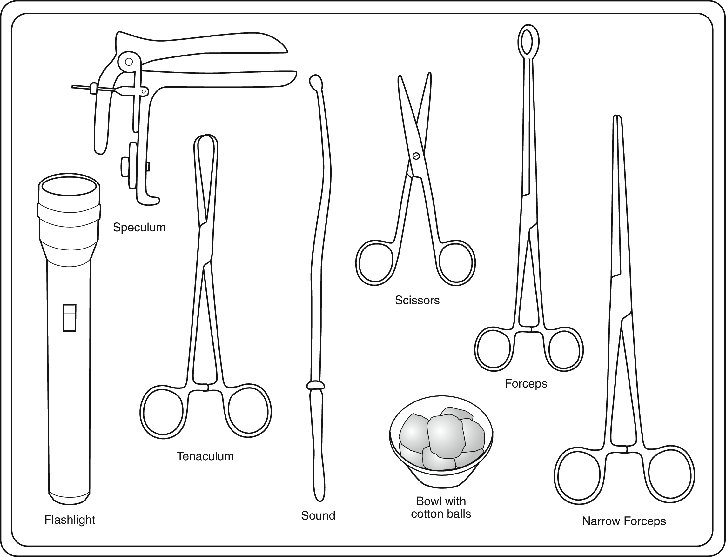
Instruments and Supplies
IUD in an undamaged, sterile package
Bivalve speculum
Tenaculum
Uterine sound
Ring forceps
Sharp scissors
Narrow forceps (e.g. artery or Kelly)
Notes:
Note to Facilitator: review the list of recommended supplies and equipment for H-IUD insertion procedures on Slides 3 and 4. Adapt this list as needed to be consistent with national guidelines.
The recommended supplies and equipment include:
H-IUD in an unopened, undamaged, sterile package that is not beyond its expiration date.
Bivalve speculum
Tenaculum
Uterine sound
Ring forceps
Sharp scissors for trimming H-IUD strings
Narrow forceps (e.g. artery or Kelly) for removal procedure

Slide 7
Instruments and Supplies
(continued)
Light source to visualize cervix
Gloves (single use disposable, HDL, or sterile)
Bowl for antiseptic solution
Antiseptic solution
Sterile gauze/cotton balls
Drape/cloth to cover table and woman’s pelvic area
Notes:
Additional required items include:
Light source to visualize cervix
Gloves (single use disposable, or HDL, or sterile)
Bowl for antiseptic solution
Antiseptic solution
Sterile gauze/cotton balls
Drape/cloth to cover table and woman’s pelvic area

Slide 8
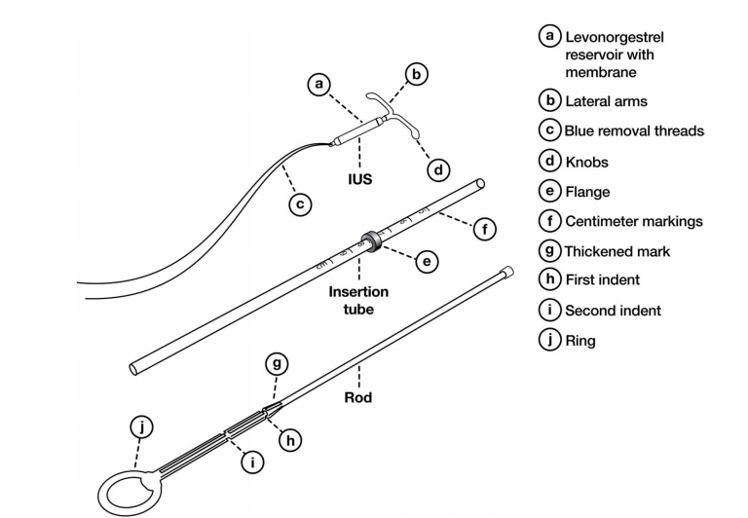

Two-Handed Inserter: Components
Notes:
Demonstrate the components of the two-handed Inserter.

Slide 9
Preventing Infection During Procedure
Wash hands thoroughly with soap and water before and after procedure
Put on examination/HLD/sterile gloves on both hands
Use HLD/sterile instruments
Have the woman wash her labia and around the vaginal area
Clean the cervical os and vaginal walls thoroughly with an antiseptic at least two times
Load the H-IUD within the sterile package using the “no-touch” technique
Notes:
The following procedures should be followed at the time of insertion to minimize the risk of infection:
Wash hands thoroughly with soap and water before and after each procedure or use alcohol hand rub.
When possible, have the client wash her vaginal area before doing the pelvic examination.
Use sterilized or high-level disinfected instruments and disposable clean examination/HLD/Sterile gloves (both hands).
Clean the cervical os and vaginal wall thoroughly with an antiseptic at least two times.
Load the H-IUD in the sterile package using the “no-touch” technique
Distribute Handout#13: Infection Prevention Practices during loading, insertion and removal of LNG IUDs.

Slide 10
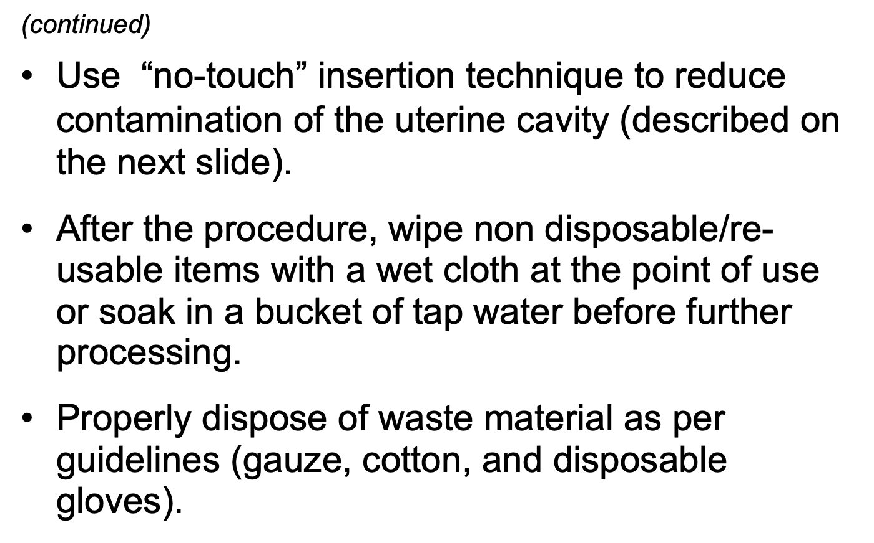
Preventing Infection During Insertion
Notes:
Use “no-touch” insertion technique to reduce contamination of the uterine cavity (described on the next slide).
After the procedure, wipe non disposable/reusable items with a wet cloth at the point of use or soak in a bucket of tap water before further processing.
Properly dispose of waste material as per guidelines (gauze, cotton, and disposable gloves).

Slide 11
No-Touch Technique
The “no-touch” insertion technique is safest and means not letting the uterine sound or loaded H-IUD touch any unsterile surfaces. It involves:
  Loading the H-IUD into the inserter without taking it out of the sterile package
  Ensuring not to touch the vaginal wall or speculum blades with the uterine sound or loaded H-IUD inserter.
  Not passing both the uterine sound and the loaded H-IUD inserter more than once each through the cervical canal.
Notes:
Explain the “No Touch” Technique to the participants

Slide 12
Performing Pelvic Exam
Pelvic exam is an essential part of IUD insertion procedure:
Do a bimanual pelvic exam to establish the size, shape and position of the uterus and any conditions that may prelude insertion.
Do a per speculum pelvic exam by gently inserting the HLD/sterile speculum to:
  Visualize the cervix and check for signs of infection, such as purulent vaginal discharge, cervical discharge, ulcers, lesions or sores.
  Clean the cervical os and vaginal walls thoroughly with an antiseptic.
Notes:
Prior to H-IUD insertion, provider should perform pelvic examination (both bimanual and speculum exam), to screen for medical eligibility and assess the size and position of the uterus.
If no signs of infection are found during the pelvic exam (no ulcers, cervical tenderness, adnexal tenderness, purulent cervical discharge, and cervix does not bleed easily when touched), the provider should proceed with the insertion.
If any of the infection signs or symptoms are present, diagnose and treat as appropriate. Reassess the woman’s eligibility for insertion after treatment is completed.
The provider also determines the position of the uterus so he/she knows in which direction to point the uterine sound and H-IUD inserter (uterus could be tilted upwards or downwards).

Slide 13
Sounding the Uterus
Grasp the cervix with an HLD/sterile tenaculum and apply gentle traction.
Insert the HLD/sterile sound using “no-touch” technique.
Gently advance the sound into the uterine cavity until a slight resistance is felt.
Slowly withdraw the sound and assess the level of mucus/blood to determine the depth of the uterus (average depth 6-8 cm)
Notes:
The next step prior to insertion is the sounding of the uterus.
Describe steps as outlined on the slide. Emphasize that the average depth of uterus is 6 to 8 cm.
Tell participants:
It is important to note that the position of the uterus is determined during the pelvic examination, not during sounding. If uterine position is not correctly determined before sounding, the sound may be inserted incorrectly and cause uterine perforation.
Distribute the Handout#XX-Passing a uterine sound. Review the steps with participants.

Slide 14

H-IUD loading procedure
Step 1: Open the packet
Place the H-IUD packet on a flat clean, surface.
Open from the bottom by pulling on the clear plastic cover from the end farthest from the H-IUD until package is 1/3 open.
Notes:
Place the H-IUD packet on a flat clean, surface.
Open from the bottom by pulling on the clear plastic cover from the end farthest from the LNG IUD until package is 1/3 open.
Remind participants that loading should be done no more than 5 minutes before introducing the H-IUD into the uterus.
Distribute Handout#16-JA _loading and insertion-two handed inserter and Handout #18- Clinical Skills checklist for two handed inserter. Review with participants as you go along the steps.

Slide 15
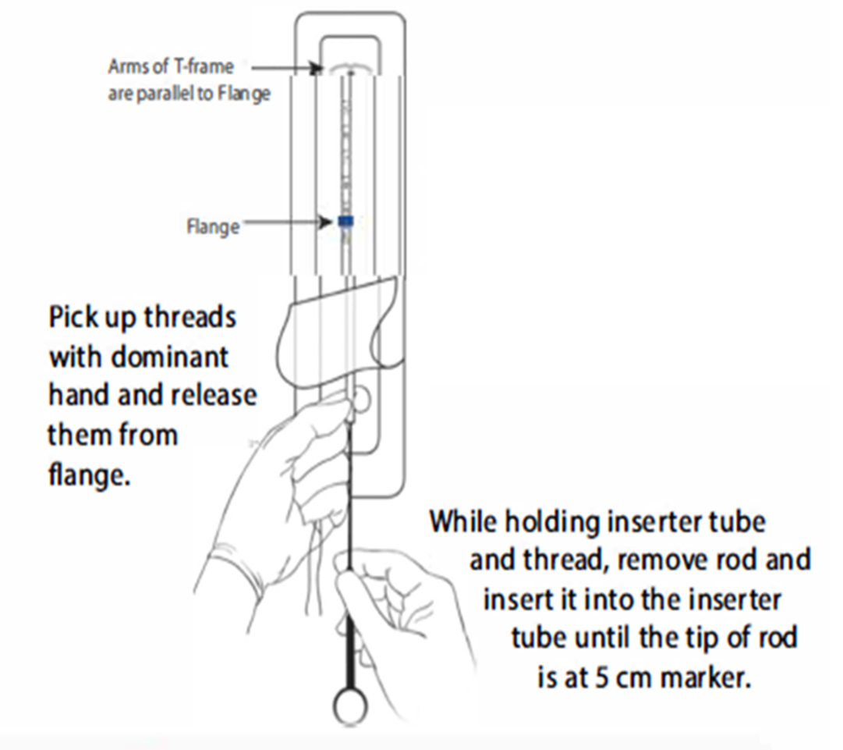
H-IUD loading procedure
Step 2: Release the threads and insert the rod
Notes:
Pick up threads with dominant hand and release them from flange
While holding inserter tube and thread, remove rod and insert into the inserter tube until the tip of the rod is at 5 cm mark and the bottom of the tube is aligned with the first (top) indent on the rod.

Slide 16
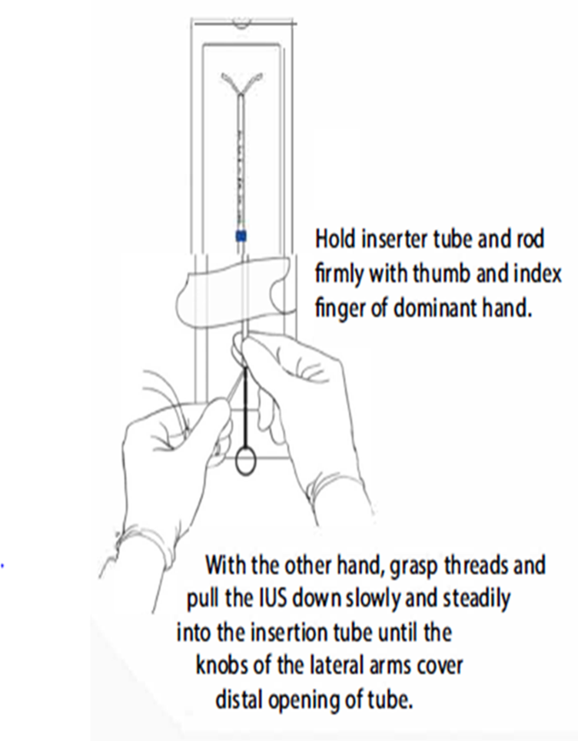
H-IUD loading procedure
Step 3: Load the H-IUD into the inserter
Notes:
Hold inserter tube and rod firmly with the thumb and index finger of dominant hand.
With the other hand grasp threads and gently pull the IUD down slowly and steadily into the insertion tube until the knobs of the lateral arms form a hemispherical dome at the top of the tube and the tip of the rod is touching the bottom of the H- IUD. The hemispherical dome facilitates safe passage through the cervical os.

Slide 17
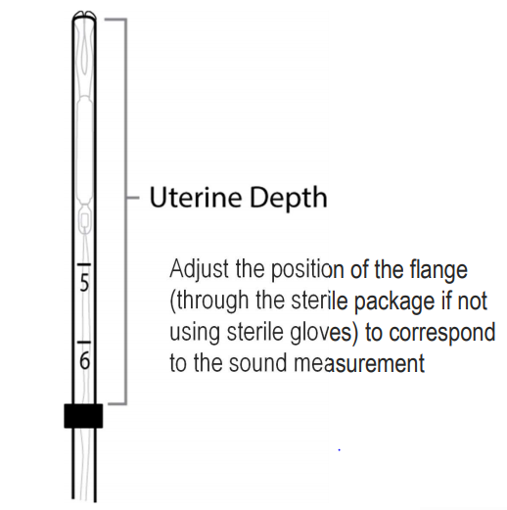
H-IUD loading procedure
Step 4: Adjust flange to uterine depth
Notes:
Adjust the upper end of the flange to the uterine depth.
The proximal end of the insertion tube will be approximately at the top of the first indent on the rod

Slide 18
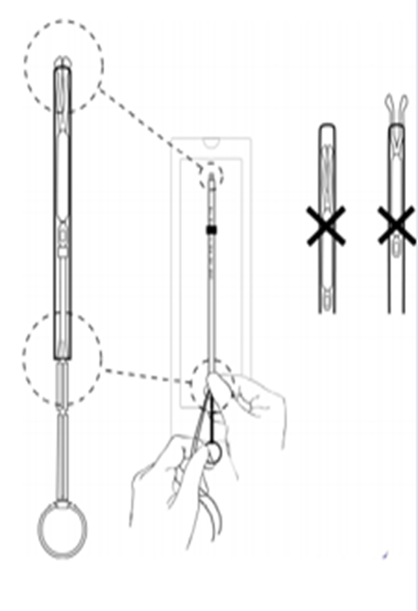
H-IUD loading procedure
Step 5: Final H-IUD Position
H-IUD should be positioned in the tube so that the knobs of the lateral arms form a hemispherical dome; the dome facilitates H-IUD passage through the cervical os
The proximal end of the insertion tube will be approximately at the top of the first indent
Notes:
Check the IUD is correctly loaded
The H-IUD is completely within the insertion tube with the knobs of the arms forming a hemispherical dome at the top of the tube
The top of the rod is touching the bottom of the IUD
The threads are hanging through the end of the insertion tube
The flange is marking the depth of the uterus
When the H-IUD tips are in correct position, PINCH AND HOLD the bottom end of the tube FIRMLY to maintain rod position

Slide 19
H-IUD loading procedure
Step 6: Remove loaded insertion tube from the packet
Remove the loaded H-IUD insertion tube from the packet while holding the lower end of the tube firmly between your fingers and thumb
If not using sterile gloves, do not touch the flange and any part of the insertion tube above the flange during this step and through the H-IUD insertion procedure.

Slide 20
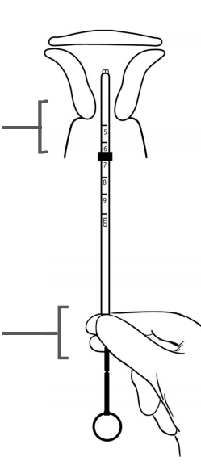
H-IUD Insertion
Step 1: Insert the loaded insertion tube into the uterus
Apply gentle traction on the tenaculum to straighten the alignment of the cervical canal and uterine cavity
Slide the loaded H-IUD insertion tube through the cervical canal until the upper edge of the flange is approximately 1.5–2.0 cm from the cervix
DO NOT advance flange to the cervix at this step
Stop 1.5-2.0 cm from the cervix
Firm pinch prevents the rod from falling out of the tube

Slide 21
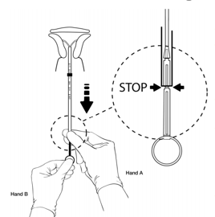
H-IUD insertion procedure
Step 2 : Pull the insertion tube back to release the arms of the H-IUD
Release hold on tenaculum
Hold insertion tube with the fingers of one hand (Hand A) and the rod with the fingers of other hand (Hand B)
Relax the firmness of the pinch on the tube, AND PULL THE INSERTION TUBE BACK with Hand A to the edge of the second (bottom) indent on the rod
Wait 10-15 seconds for the arms of the IUD to fully open

Slide 22
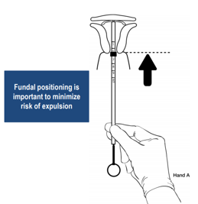

LNG IUD insertion procedure
Step 3: Advance H-IUD to fundus
Apply gentle traction with tenaculum
With Hand A still holding the proximal end of the tube, advance the insertion tube (with the rod still inside) up to the uterine fundus
You will feel slight resistance when the H-IUD is at the fundus
The flange should be touching the cervix when the H-IUD reaches the uterine fundus
Notes:
Tell participants that fundal positioning is important to minimize the risk of expulsion.

Slide 23
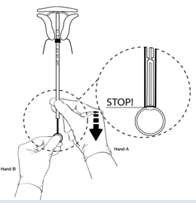
H-IUD insertion procedure
Step 4: Release H-IUD and withdraw inserter
Hold rod still with Hand B while pulling the insertion tube back with Hand A to the ring of the rod
While holding the inserter tube with Hand A, withdraw the rod from the insertion tube all the way out
Withdraw the insertion tube until the tube is 3-4 cm away from the cervical os, but the ends of the strings are still inside the tube.
Removing the rod first and then the tube prevents the H-IUD from being pulled out of the uterus

Slide 24
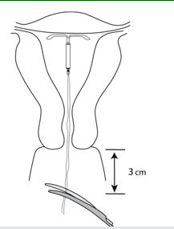
H-IUD insertion procedure
Step 5: Cut the threads
Use blunt-tipped sharp scissors to cut the H-IUD threads perpendicular to the thread length leaving about 3 cm outside of the cervix while strings ends are still in the inserter tube (cutting threads at an angle may leave sharp ends)
Do not apply tension or pull on the threads when cutting to prevent displacing the H-IUD

Slide 25

Post Insertion Tasks
Before removing gloves:
Wipe used instruments with a wet cloth or soak them in a bucket of tap water for point of use cleaning and further processing
Segregate and dispose of waste materials in appropriate leak proof containers with lids
Wipe surfaces that may have been contaminated with blood/discharge with 0.5% chlorine solution.
Take gloves off, wash hands thoroughly with soap and water, and dry them.
Allow the woman to rest
Notes:
Illustration credit: Adapted from World Health Organization Department of Reproductive Health and Research (WHO/RHR) and Johns Hopkins Bloomberg School of Public Health/Center for Communication Programs (JHU/CCP), Knowledge for Health Project.

Slide 26
Post-insertion tasks
Provide post-insertion instructions; remind client:
  No protection against STIs; need to use condoms if at risk.
  Possible side effects, especially bleeding changes.
  When to return to the clinic.
Complete the H-IUD reminder card and give it to the client. Explain that the user card shows the name and type of the H-IUD, the date of insertion, the clinic name, and the intended date of removal. However, she can get it removed at anytime for any reason.
Complete the client record

Slide 27
Removal Steps
  Follow infection prevention guidelines.
  Counsel client that cramping/bleeding may occur.
  Gently insert the HLD/sterile speculum
  Visualize the strings, and clean the cervical os and vaginal wall with antiseptic
Notes:
Use the information on the Slide to describe steps in the H-IUD removal procedure.
• H-IUD removal is usually routine and uncomplicated.
• The H-IUD can be removed at any time, although removal during menses may make the procedure easier for the provider.
Any trained health care provider, including a nurse or midwife, can remove the H-IUD.
• As with H-IUD insertion, the provider should follow standard infection prevention guidelines to minimize the risk of infection.
Let the woman know that some cramping and/or bleeding is normal during removal.

Slide 28
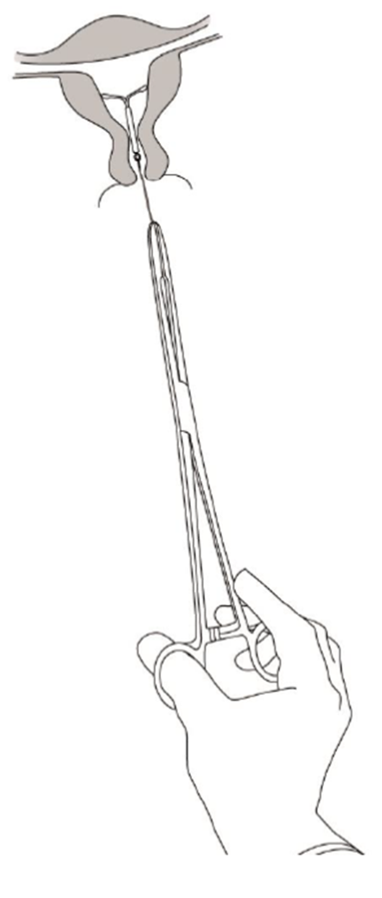
H-IUD Removal Steps (cont.)
  Grasp strings close to the cervix and pull gently but firmly to remove H-IUD. Do not use force.
  Show the removed IUD to the client
  Dispose of waste materials including the removed IUD according to guidelines
  Insert a new H-IUD immediately following removal (if desired).
  Refer client to an experienced provider for difficult removals.
Notes:
Grasp strings close to the cervix and pull gently but firmly to remove H-IUD. Do not use force, but apply slow, gentle traction to avoid breaking the strings.
A woman returning to the clinic to have an old H-IUD replaced can have a new H-IUD inserted at the same time.
Refer the client to a specially trained or experienced clinician for difficult removals.

Slide 29
Demonstration and practice session
Demonstrate the following procedures using the checklists and allow participants to practice on models under guidance of the facilitator:
Pelvic examination
Loading the IUD in the sterile package
Insertion of IUD using the "No Touch" technique
Removal Procedure
Notes:
See Session Plan for details.

