Slide 1
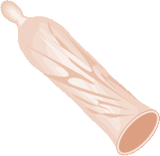
Male Condoms
Session III: Providing the Male Condom
Notes:
Illustration credit: Salim Khalaf/FHI

Slide 2
Counseling about Male Condoms:
Key Counseling Topics
Characteristics
Correcting myths, misperceptions, fears
How to use; demonstration
Importance of correct and consistent use
Common problems; practices to avoid
Lubricants
Where to get more condoms
Use of ECPs, if needed
How to talk with partner about condoms

Slide 3
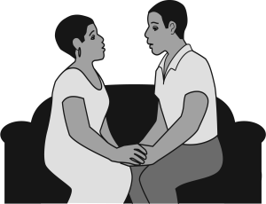
Counseling about Male Condoms:
Talking with Partners (1)
Counseling on negotiating condom use:
Ensure client knows facts about condoms
Offer suggestions, but let client decide
Discuss doubts, fears
Reassure; tell success stories
Offer couples counseling
Follow-up
Notes:
Illustration credit: Rafael Avila

Slide 4
Counseling about Condoms:
Talking with Partners (2)
Counseling on negotiating condom use:
Assess client’s ability to talk with partner.
Explore client’s barriers to talking about condoms.
Identify strategies.
Help client explore strategies; stress listening to partner views; role play.
Notes:
Illustration credit: Rafael Avila

Slide 5
Counseling about Condoms:
Talking with Partners (3)
Help the client plan for:
Where: A private, safe, comfortable place
When: Relaxed, sober, before sex
How:
  Decide what you want to say
  Ask partner for ideas; create dialog
  Focus on safety, health, trust, caring and coming to an agreement
Notes:
Illustration credit: Rafael Avila

Slide 6
Follow-Up Visits
Ask how the client is doing with the method. Ask about questions or concerns.
Ask if they are having any problems using condoms correctly and every time they have sex.
Give the client more condoms, and ask them to return before supply runs out. Remind them of other places they can get condoms.
Ask a long-term client about major life changes that may affect her needs; plans for having children or STI/HIV risk.

Slide 7
Male Condoms: Summary
Safe and easy to use
Protect from both pregnancy and STIs/HIV
Female condom can be initiated by woman
Require partner’s cooperation

