Slide 1
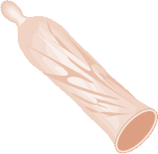
Male Condoms
Session I: Characteristics Male Condoms
Notes:
Illustration credit: Salim Khalaf/FHI

Slide 2
Male Condoms:
Objectives
Participants will:
Describe the characteristics of male condoms in a manner that clients can understand.
Demonstrate the ability to counsel clients about:
  How to use male condoms, practices to avoid
  Problems with condom use
  Common concerns, misconceptions and myths
  Negotiating condom use
  When to return
Demonstrate the ability to conduct routine follow-up for clients in a way that enhances continuing satisfaction and acceptance.
Demonstrate how to correctly put on a male condom.
Identify problems that may require switching to another method.
Notes:
The objectives for this session are based on input from various stakeholders <insert who provided input: participants, supervisors, health officials>.
The objectives of this session are as follows: By the end of this training session, participants will be able to: <click the mouse to advance through the objectives, reading each objective aloud >.

Slide 3
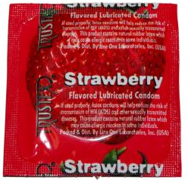
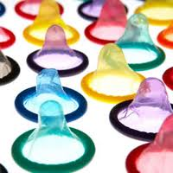
What Are Male Condoms?
Effective barrier method that can be used for both prevention of pregnancy and protection against HIV and other sexually transmitted infections (STIs)
A sheath that fits over a man’s
erect penis
Most made of thin latex rubber
Variety of sizes, colors, flavors,
and textures are available.
Notes:
Describe and discuss the types of male condoms that are available in your country or region.
Ask participants What are some words that clients use to refer to condoms?
Discuss the common words for male condoms that participants have heard their clients use. Inform participants that knowing common terms can help them communicate more effectively with clients.
Display samples of locally available condoms (latex and synthetic) and distribute them among the group for participants to examine.
Illustration credit: Salim Khalaf/FHI
Training Resource Package for Family Planning
Male Condom Module: Basic Slide Set I
3

Slide 4
Male Condoms:
Key Points for Providers and Clients
Protects against both pregnancy AND STIs including HIV/AIDS | Client needs condom when: Client is unsure whether he/she or his/her partner has an STI including HIV. Client has other sex partners or is not sure if current partner has had other sex partners.
Very effective when used EVERY TIME you have sex | When condoms are used correctly every time, they are very effective in preventing pregnancy, HIV and other STIs. Best if used during ALL sexual contact.
Can be used alone or with another family planning method | You can use another family planning method along with condoms for extra protection from pregnancy (but not the female condom). Also used as back-up for another method of family planning (for example, missed pills, late for injection).
Notes:
Adapted from WHO’s Decision-making tool for family planning clients and providers.

Slide 5

Male Condoms:
Key Points for Providers and Clients
Easy to get, easy to use | Sold in many shops. Use becomes easy with a little experience. Most couples find that they still enjoy sex with condoms
Usually partners need to discuss | If partner does not want to use condoms, “We can discuss and practice what you might say.”
Notes:
Adapted from WHO’s Decision-making tool for family planning clients and providers.

Slide 6
Male Condoms:
Dual Protection
Male (and female) condoms are the only FP methods that provide dual protection:
Protection from pregnancy and
Protection from transmission of HIV and other STIs between partners
Notes:
Illustration credit: Salim Khalaf/FHI

Slide 7
Contraceptive Effectiveness
In this progression of effectiveness, where would you place male condoms and female condoms?
Implants Male Sterilization Female Sterilization Intrauterine Devices
Progestin-Only Injectables Combined Oral Contraceptives
Standard Days Method
Spermicides
More effective
Male condoms
Less effective
Notes:
Ask participants: Where would you put male condoms on this list? <After participants respond, click the mouse to reveal the answer>.
The list on this slide categorizes contraceptive methods from most effective to least effective as commonly used. In this list, spermicides are the least effective method and the most effective methods are sterilization and IUDs.
Use Optional Advanced Slide 1 to review and compare the effectiveness of FP methods during correct and consistent use and common use.

Slide 8
Relative Effectiveness of FP Methods
Method | # of unintended pregnancies among 1,000 women in 1st year of typical use
No method | 850
Withdrawal | 220
Female condom | 210
Male condom | 180
Pill | 90
Injectable | 60
IUD (CU-T 380A / LNG-IUS) | 8 / 2
Female sterilization | 5
Vasectomy | 1.5
Implant | 0.5
Source: Trussell J., Contraceptive Failure in the United States, Contraception 83 (2011) 397- 404, Elsevier Inc.
Notes:
Explain that there is another way to look at effectiveness. In this slide we look at how effective FP methods are as they are commonly used.
Ask participants: What if these same women were using the pill? How many would become pregnant?
Training Resource Package for Family Planning
Male Condom Module: Basic Slide Set I
8

Slide 9
Male Condoms:
Effectiveness for Preventing HIV
Correct and consistent use of condoms significantly reduces the risk of HIV infection in men and women.
When used correctly with every act of sex, condoms prevent 80 to 95 out of 100 HIV infections that would have occurred without condoms.
Source: Weller, 2002; WHO/RHR and JHU/CCP, 2011; Boily, 2009;
FHI, 2007; Minnis 2005.

Slide 10
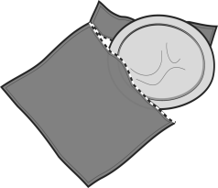
Characteristics of Male Condoms
Safe and easy to use
Widely available
Effective for preventing pregnancy and STIs when used consistently and correctly
No hormonal side effects
Can be used as backup method of contraception
Can help men with premature ejaculation
Do not require provider’s help
Protect women from PID, cervical cancer
Available in a variety of sizes, flavors and textures
Notes:
Read the positive characteristics (advantages) of male condoms listed on the slide and compare with brainstorming list.
Illustration credit: Rita Meyer, from The Decision-Making Tool for Family Planning Clients and Providers

Slide 11
Characteristics of Male Condoms
(continued)
As commonly used, less effective than many other methods
Require partner communication and cooperation
Require motivation to put on before any physical contact occurs
Latex condoms can be damaged by oil-based lubricants, heat, humidity or light
May reduce sensation
Notes:
Read the negative characteristics (limitations) of male condoms listed on the slide and compare with brainstorming list.
Illustration credit: Rita Meyer, from The Decision-Making Tool for Family Planning Clients and Providers

